Slide 1
Show and Tell
Walt Disney and the Development of Diverse Cultures, Governments, and Economies

Slide 2
Prehistoric Human Remains

Slide 3
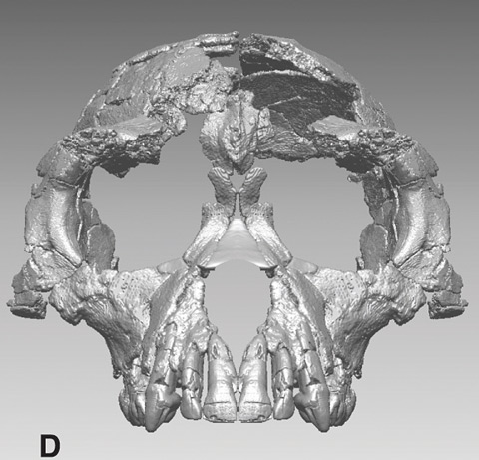
Oldest skeletal remains of humanoid creature dating to 4.2 million years.
Notes:
Scientists on October 1, 2009 the discovery of the oldest fossil skeleton of a human ancestor. The find reveals that our forebears underwent a previously unknown stage of evolution more than a million years before Lucy, the iconic early human ancestor specimen that walked the Earth 3.2 million years ago.

Slide 4
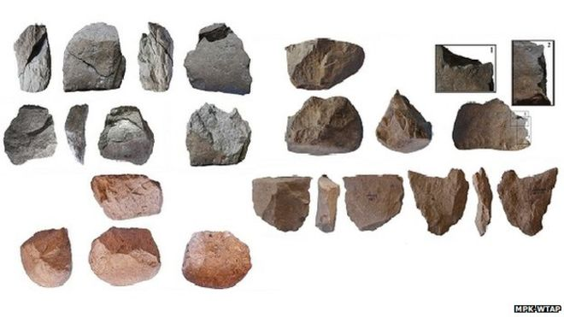
The World’s Oldest Stone Tools: 3.3 million years. The tools include sharp-edged flakes, hammers and anvils
Notes:
The world's oldest stone tools were unearthed from the shores of Lake Turkana in Kenya, and date to 3.3 million years ago. They are 700,000 years older than any tools found before, even pre-dating the earliest humans in the Homo genus. The find, reported in Nature, suggests that more ancient species, such as Australopithecus afarensis or Kenyanthropus platyops, may have been more sophisticated than was thought.

Slide 5
Notes:
Left: modern human. Center: Lucy. Right: Chimpanzee. Note the difference in the cranial size for the three skulls.

Slide 6
Prehistoric Instruments of War
Notes:
Axe Club

Slide 7
Notes:
Paint Bowls for Coloring the Body

Slide 8
American Clovis Period Older than 9,000-14,000 BC
Notes:
Spear Heads

Slide 9
Notes:
Clovis period knives for scraping hides.

Slide 10
Notes:
Clovis period bone tools

Slide 11
Stonehenge: 2,200-2,400 BC
Notes:
Archaeologists believe it was constructed from 3000 BC to 2000 BC. The surrounding circular earth bank and ditch, which constitute the earliest phase of the monument, have been dated to about 3100 BC. Radiocarbon dating suggests that the first bluestones were raised between 2400 and 2200 BC, although they may have been at the site as early as 3000 BC.

Slide 12
Easter Island: Not So Ancient Around 1200-1500
Notes:
Easter Island (Rapa Nui: Rapa Nui, Spanish: Isla de Pascua) is a Chilean island in the southeastern Pacific Ocean, at the southeasternmost point of the Polynesian Triangle. Easter Island is famous for its 887 extant monumental statues, called moai, created by the early Rapa Nui people. Polynesian people most likely settled on Easter Island sometime between 700 and 1100 CE, and created a thriving and industrious culture as evidenced by the island's numerous enormous stone moai and other artifacts.

Slide 13
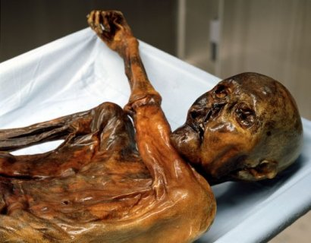
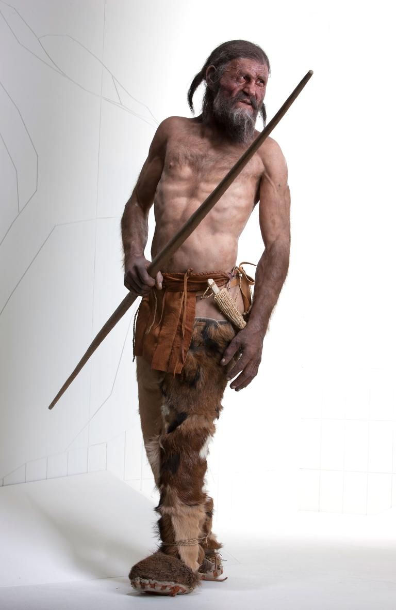
Otzi: The Iceman. 5300 year old remains recovered from glacial ice in the Austrian/Italian Alps in 1991. On display at Bolzano, Italy.
Notes:
Reconstruction of Otzi, the ice man on display at Bolzano, Italy. Since the discovery of Ötzi the Iceman in a European glacier in 1991, scientists have recovered a wealth of information from his 5,300-year-old mummified remains: The brown-eyed, gap-toothed, tattooed man most likely spent his 40-odd years farming and herding, and was probably suffering from a painful stomach ache at the time that he died a quick—albeit violent—death in the Öztal Alps. His clothing was made from goat skins. His arrow quiver was from deer skin, and his hat was from bear skin.

Slide 14
The Step Pyramid at Saqqara: 2667-2648 BC
Notes:
The Pyramid of Djoser (or Zoser), or step pyramid is an archeological remain in the Saqqara necropolis, Egypt, northwest of the city of Memphis. It was built during the 27th century BC for the burial of Pharaoh Djoser by Imhotep, his vizier. It is the central feature of a vast mortuary complex in an enormous courtyard surrounded by ceremonial structures and decoration. Remember Imhotep from fantasy movie “The Mummy”.

Slide 15
The Great Pyramid of Giza: 2,560-2,540 BC
Notes:
The Great Pyramid of Giza (also known as the Pyramid of Khufu or the Pyramid of Cheops) is the oldest and largest of the three pyramids in the Giza pyramid complex bordering what is now El Giza, Egypt. It is the oldest of the Seven Wonders of the Ancient World, and the only one to remain largely intact.

Slide 16
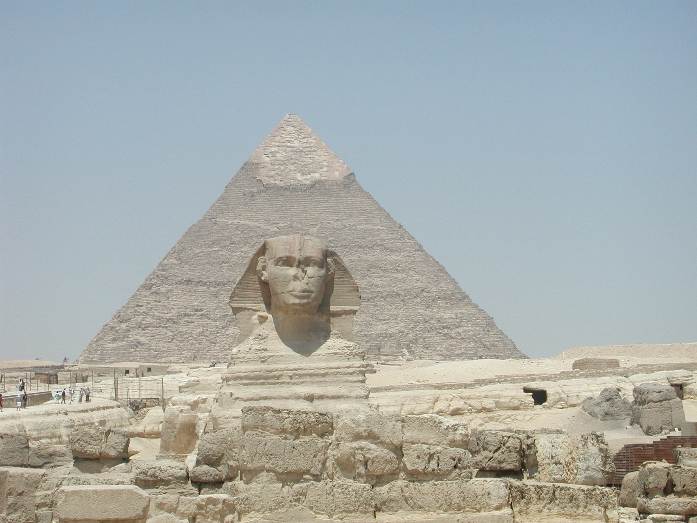
Notes:
A sphinx is a mythical creature with, at a minimum, the head of a human and the body of a lion. The largest and most famous sphinx is the Great Sphinx of Giza, situated on the Giza Plateau adjacent to the Great Pyramids of Giza on the west bank of the Nile River and facing east. The sphinx is located southeast of the pyramids. Although the date of its construction is uncertain, the head of the Great Sphinx now is believed to be that of the pharaoh Khafra.

Slide 17
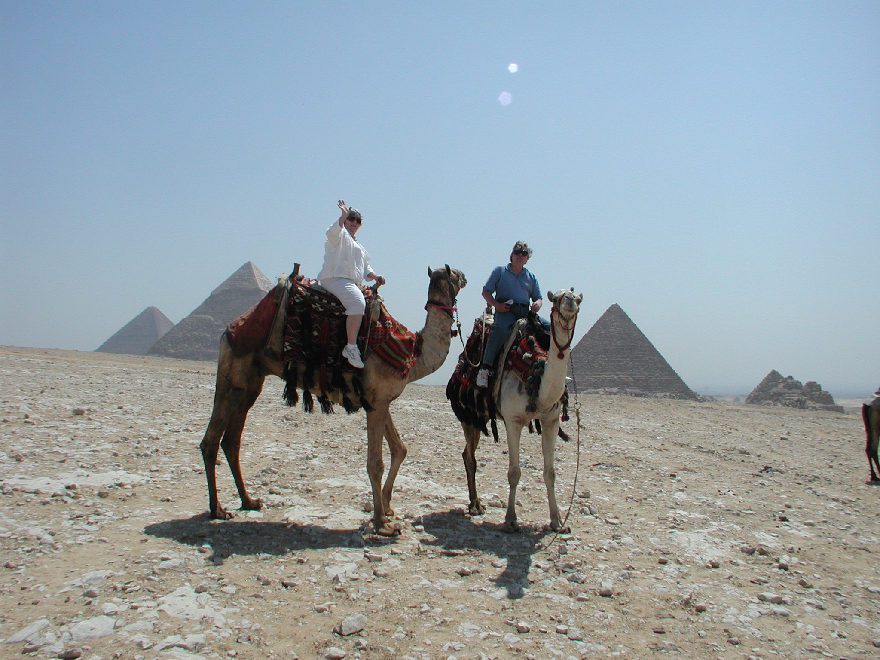
Notes:
My beloved and me. The camel owner offered to trade me three camels for my wife. Exchange is still alive in and around the Great Pyramid.

Slide 18
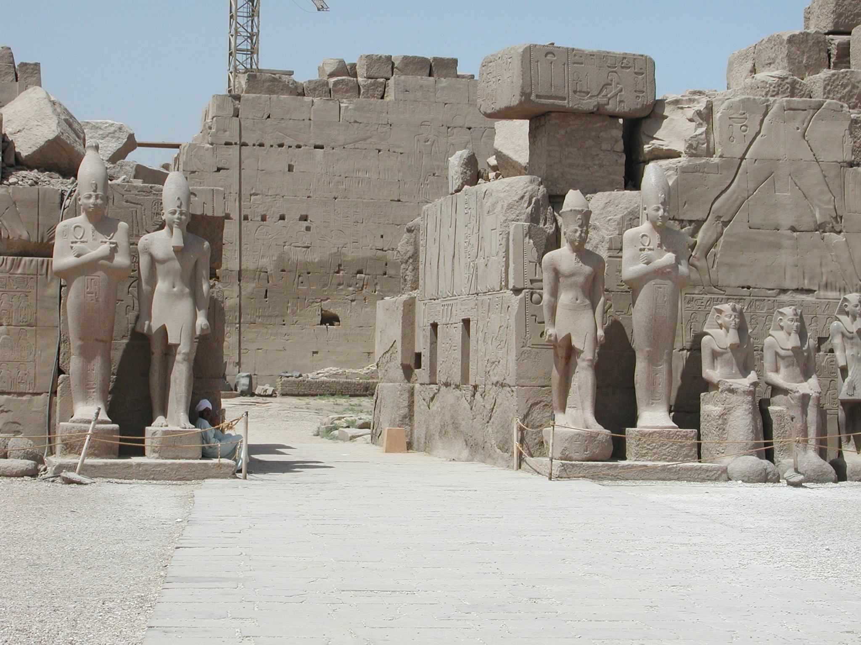
Notes:
The Temple of Luxor on the site of the ancient city of Thebes, Egypt.

Slide 19
Notes:
The Temple of Karnak at Luxor, the ancient city of Thebes.

Slide 20
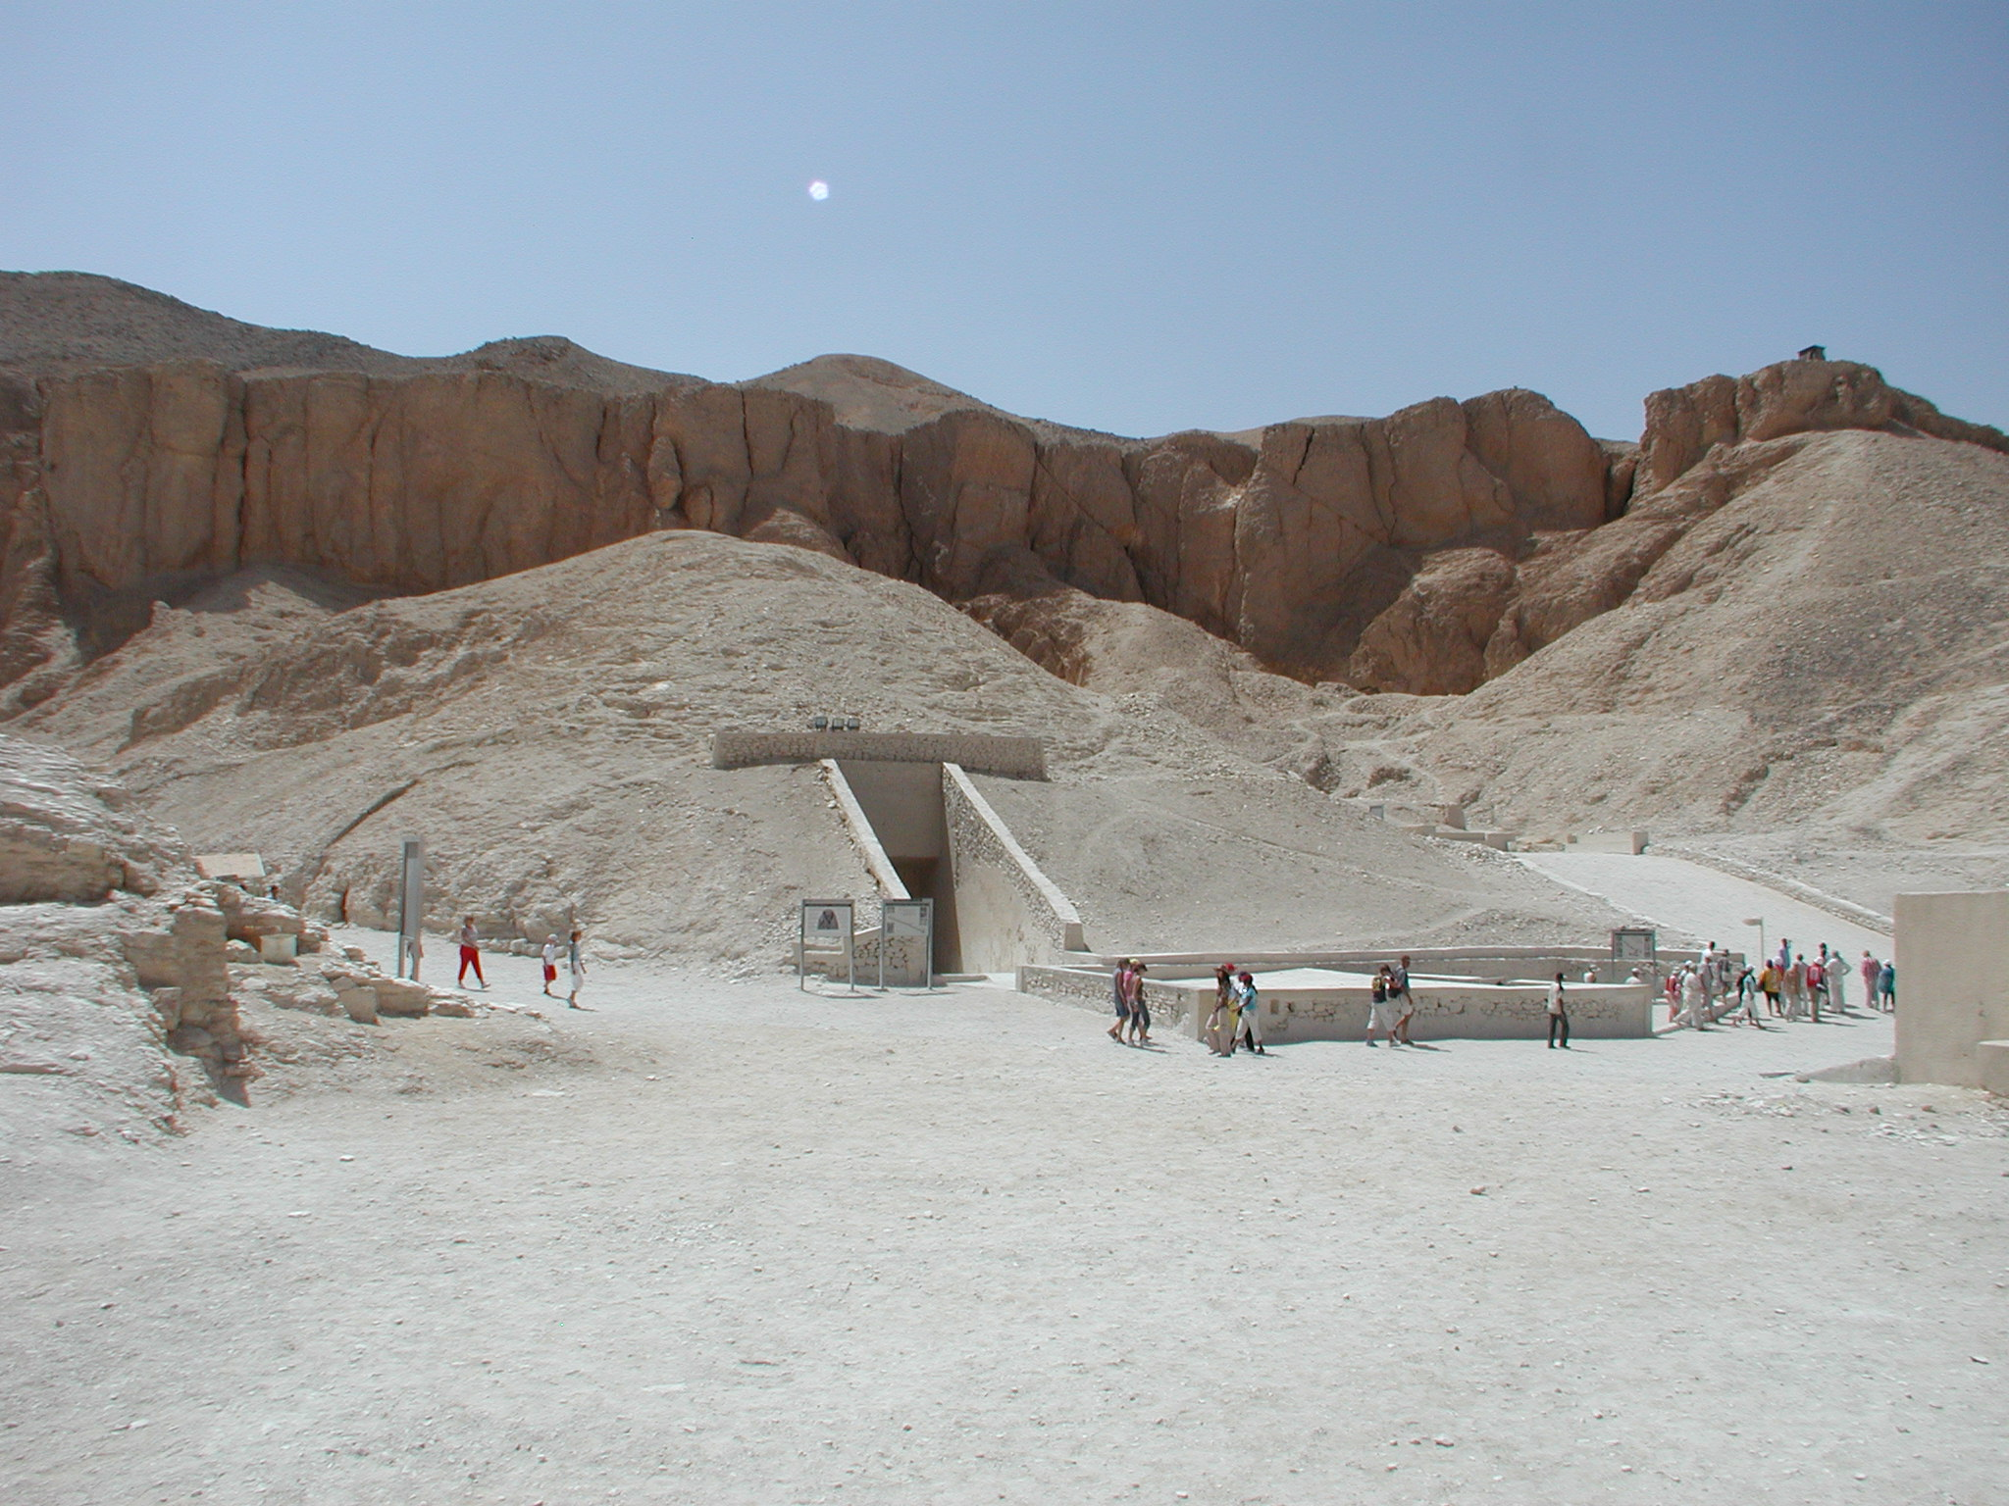
Notes:
The Valley of the Kings is a valley in Egypt where, for a period of nearly 500 years from the 16th to 11th century BC, tombs were constructed for the Pharaohs and powerful nobles of the New Kingdom (the Eighteenth to the Twentieth Dynasties of Ancient Egypt). The valley stands on the west bank of the Nile, opposite Thebes (modern Luxor), within the heart of the Theban Necropolis. It is where Tutankamen was uncovered and the tombs of many of the Egyptian pharaohs are still being excavated.

Slide 21
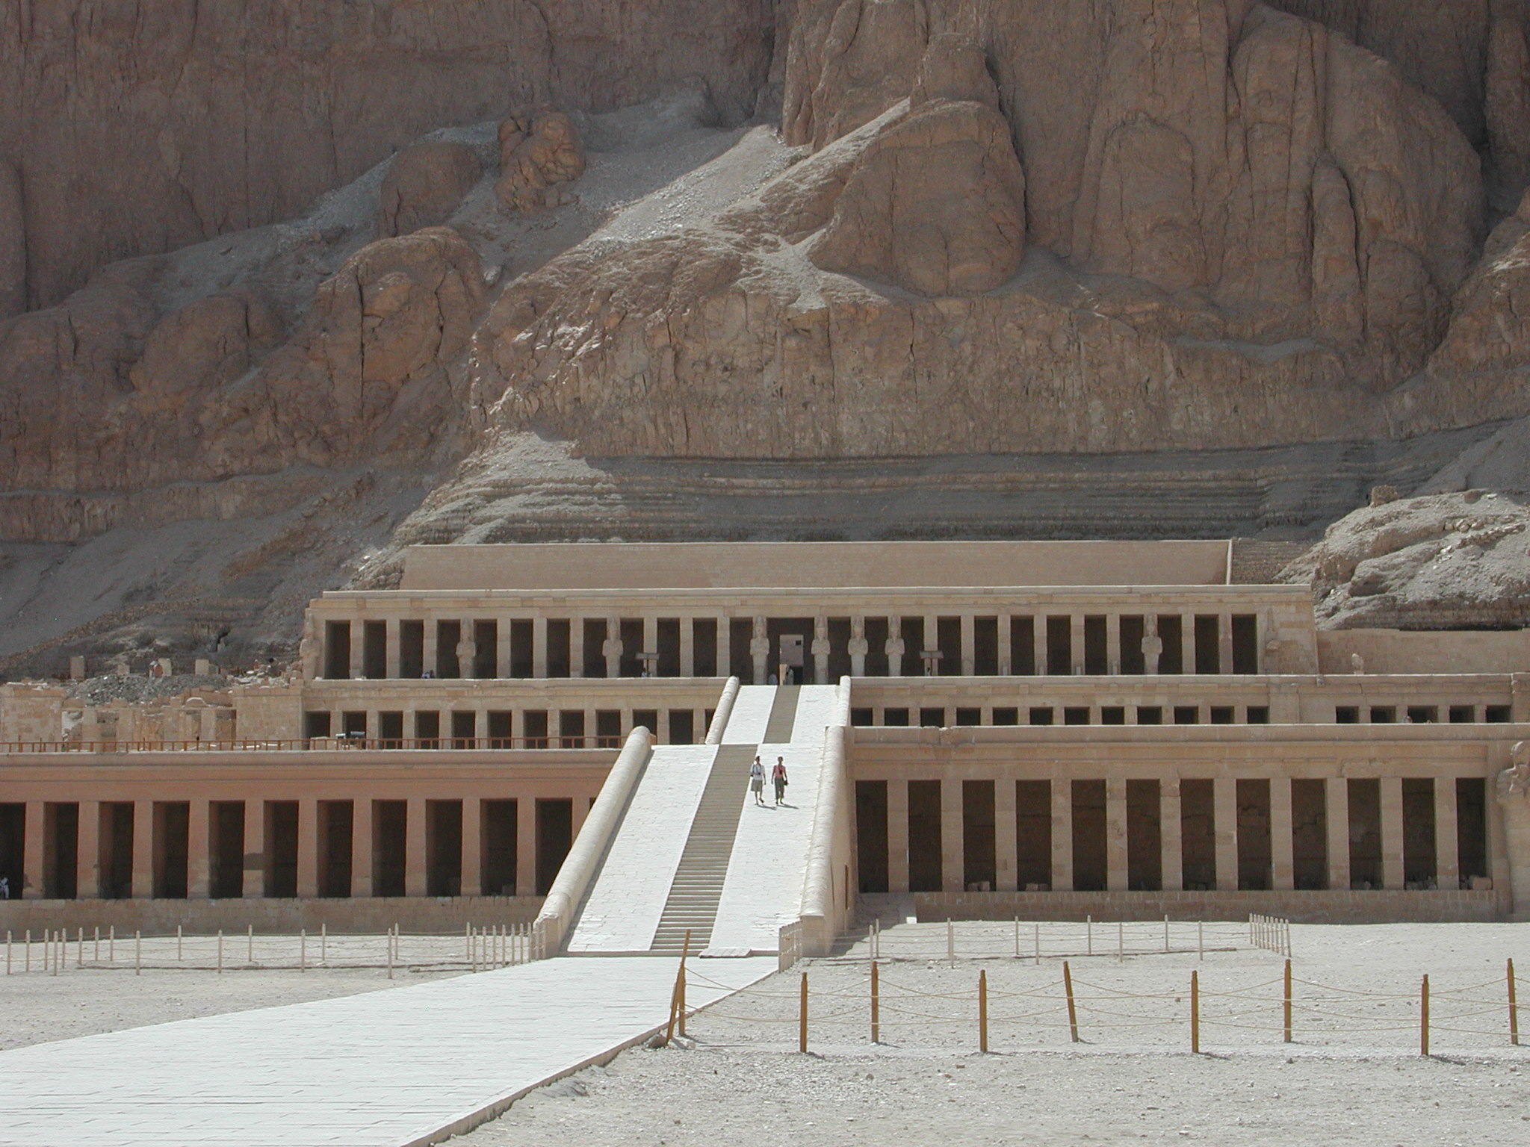
Notes:
The Mortuary Temple of Hatshepsut, also known as the Djeser-Djeseru ("Holy of Holies"), is an ancient funerary shrine in Upper Egypt. Dedicated to the Pharaoh Hatshepsut. Hatshepsut was the fifth pharaoh of the Eighteenth Dynasty of Egypt. She was the second historically confirmed female pharaoh, the first being Sobekneferu. (Various other women may have also ruled as pharaohs regnant before Hatshepsut, as early as Merneith almost 1500 years prior.) Hatshepsut came to the throne of Egypt in 1478 BC. Officially, she ruled jointly with Thutmose III, who had ascended to the throne the previous year as a child of about two years old.

Slide 22
Notes:
The Egyptian God Horus at the Edfu Temple of Horus. It is located on the West Bank of the Nile river in Egypt. It was a Ptolemaic temple, built between 237 BC and 57 BC, into the reign of Cleopatra VII. Cleopatra of Anthony and Cleopatra fame.

Slide 23
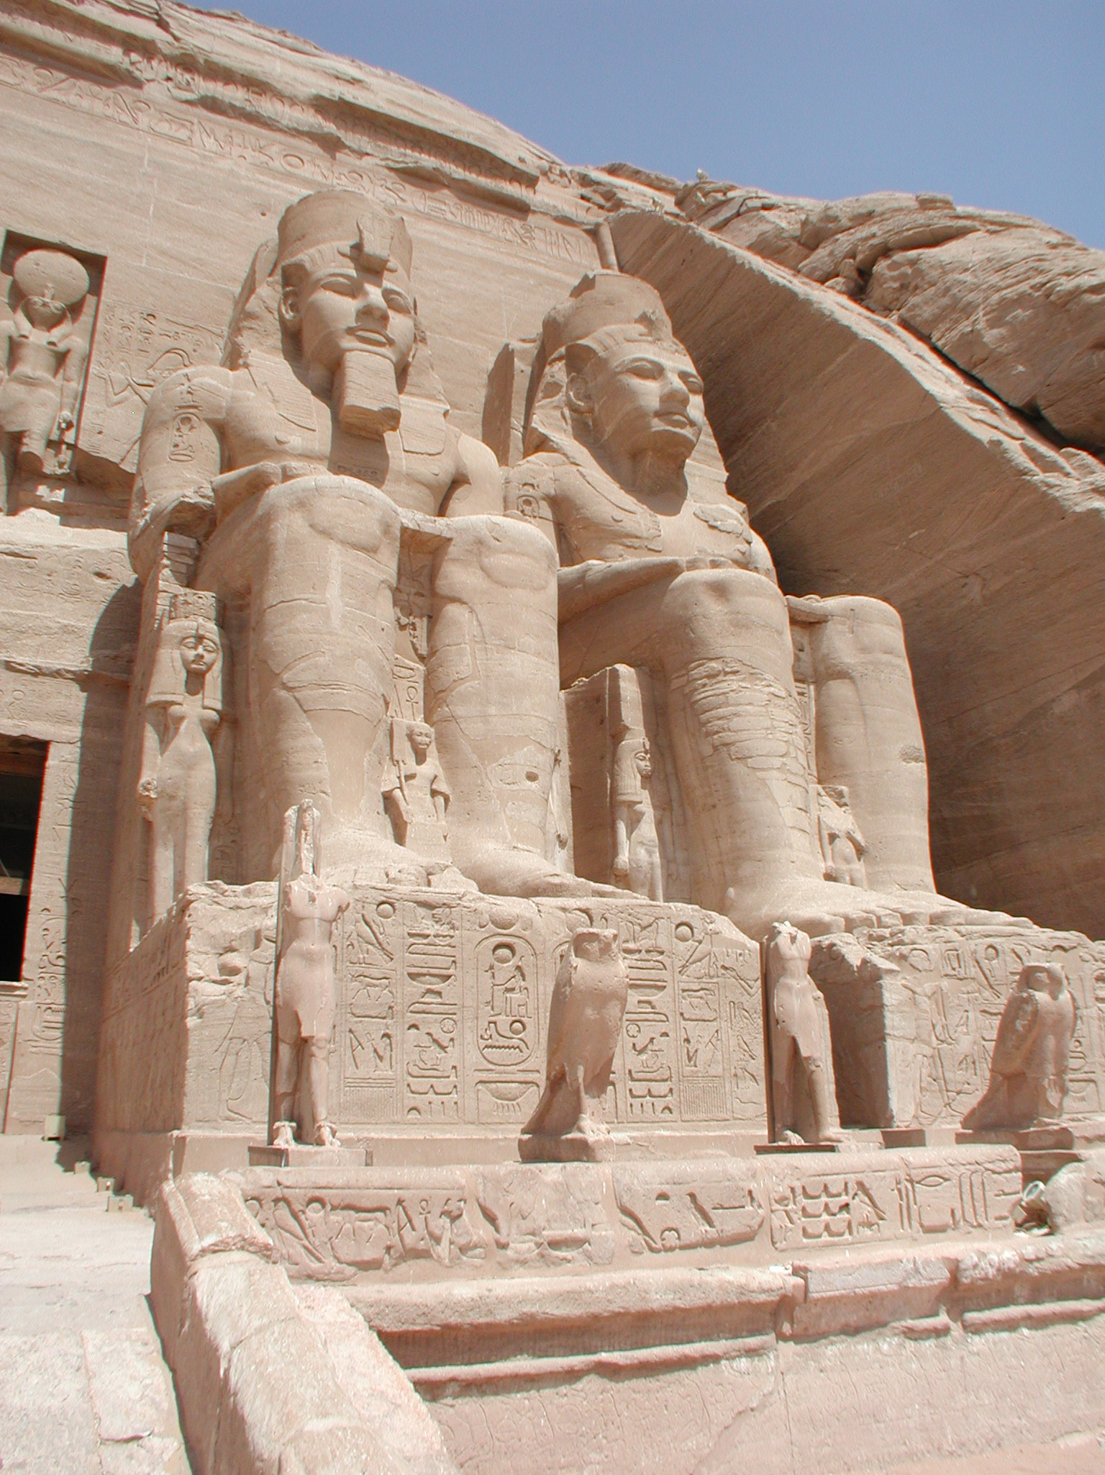
Notes:
Temple of Ramses. The Abu Simbel temples are two massive rock temples at Abu Simbel, a village in Nubia, southern Egypt, near the border with Sudan. They are situated on the western bank of Lake Nasser, about 230 km southwest of Aswan (about 300 km by road). The complex was relocated in its entirety in 1968, on an artificial hill made from a domed structure, high above the Aswan High Dam reservoir. The relocation of the temples was necessary to prevent their being submerged during the creation of Lake Nasser, the massive artificial water reservoir formed after the building of the Aswan High Dam on the Nile River.

Slide 24
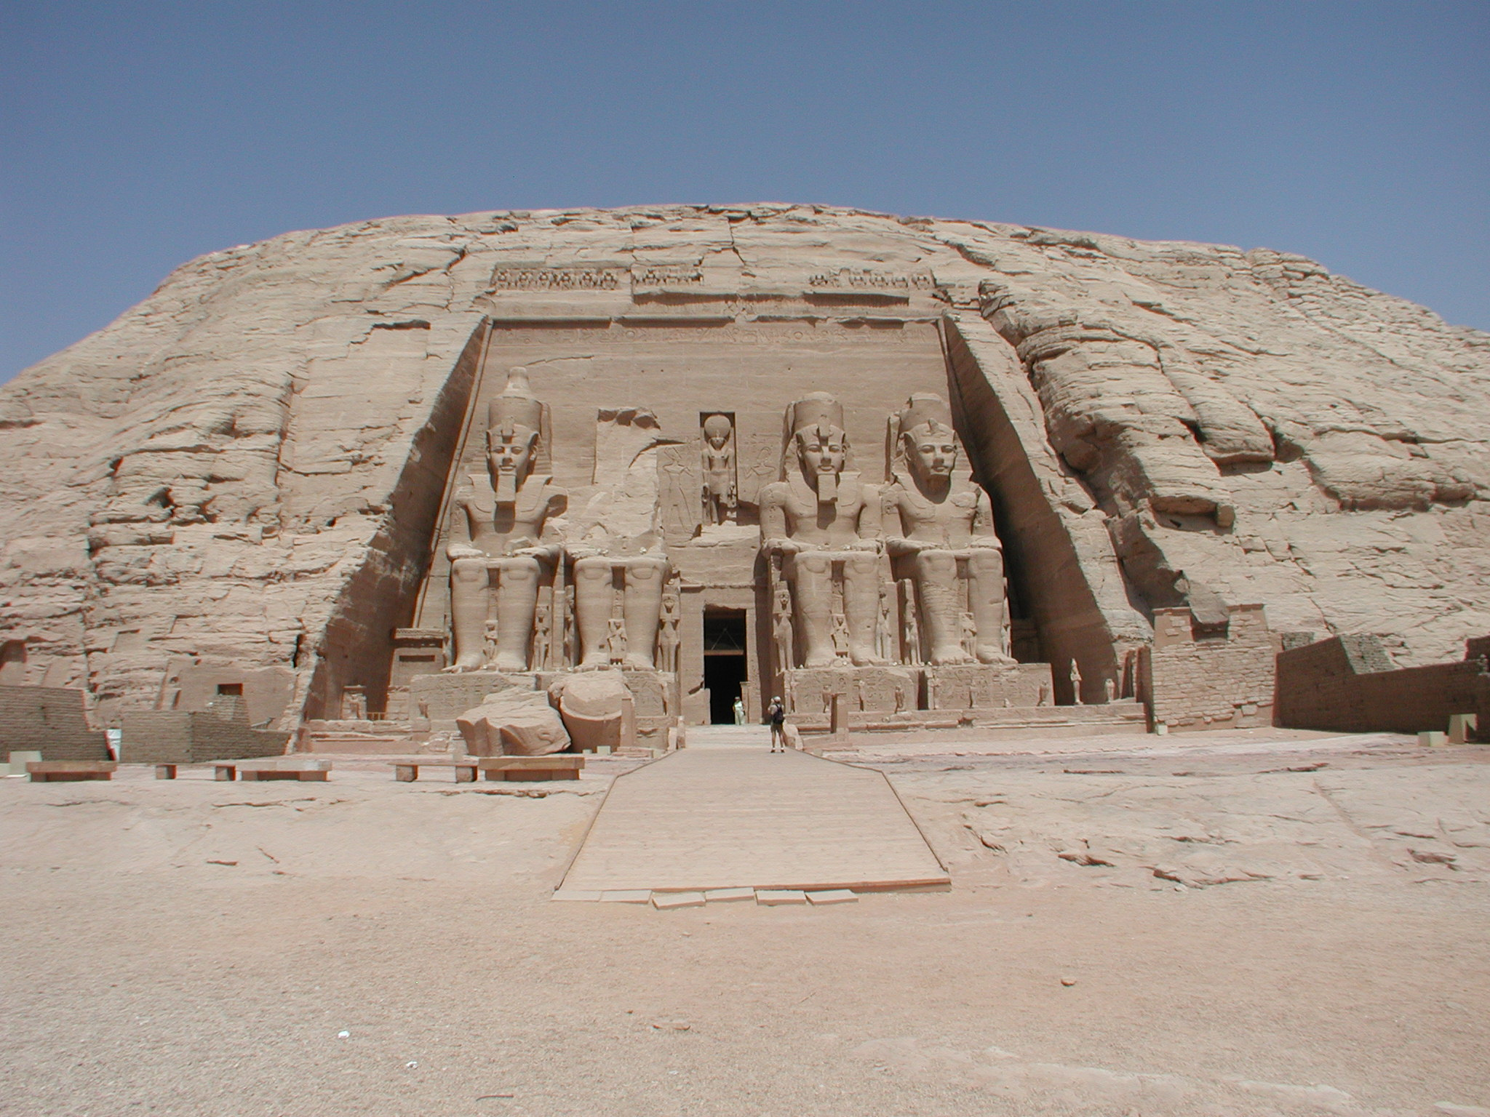
Notes:
Same

Slide 25
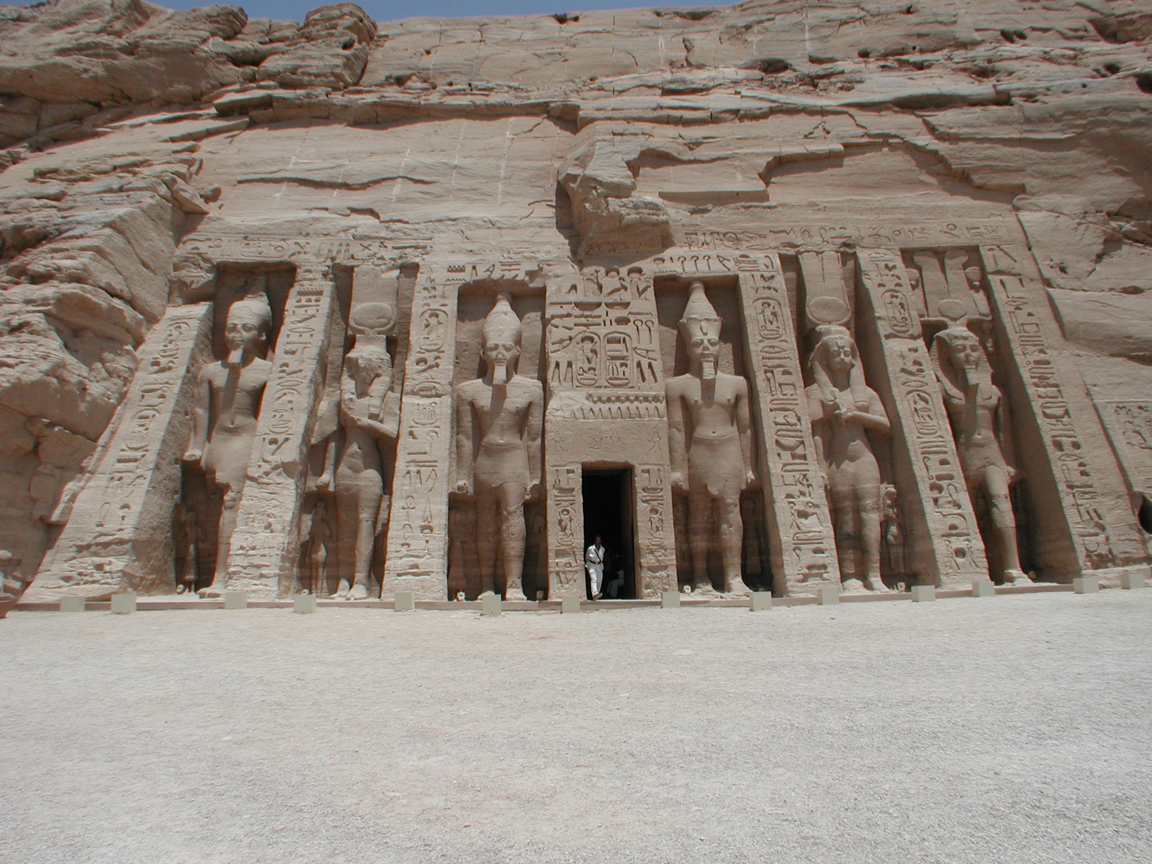
Notes:
Same

Slide 26
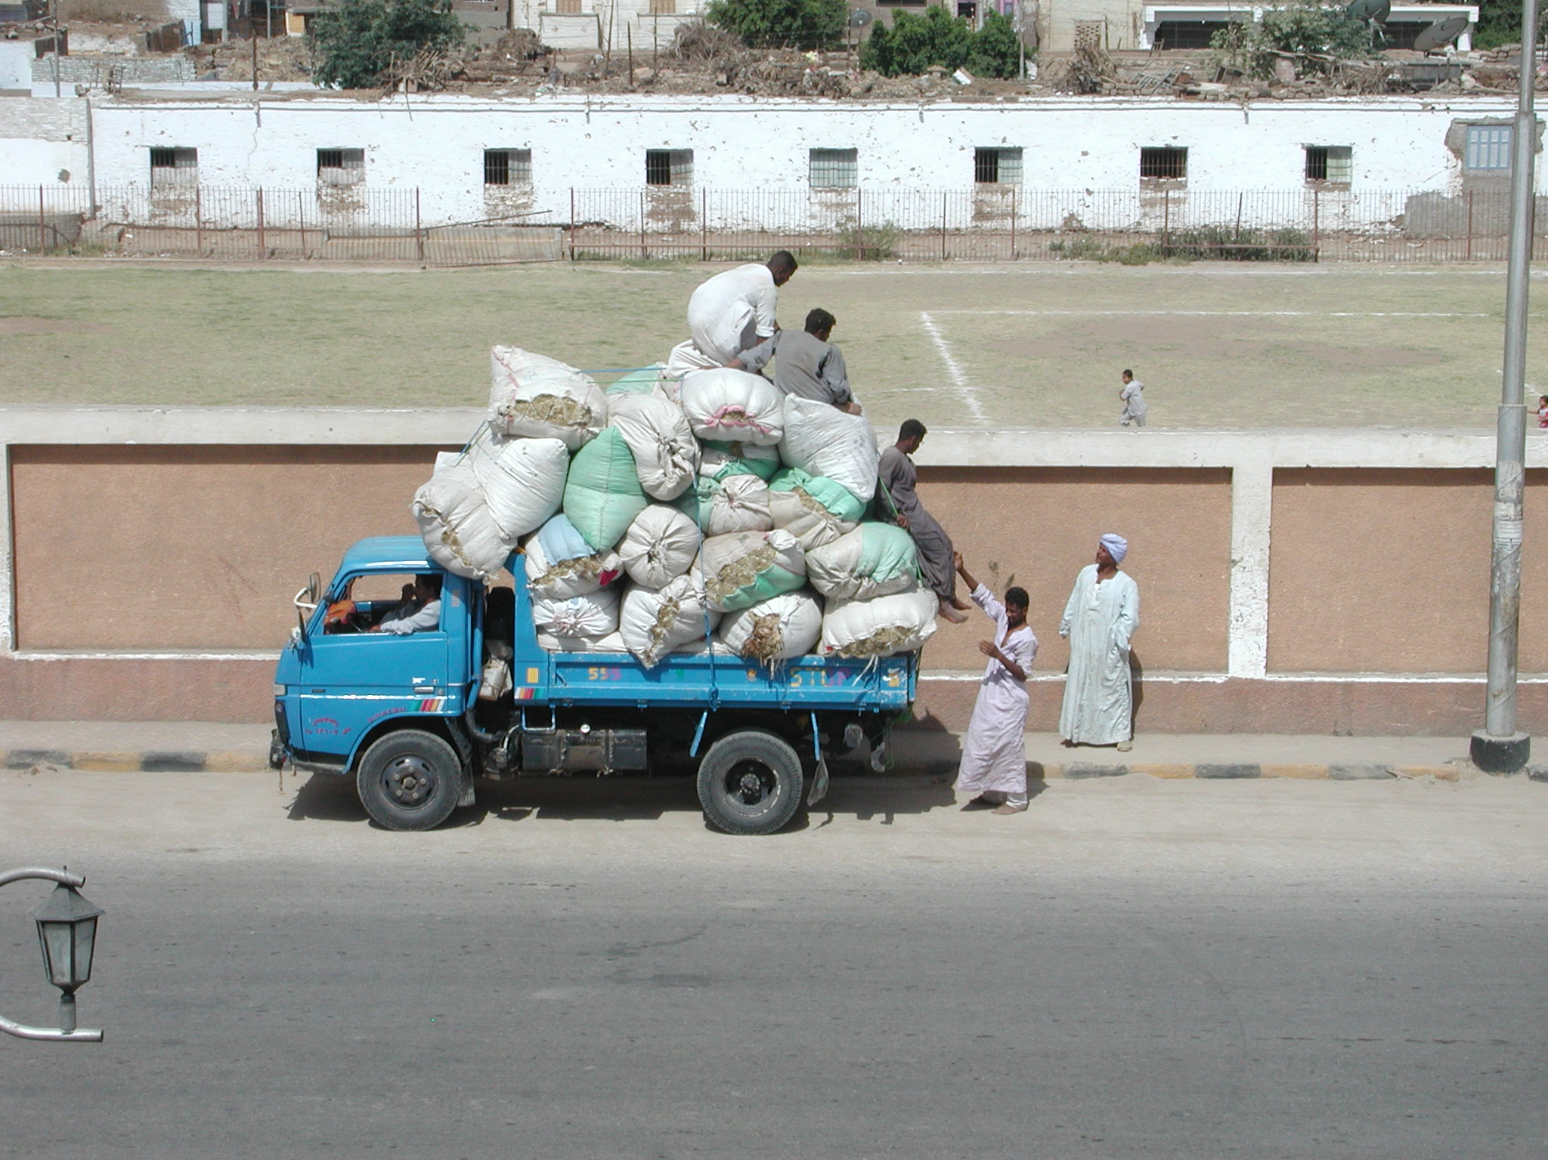
Notes:
Modern Egypt on the Nile at Esna.

Slide 27
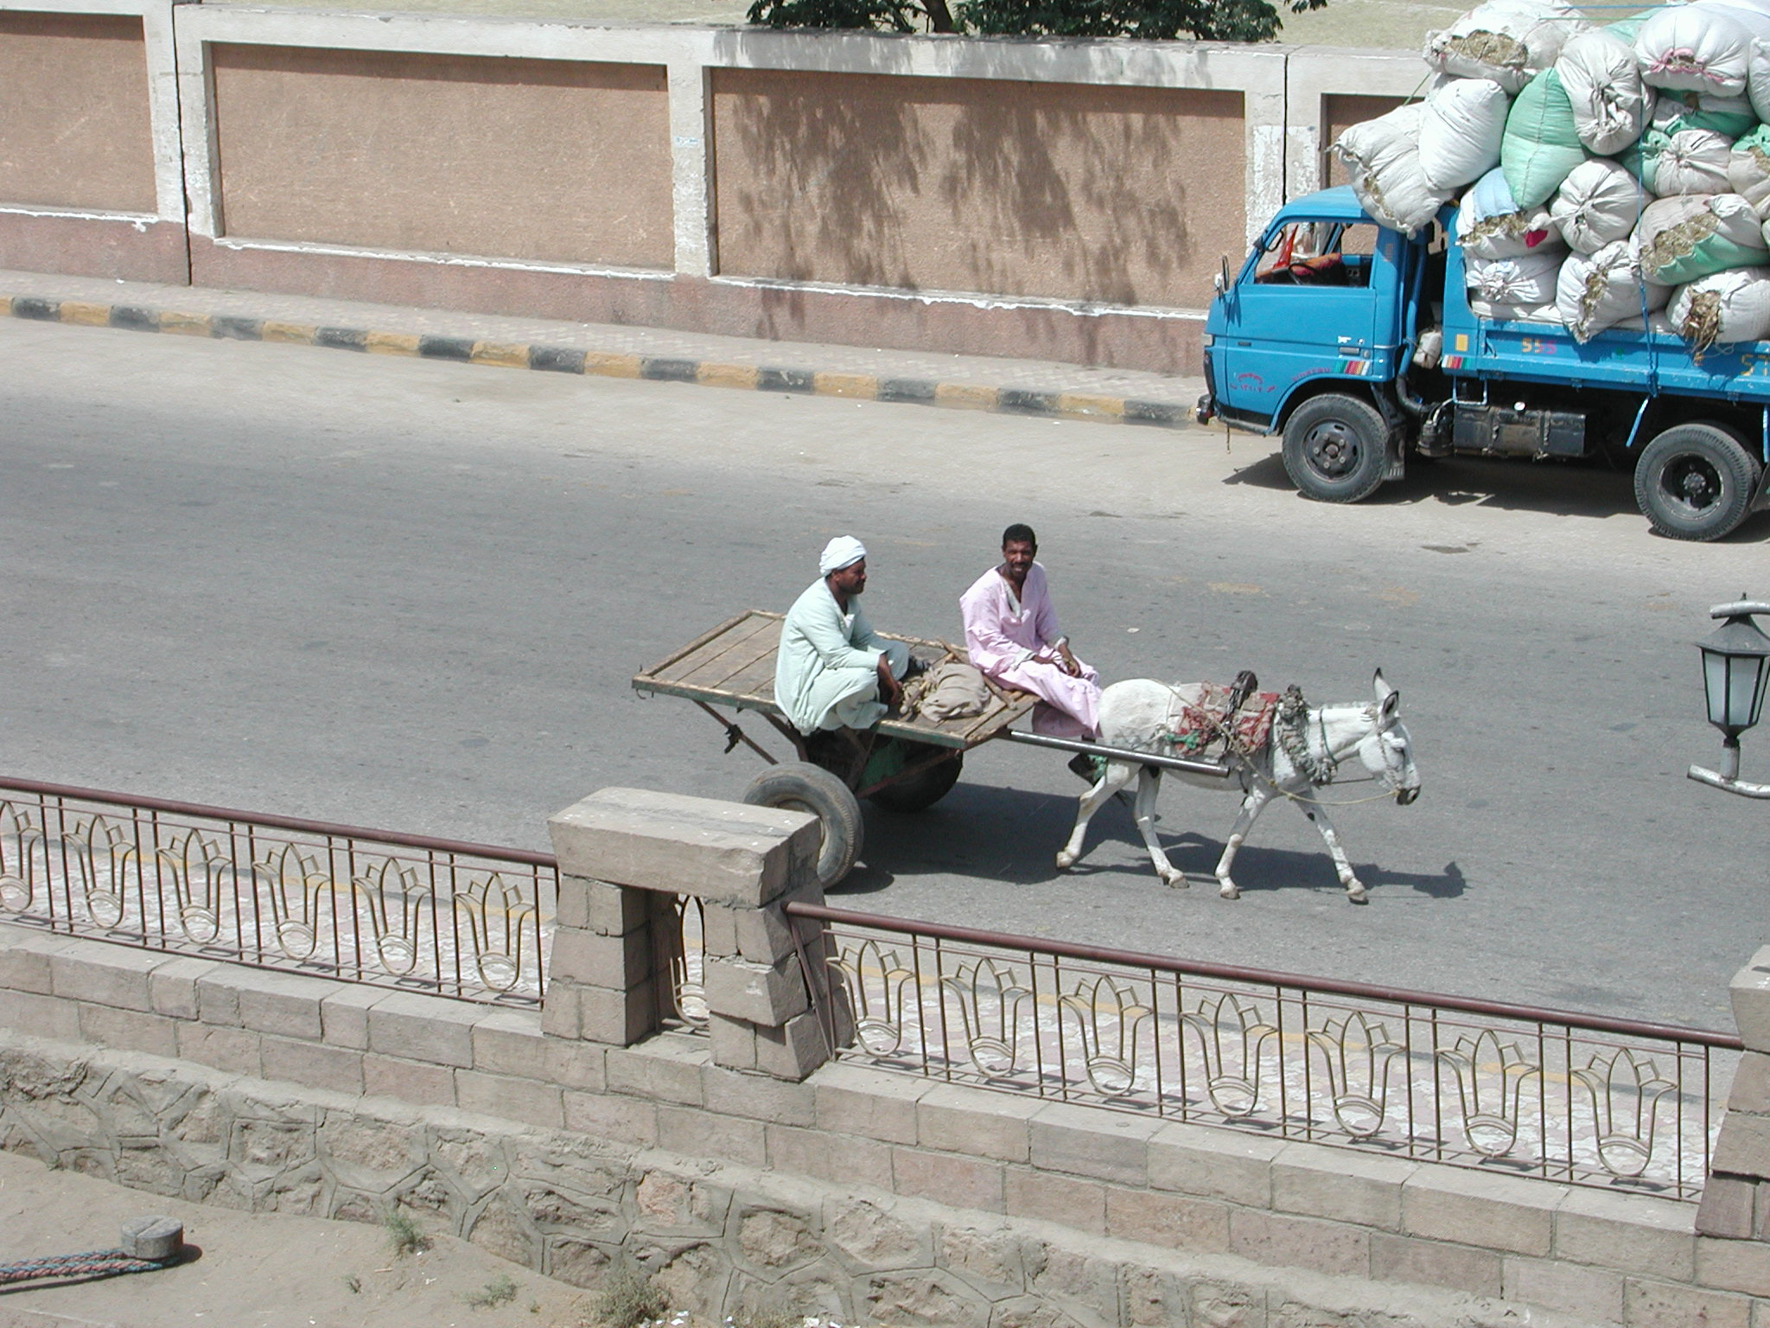
Notes:
Everyday life in a town by the Nile, Esna

Slide 28
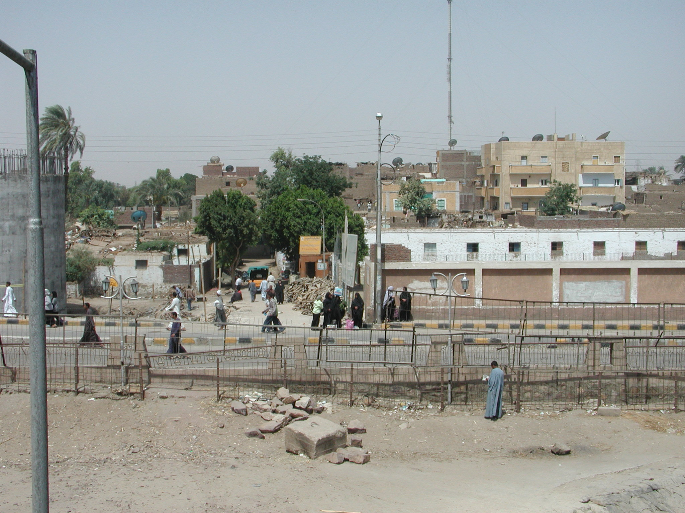
Notes:
Everyday life in a town by the Nile, Esna

Slide 29
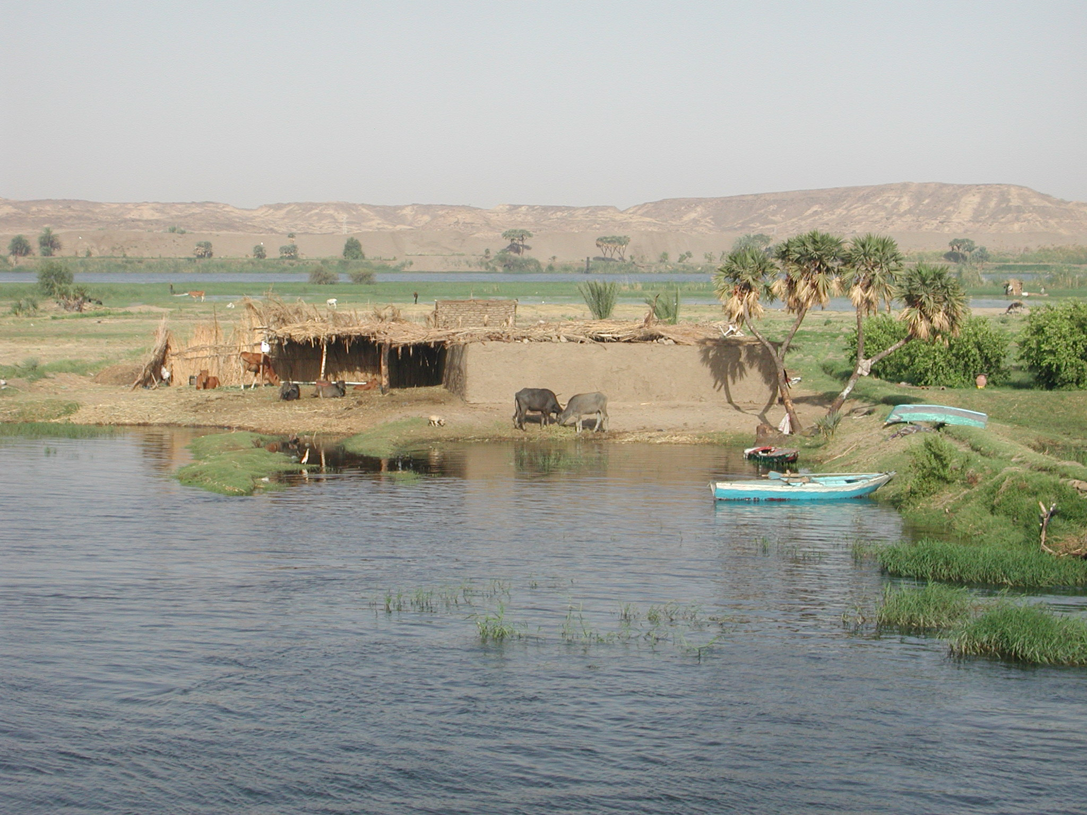
Notes:
Everyday life for the poor along the Nile

Slide 30
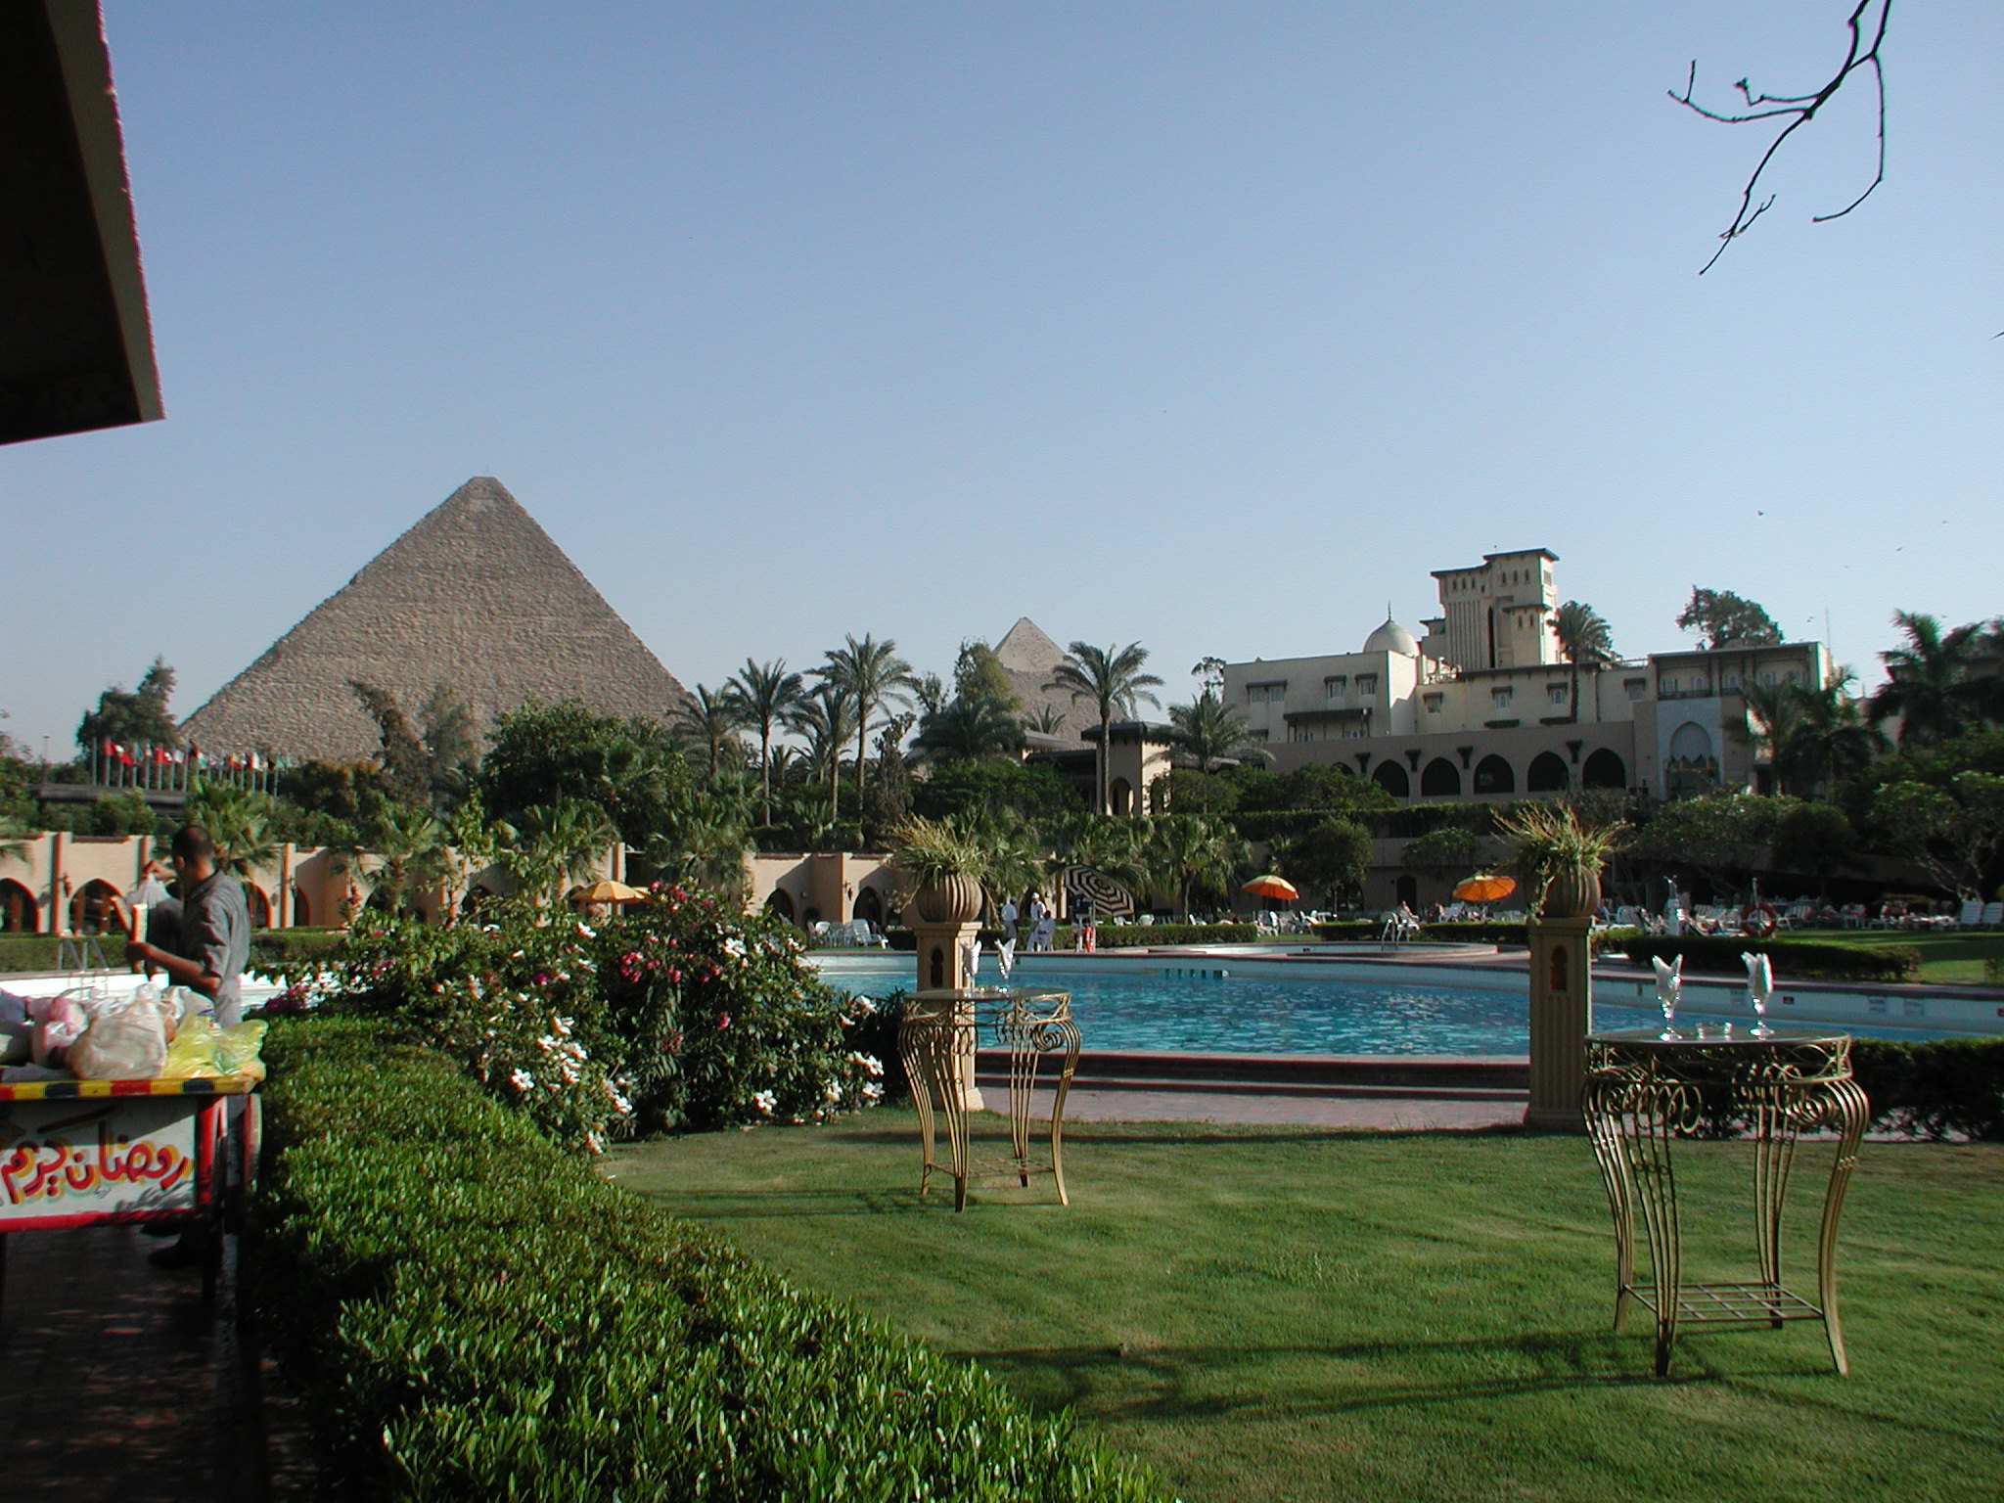
Notes:
The Great Pyramid viewed from the Mena House Hotel. The Mena House is located 700 meters from these wonders of the ancient world and offers unmatched views of the pyramids. The Mena House was initially a hunting lodge for Egyptian royalty; it was originally a two story hut nicknamed the "Mud Hut”, built in 1869 for the Egyptian King Isma'il Pasha. Surrounded by 40 acres of verdant green gardens, this palatial hotel is located in the shadows of the Great Pyramids of Giza in Cairo. The royal history of the hotel is reflected in luxurious interiors that are embellished with exquisite antiques, handcrafted furniture, original work of arts and magnificent antiques that are rarely found in luxury hotels. Mena House has played host to kings and emperors, Heads of State and celebrities.

Slide 31
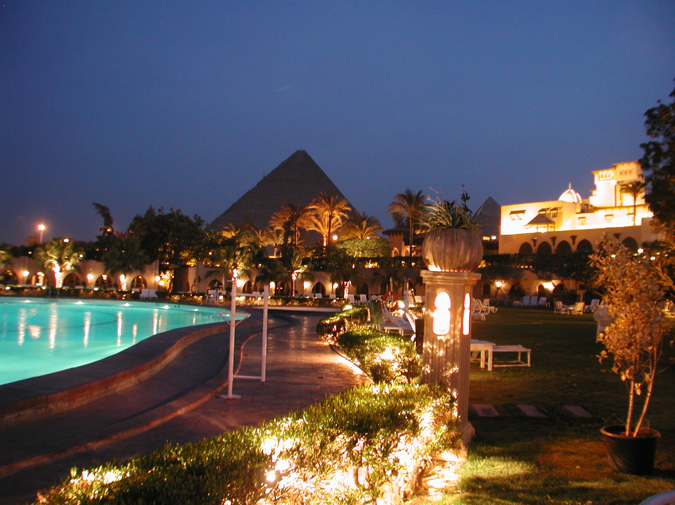
Notes:
Mena House Hotel in Giza at night.

Slide 32
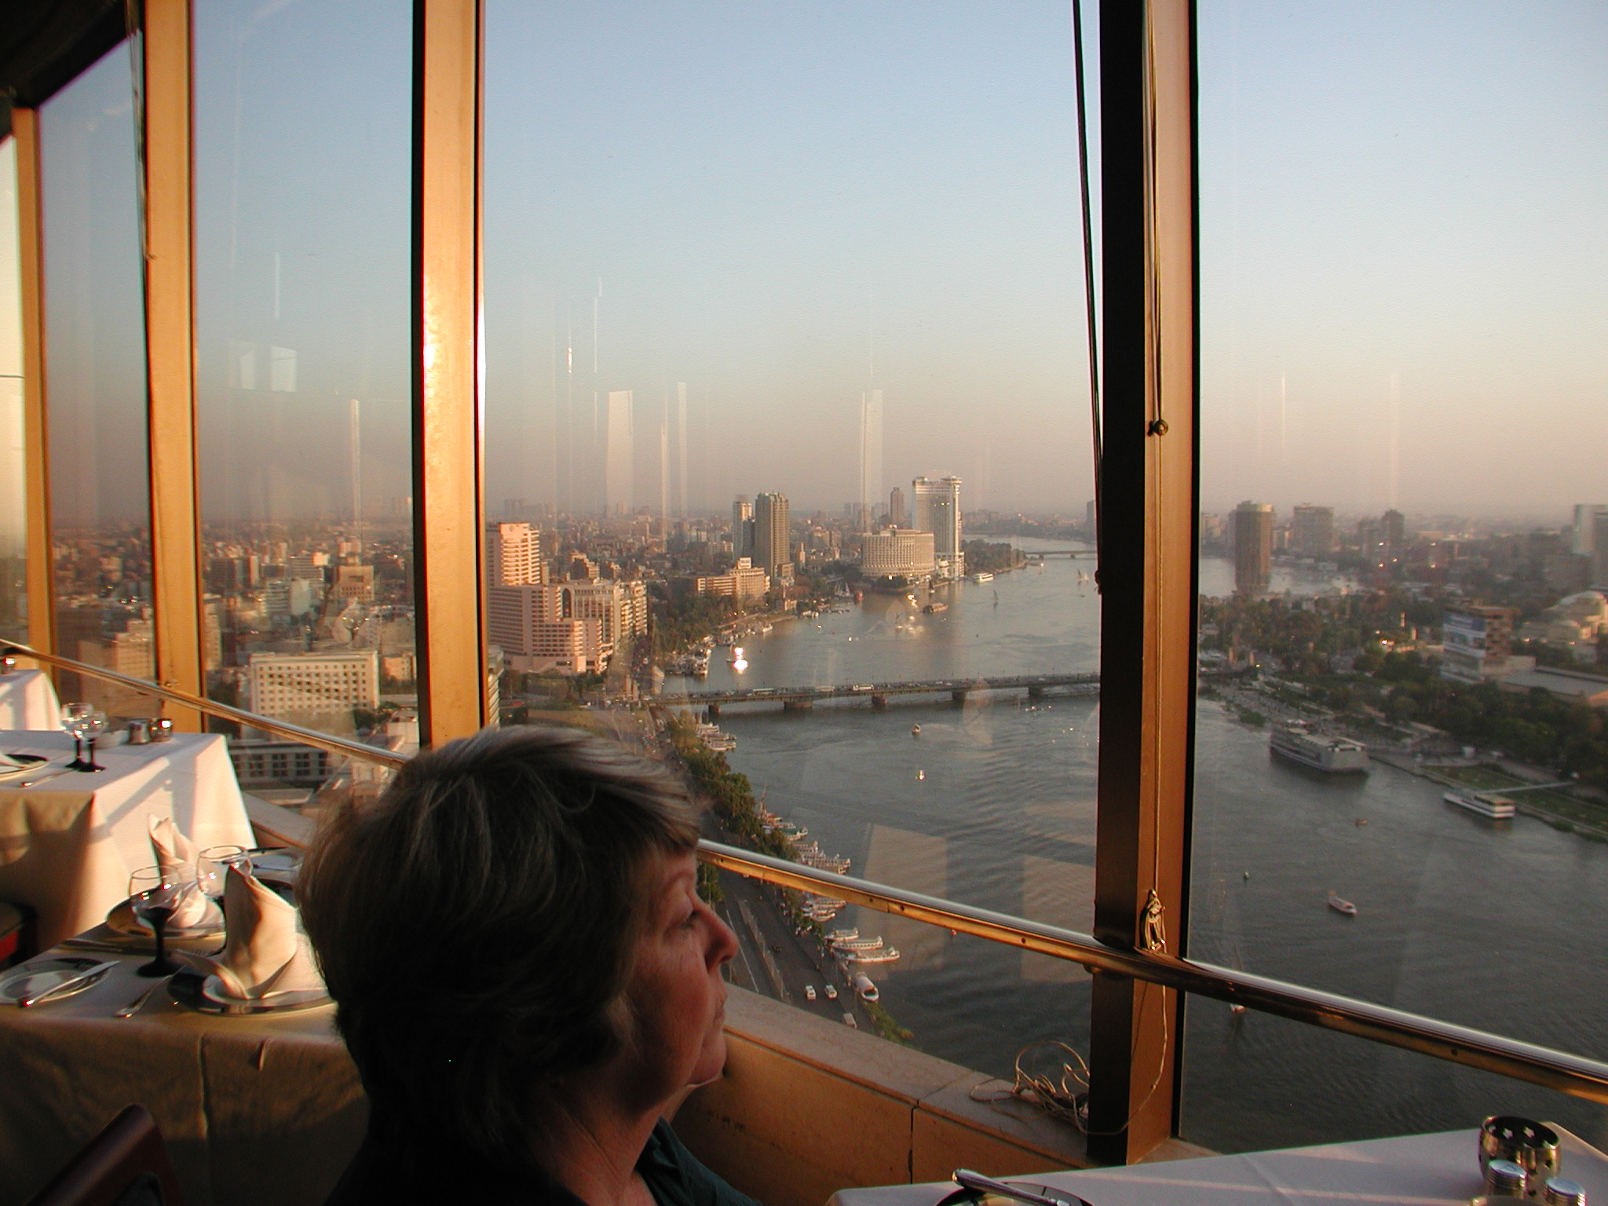
Notes:
Windows on the World Restaurant at the Ramses Hilton in Cairo overlooking the Nile.

Slide 33
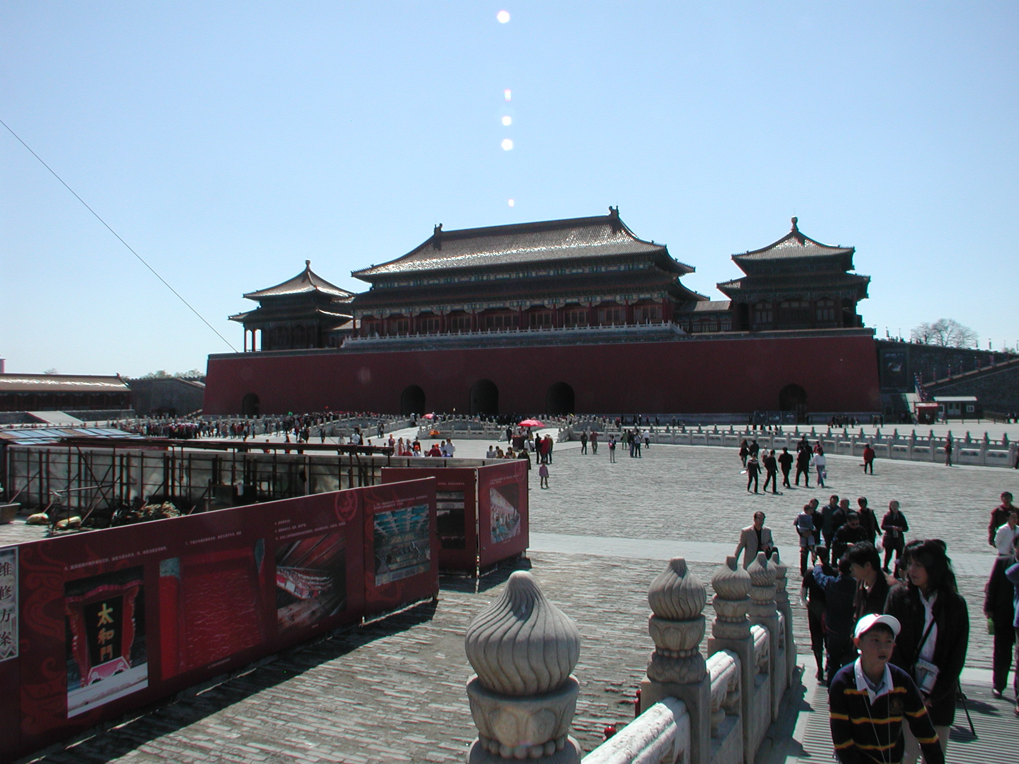
Notes:
Beijing Forbidden City. The Forbidden City was the Chinese imperial palace from the Ming dynasty to the end of the Qing dynasty—the years 1420 to 1912. It is located in the centre of Beijing, China, and now houses the Palace Museum. It served as the home of emperors and their households as well as the ceremonial and political centre of Chinese government for almost 500 years.

Slide 34
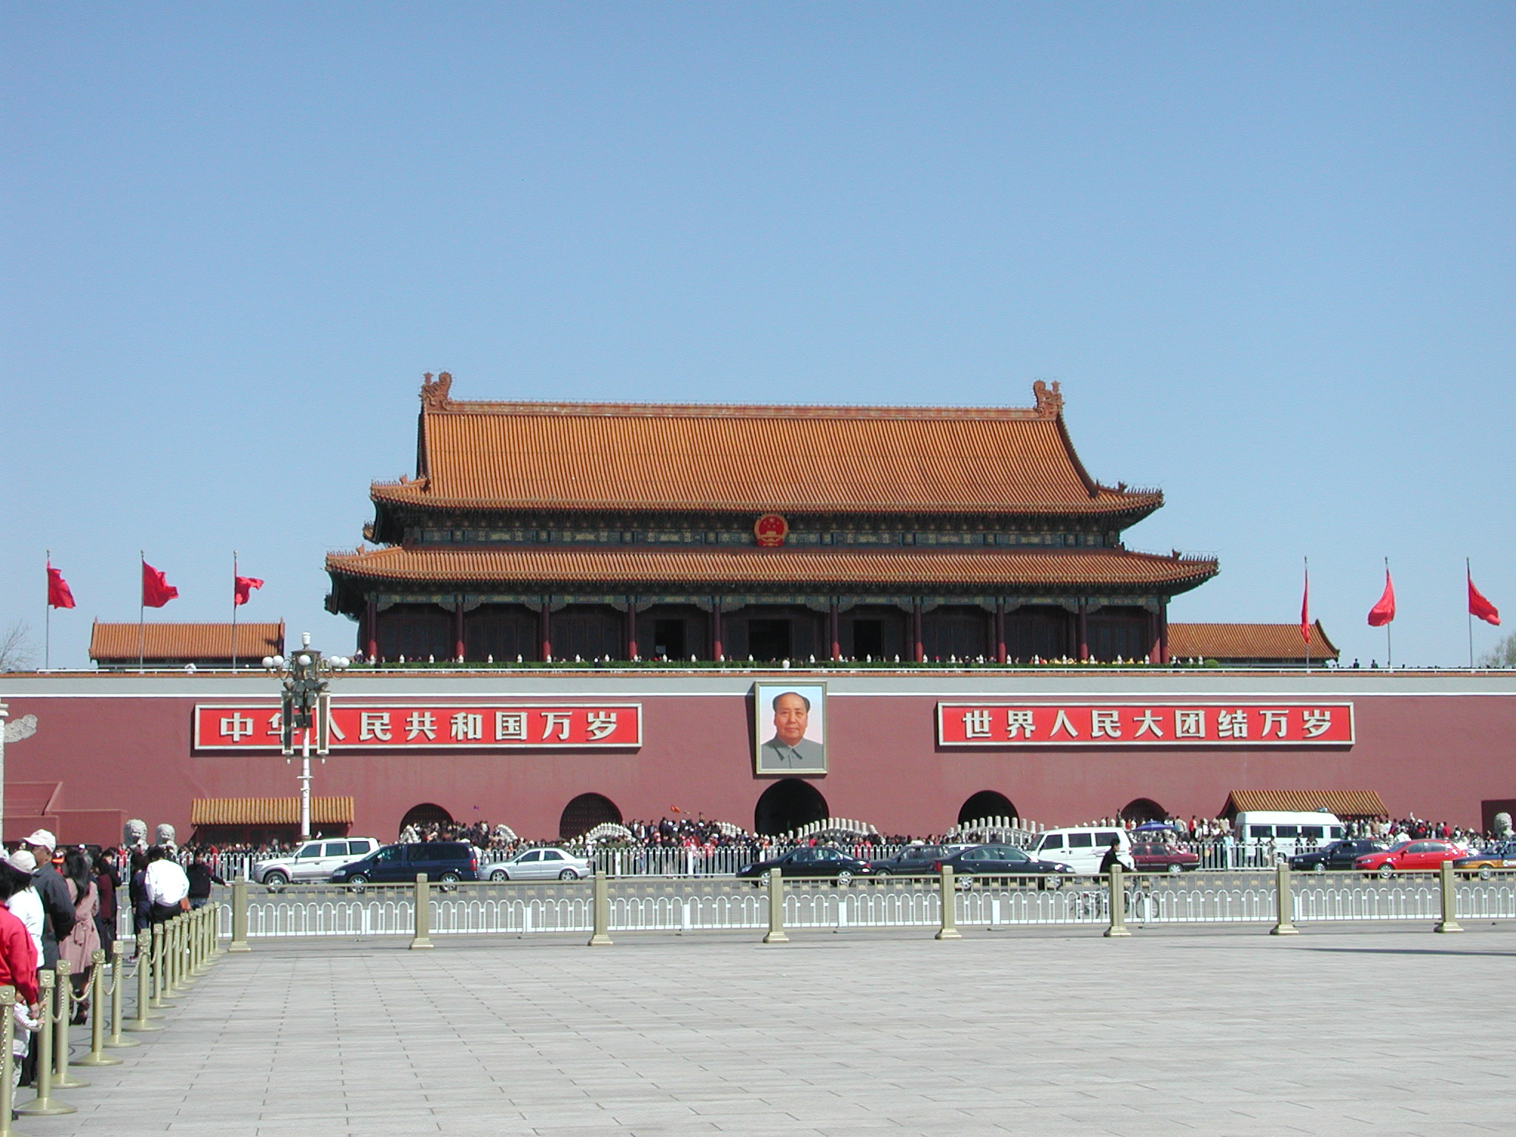
Notes:
Tianamen Square. Tiananmen Square is a large city square in the centre of Beijing, China, named after the Tiananmen ("Gate of Heavenly Peace") located to its north, separating it from the Forbidden City. The square contains the Monument to the People's Heroes, the Great Hall of the People, the National Museum of China, and the Mausoleum of Mao Zedong. Mao Zedong proclaimed the founding of the People's Republic of China in the square on October 1, 1949; the anniversary of this event is still observed there. Most Americans recognize it as the site for the Tianamen Massacre in 1989 amidst a democracy movement.

Slide 35
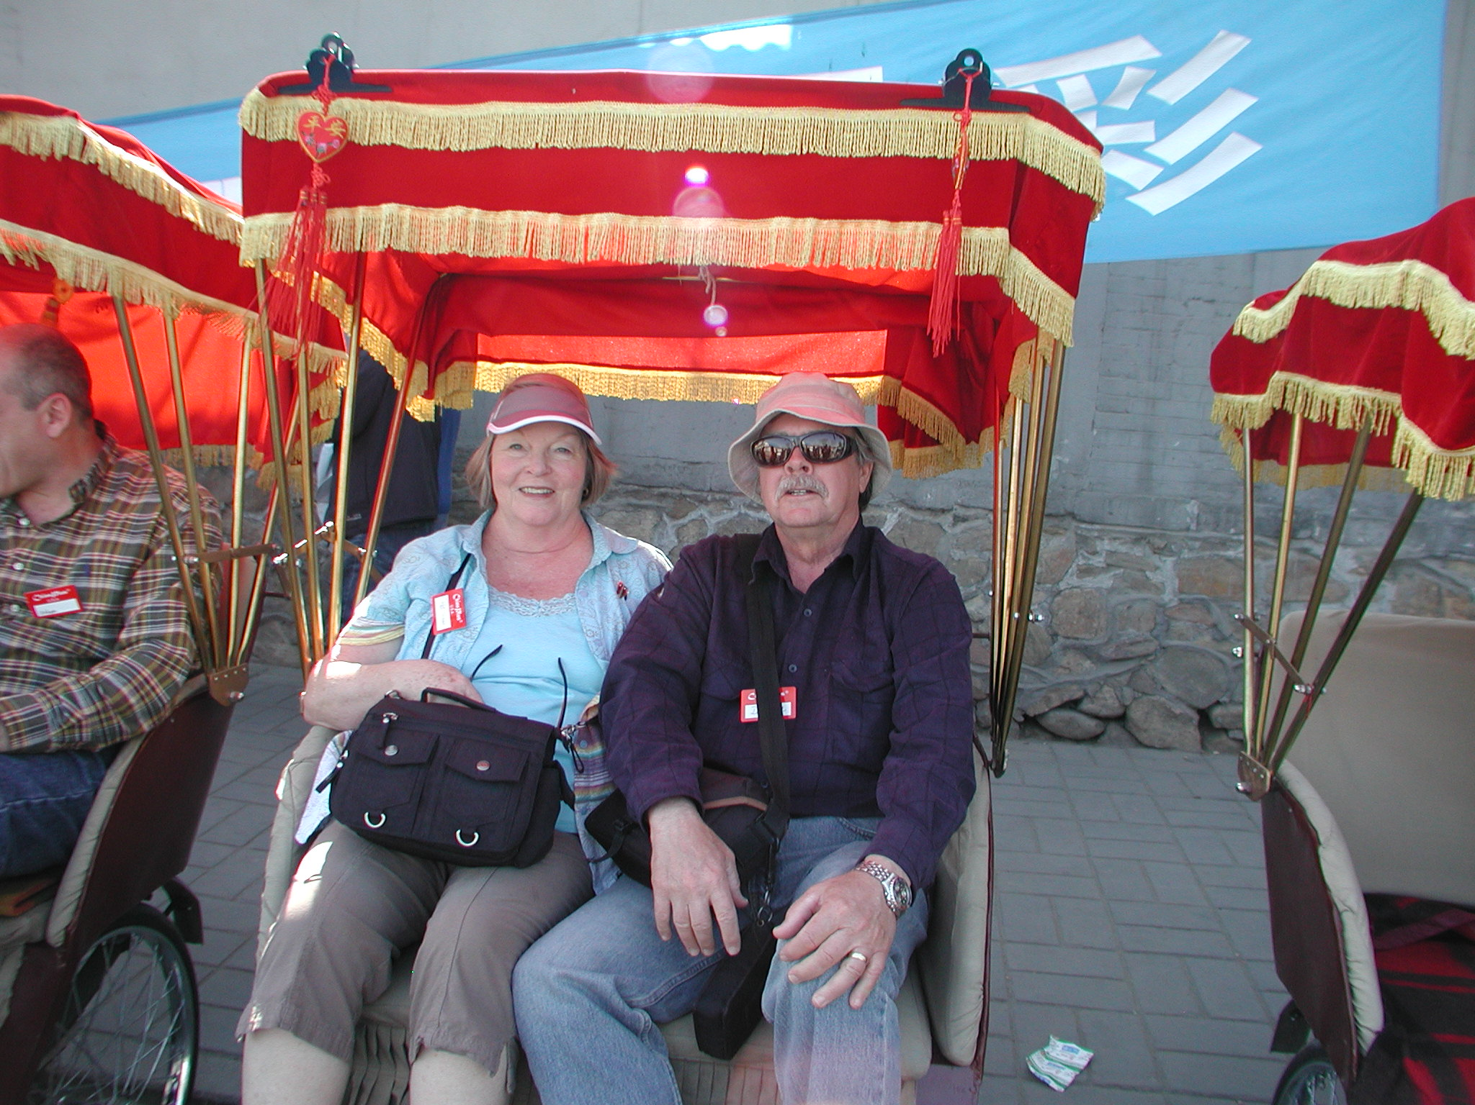
Notes:
Ricksaw Ride Through the Hutongs in Beijing. Hutongs (simplified Chinese: 胡同; traditional Chinese: 衚衕; pinyin: hútòng; Wade–Giles: hu2-t'ung4) are a type of narrow streets or alleys, commonly associated with northern Chinese cities, most prominently Beijing. In Beijing, hutongs are alleys formed by lines of siheyuan, traditional courtyard residences. Many neighborhoods were formed by joining one siheyuan to another to form a hutong, and then joining one hutong to another. The word hutong is also used to refer to such neighbourhoods.

Slide 36
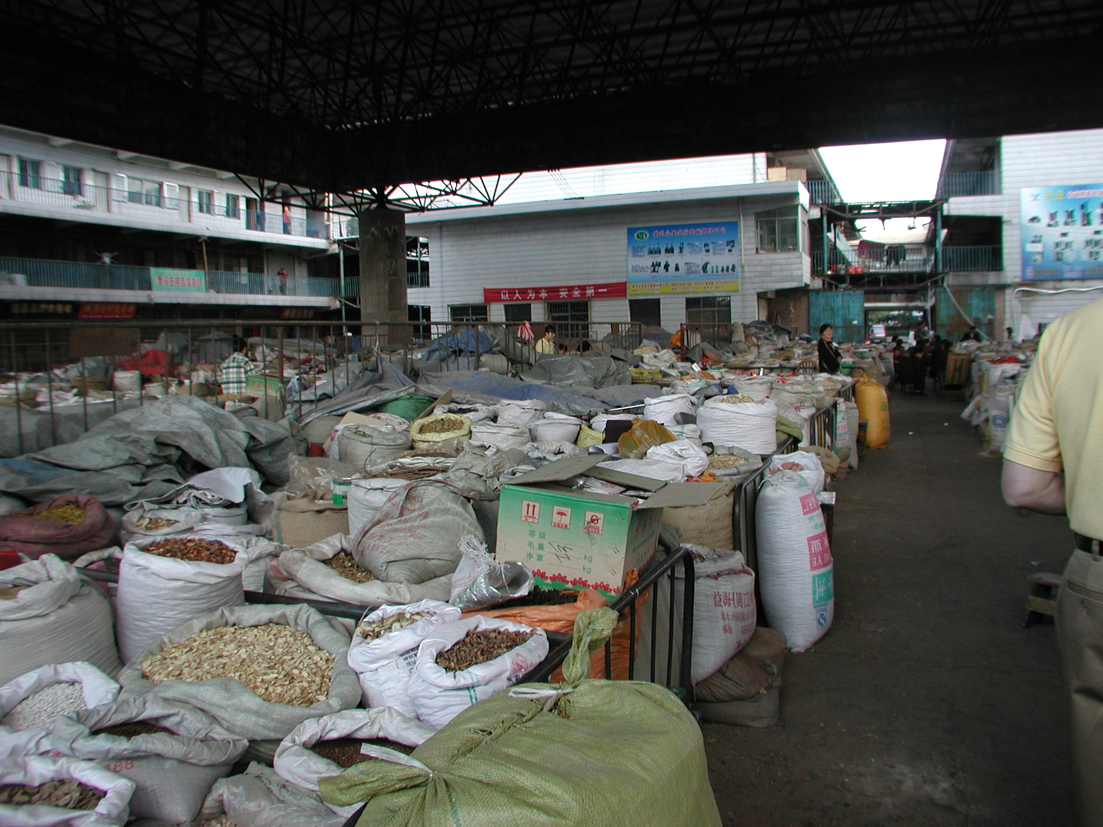
Notes:
Open Air Herb Market in China

Slide 37
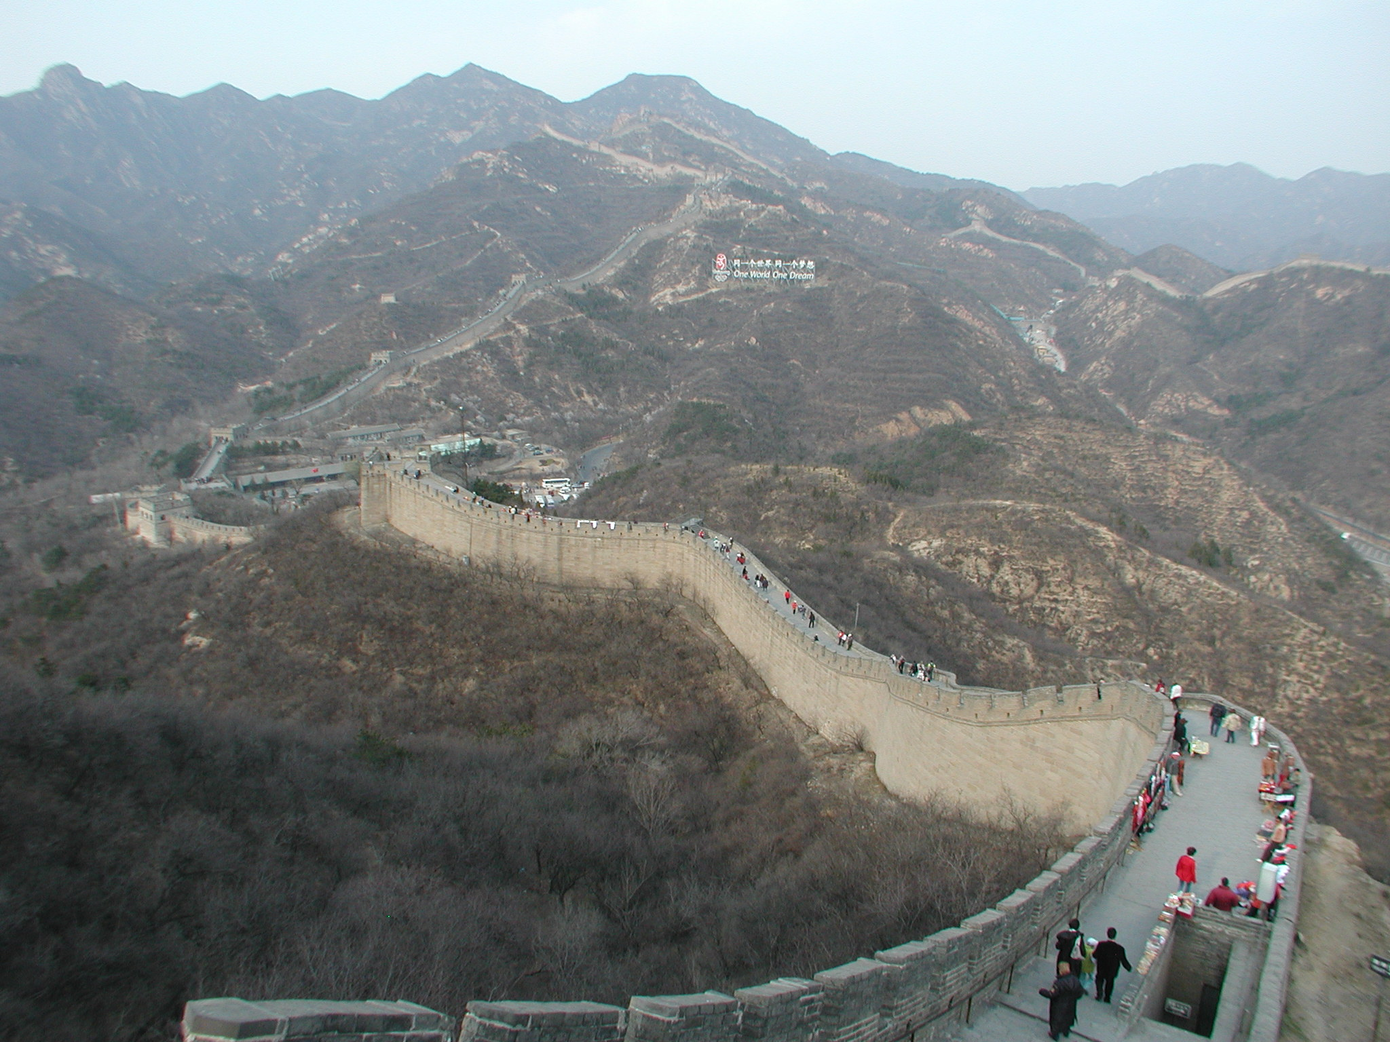
Notes:
The Great Wall is a series of fortifications made of stone, brick, tamped earth, wood, and other materials, generally built along an east-to-west line across the historical northern borders of China to protect the Chinese states and empires against the raids and invasions of the various nomadic groups of the Eurasian Steppe. Several walls were being built as early as the 7th century BCE; these, later joined together and made bigger and stronger, are now collectively referred to as the Great Wall. Especially famous is the wall built 220–206 BCE by Qin Shi Huang, the first Emperor of China. The majority of the existing wall is from the Ming Dynasty (1368–1644)

Slide 38
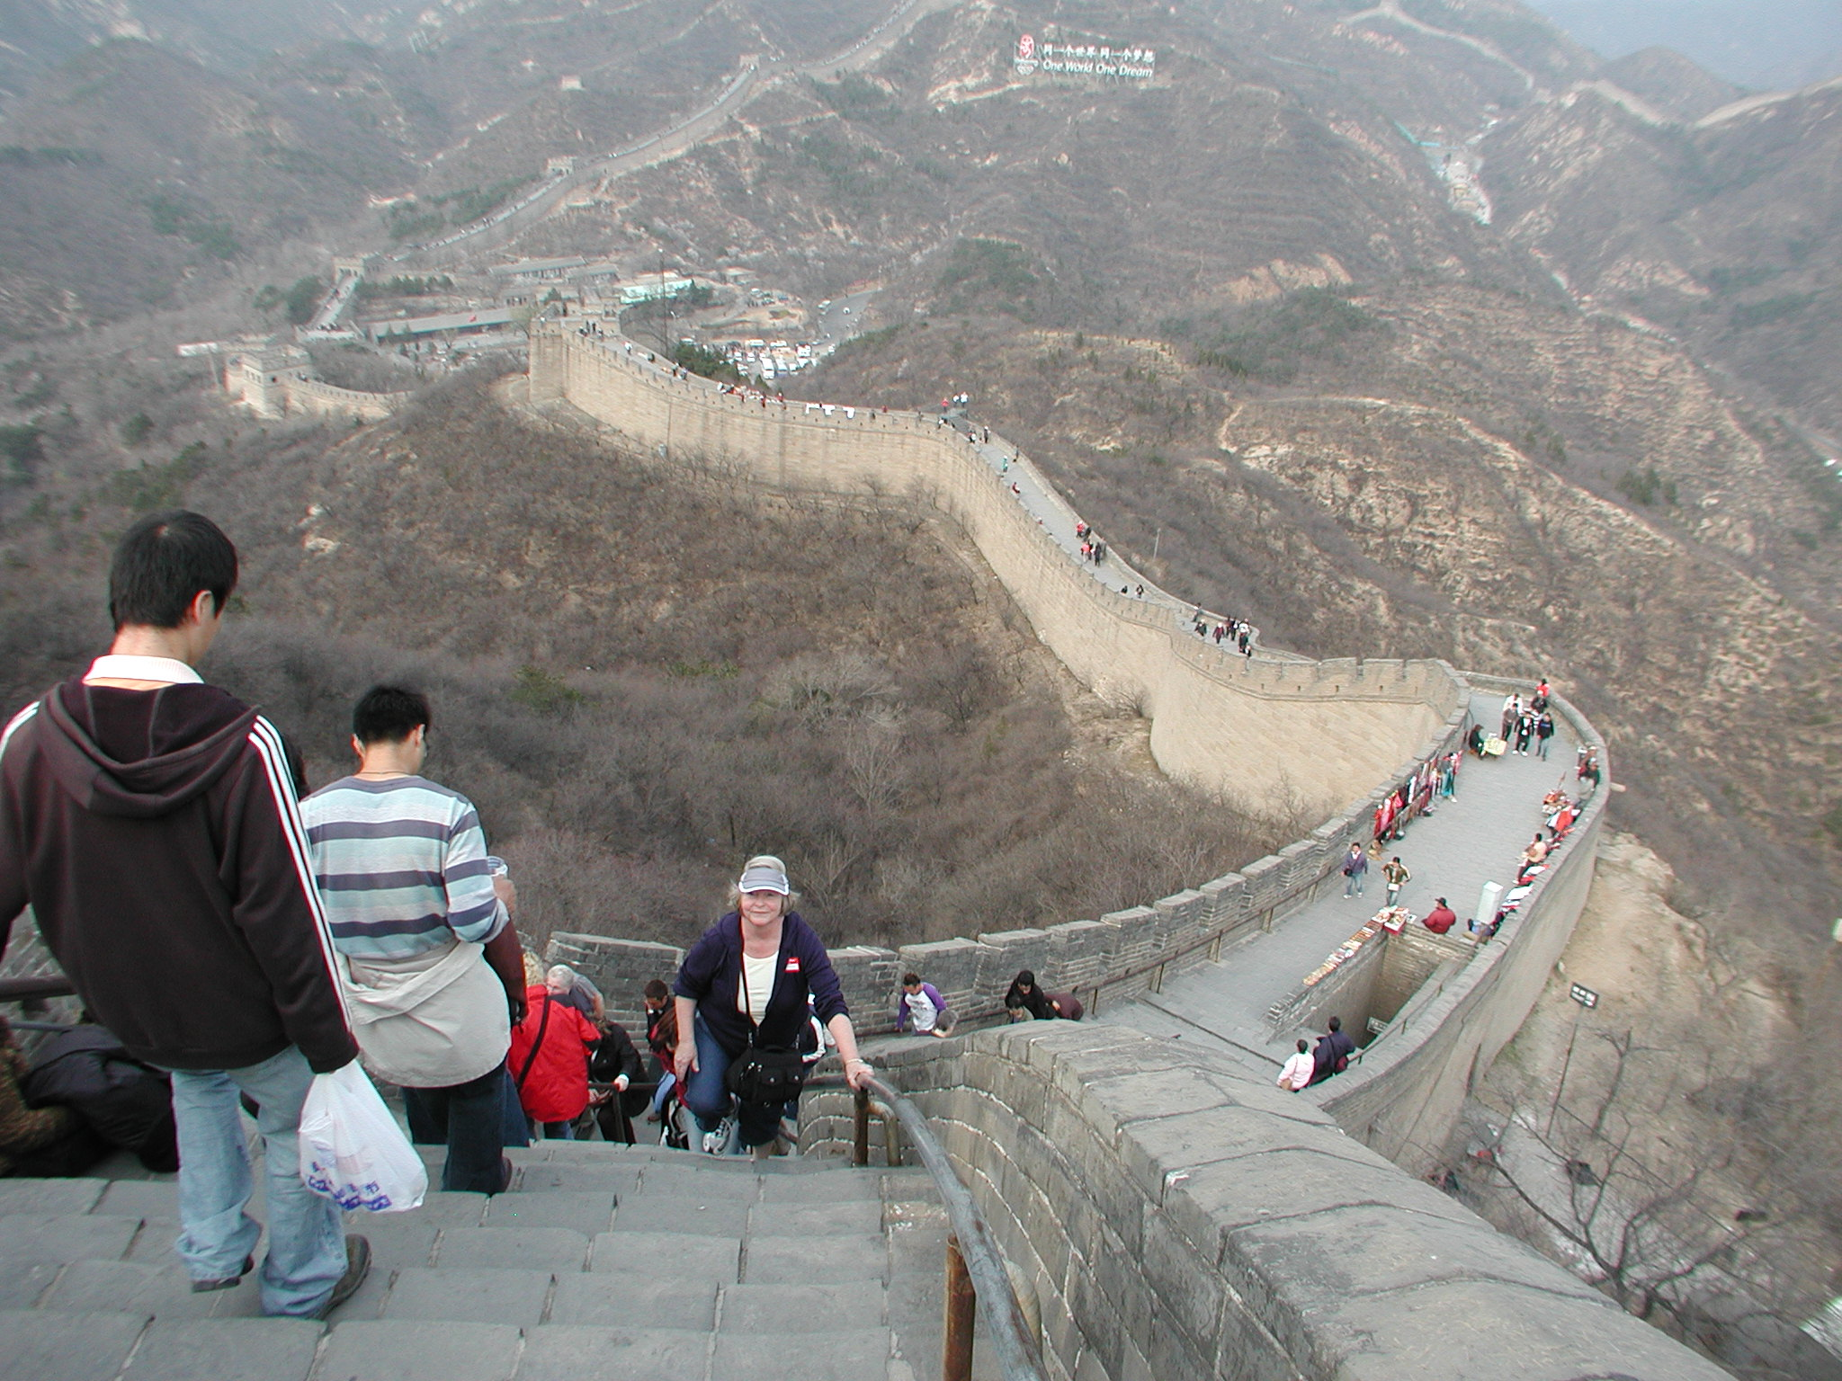
Notes:
My beloved.

Slide 39
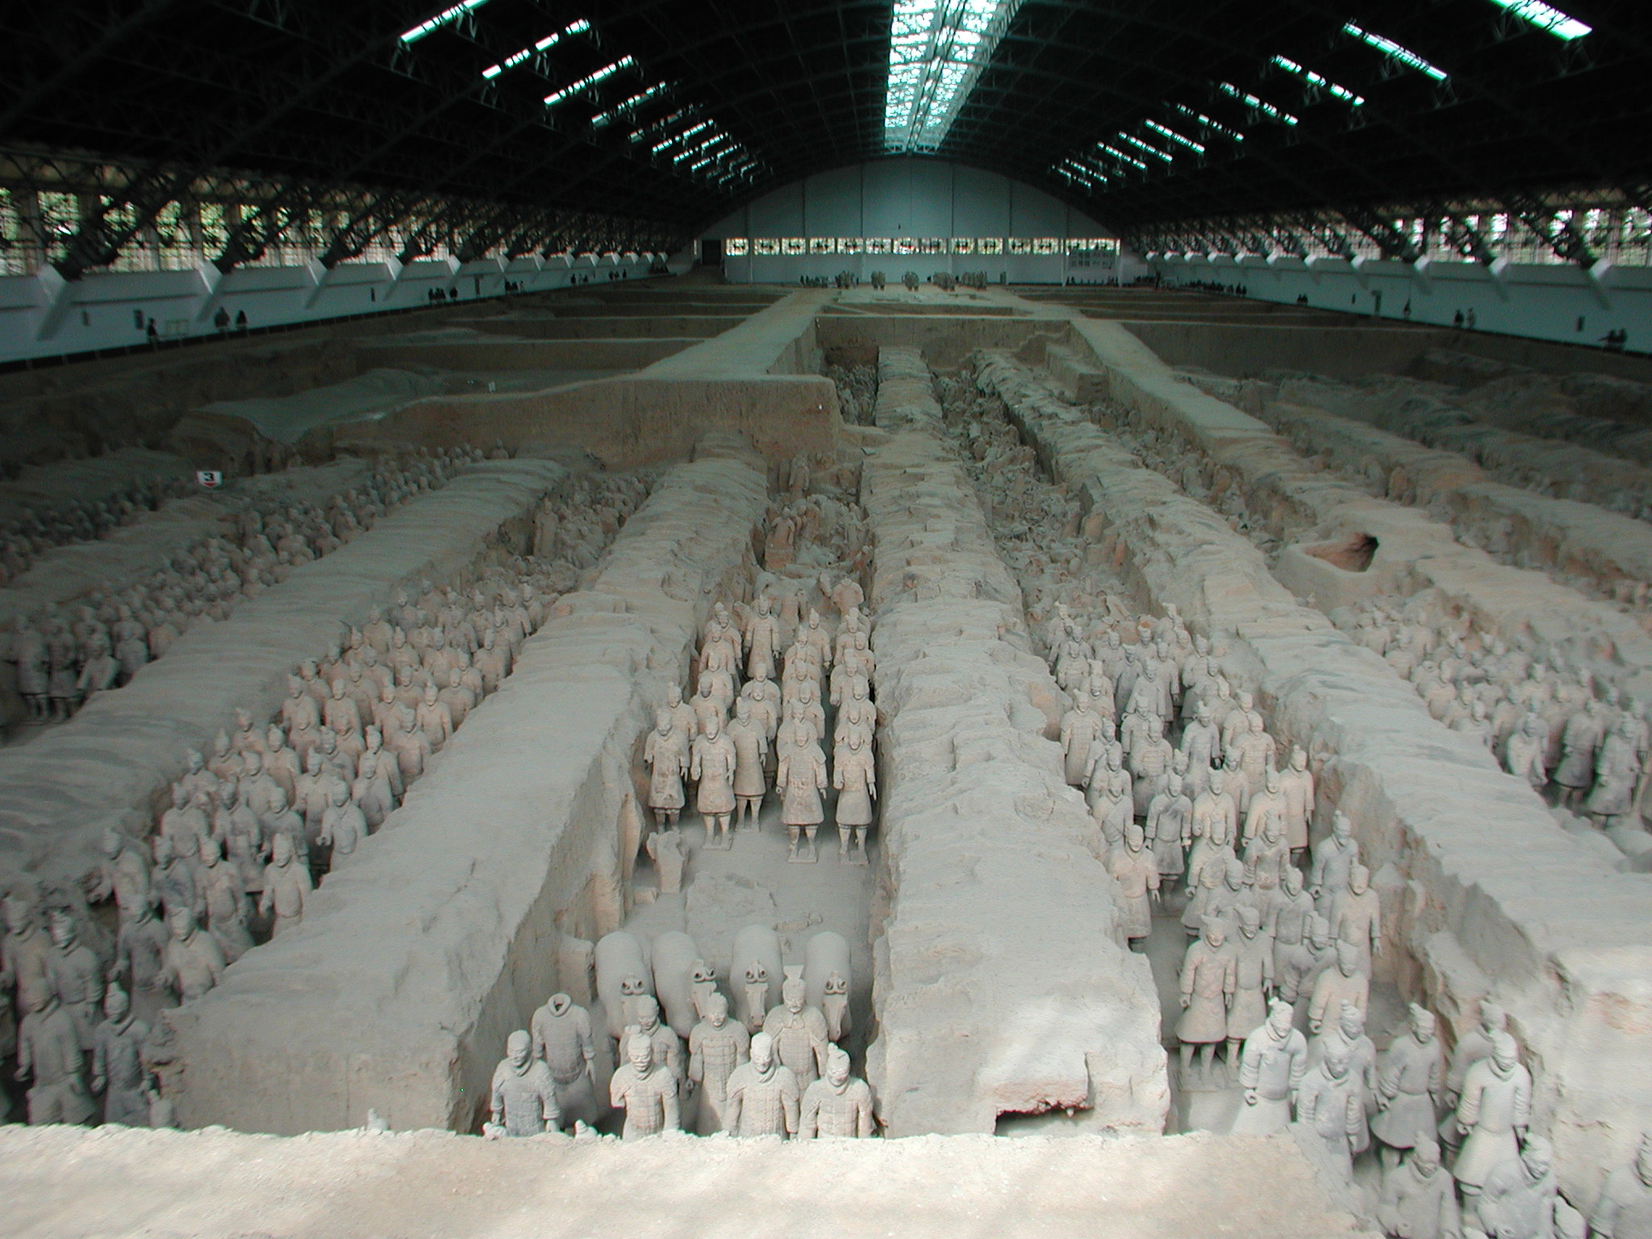
Notes:
Tien ‘a Mien and the Terra Cotta Warriors. The Terracotta Army (Chinese: 兵马俑; literally: "Soldier-and-horse funerary statues") is a collection of terracotta sculptures depicting the armies of Qin Shi Huang, the first Emperor of China. It is a form of funerary art buried with the emperor in 210–209 BCE and whose purpose was to protect the emperor in his afterlife.

Slide 40
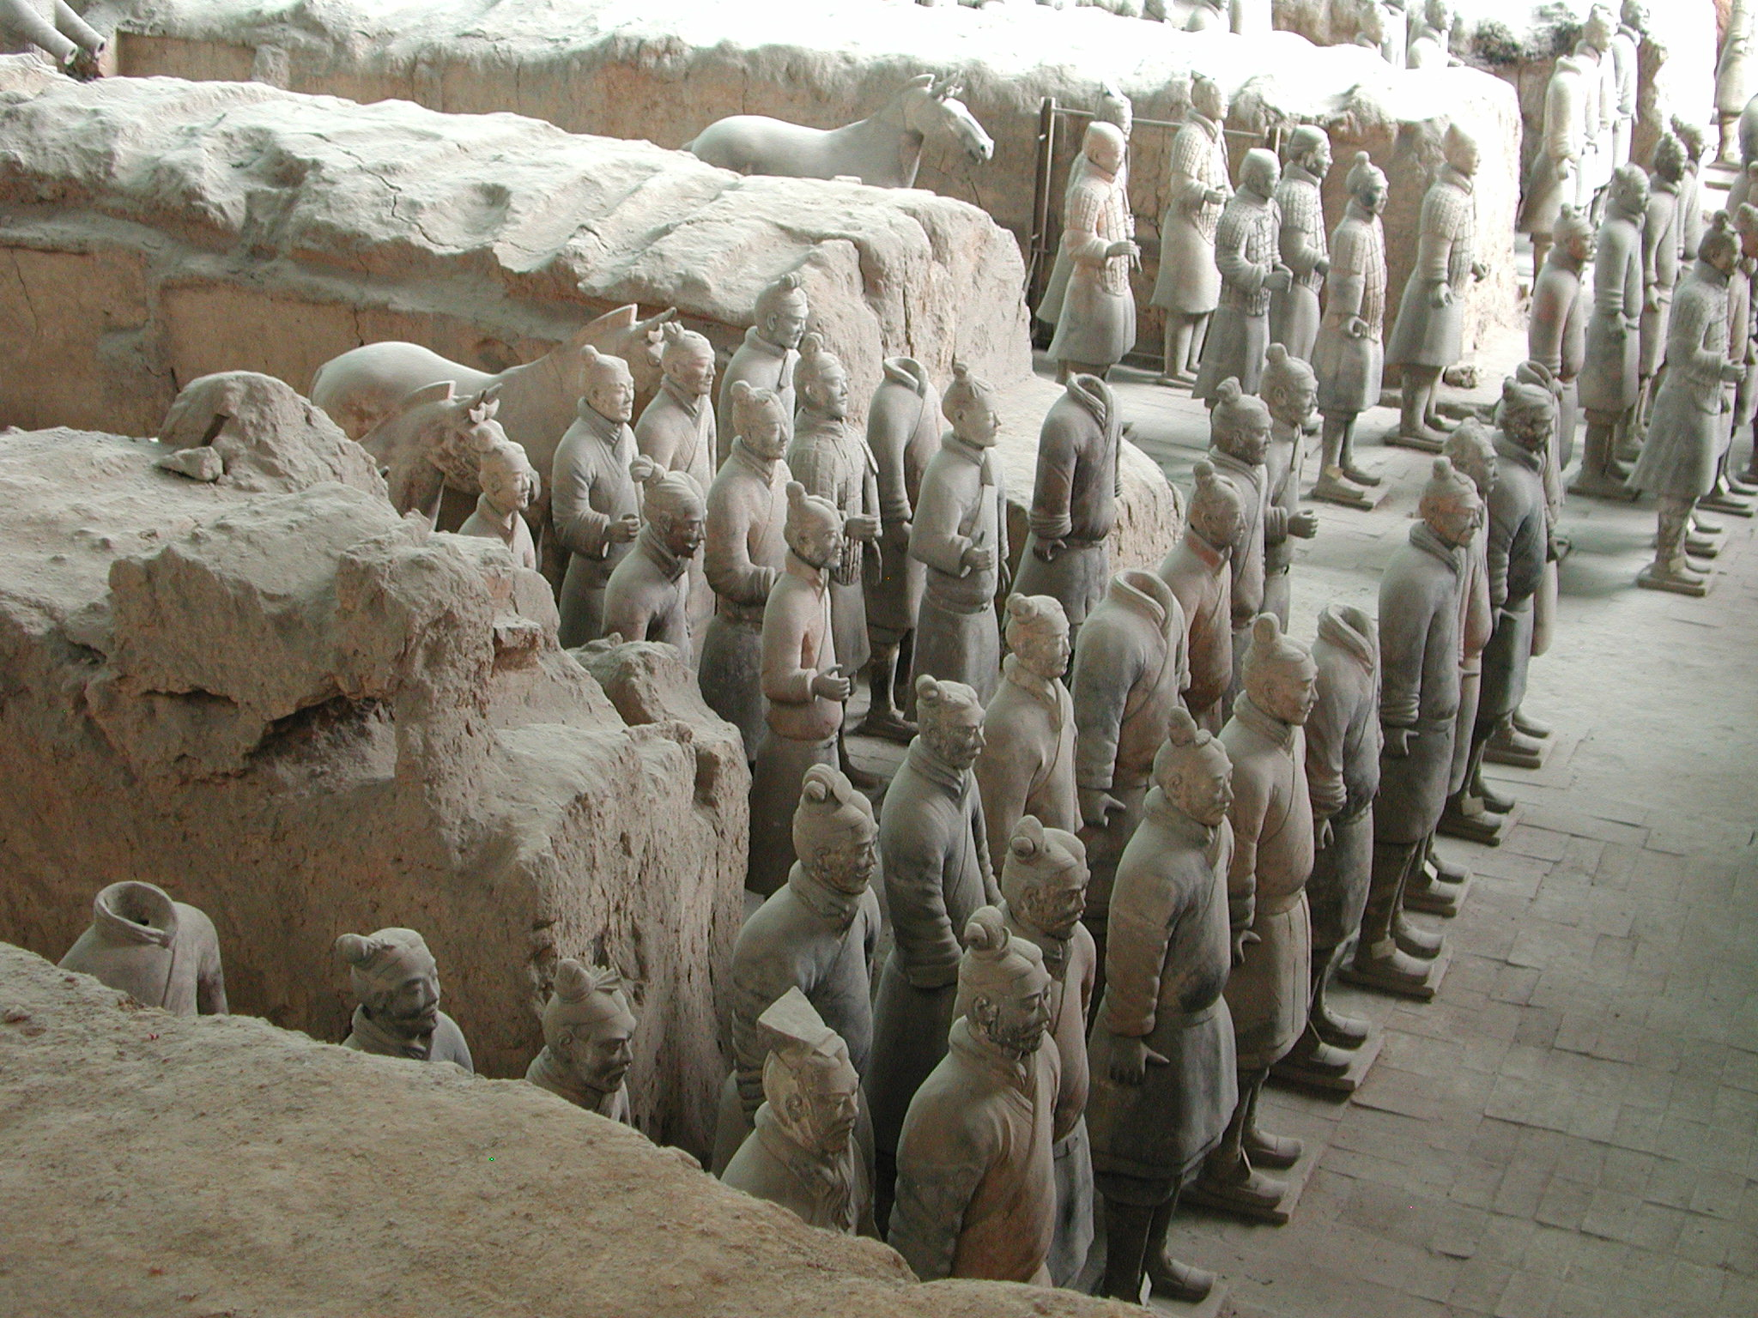
Notes:
More terra cotta warriors.

Slide 41
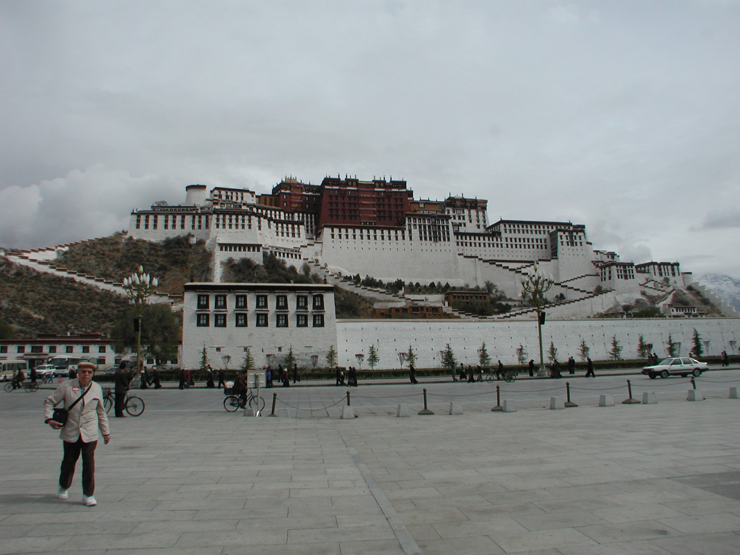
Notes:
Lhasa, Tibet at Potala Palace, former home of the 14th Dalai Lama who fled to India during the communist takeover of Tibet in 1959. The 5th Dalai Lama started its construction in 1645.

Slide 42
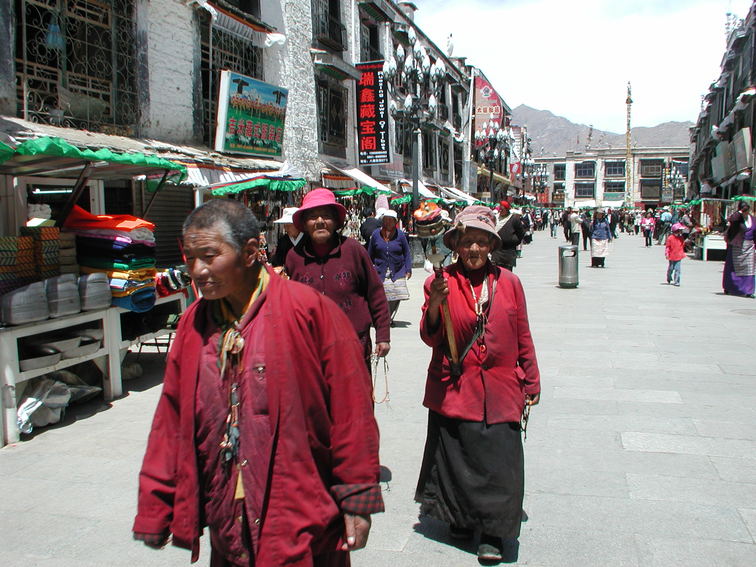
Notes:
Modern Day Lhasa

Slide 43
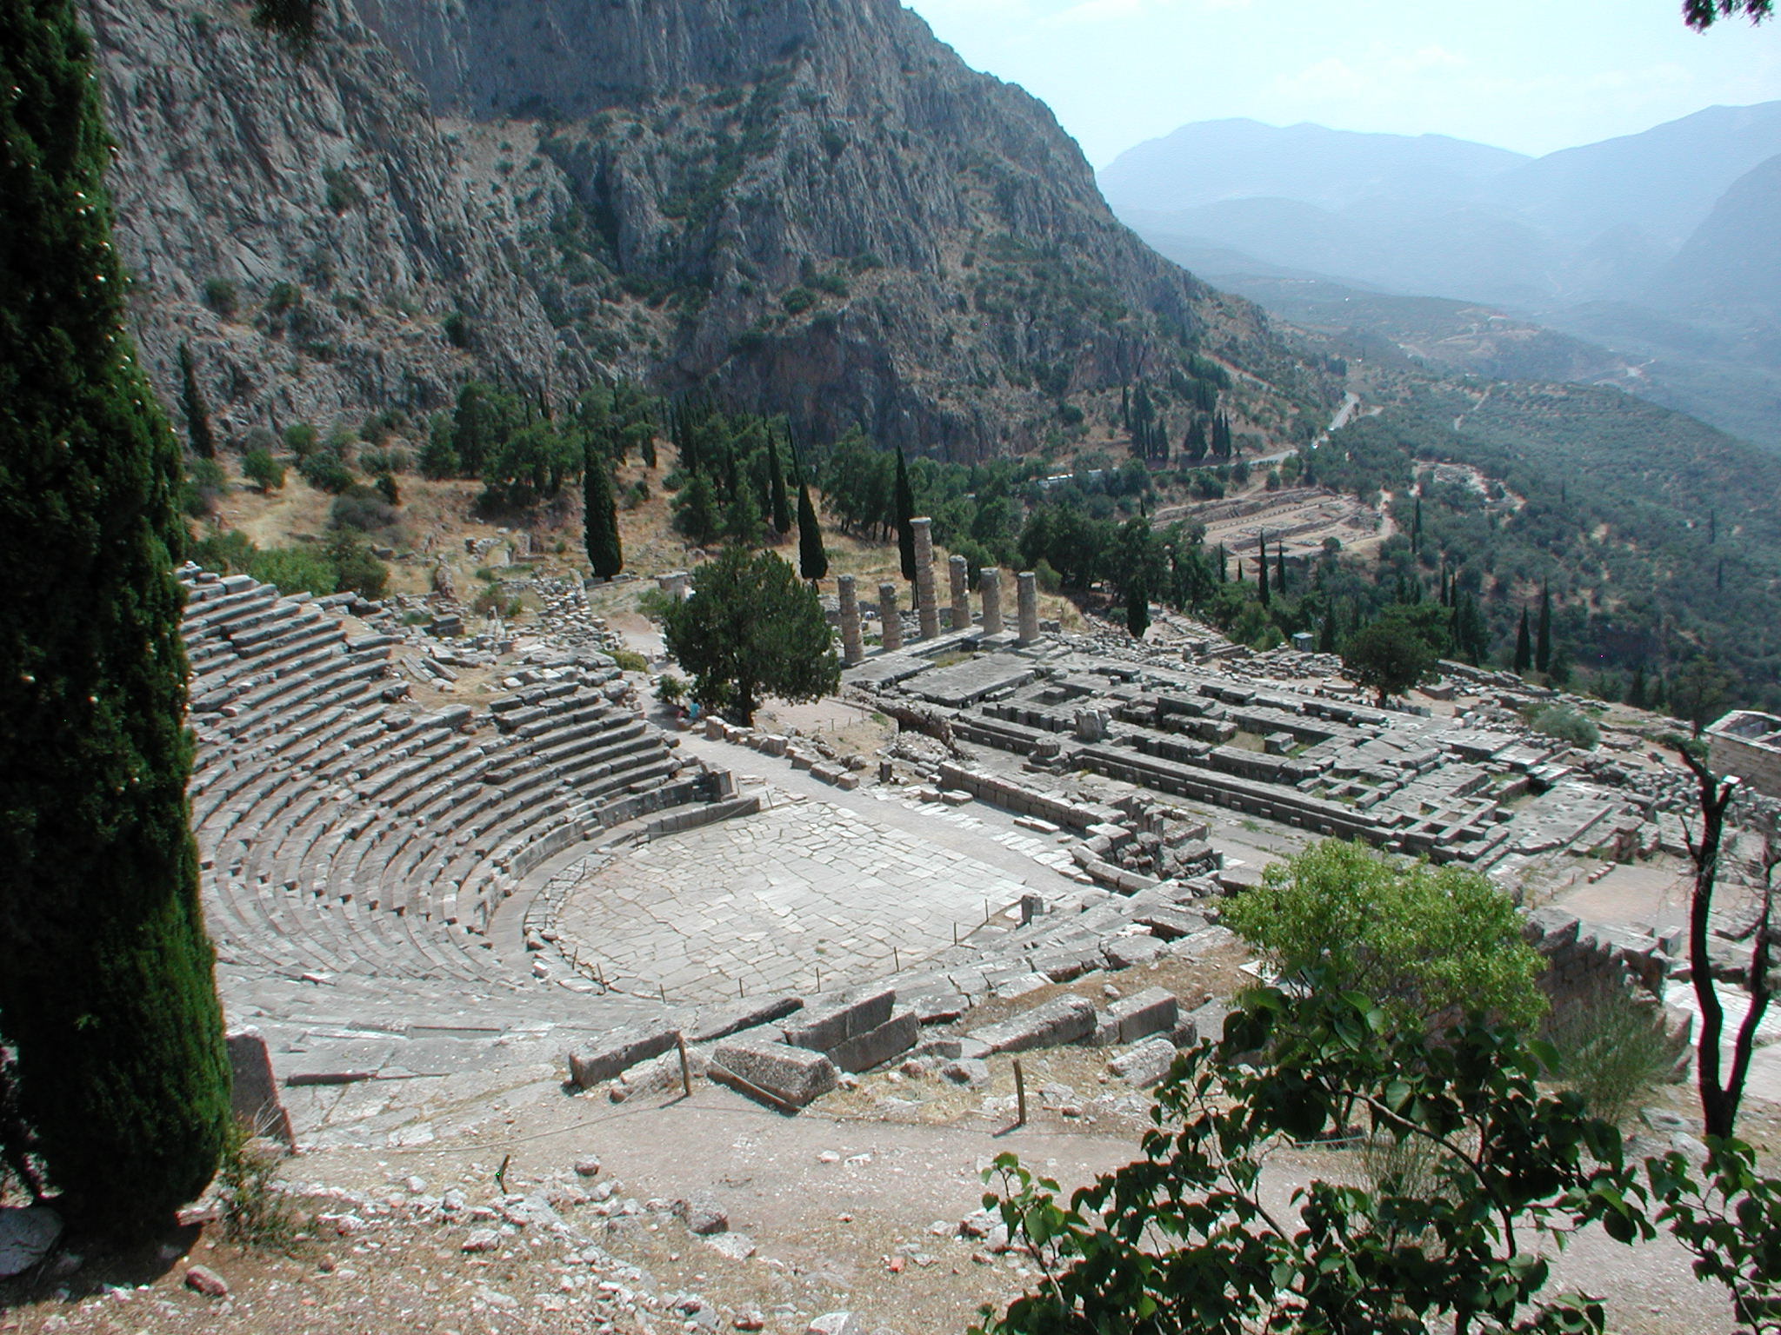
Notes:
Delphi, Greece: In myths dating to the classical period of Ancient Greece (510-323 BC), the site of Delphi was believed to be determined by Zeus when he sought to find the centre of his "Grandmother Earth" (Ge, Gaea, or Gaia). He sent two eagles flying from the eastern and western extremities, and the path of the eagles crossed over Delphi where the omphalos, or navel of Gaia was found. Delphi is perhaps best known for the oracle of the Pythia in the form of the sibyl or priestess at the sanctuary dedicated to Apollo. According to Aeschylus in the prologue of the Eumenides, the oracle had origins in prehistoric times and the worship of Gaea.

Slide 44
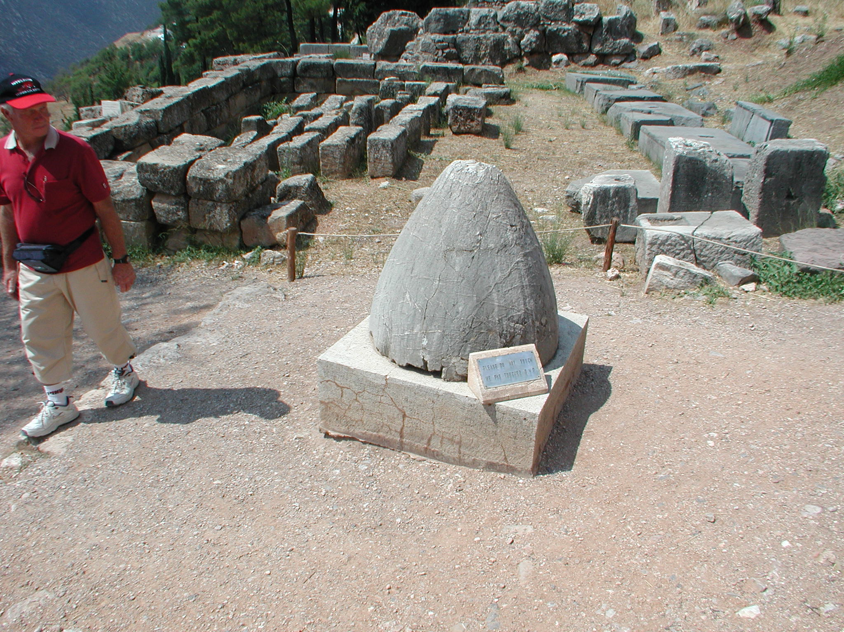
Notes:
The Center of the Earth at Delphi

Slide 45
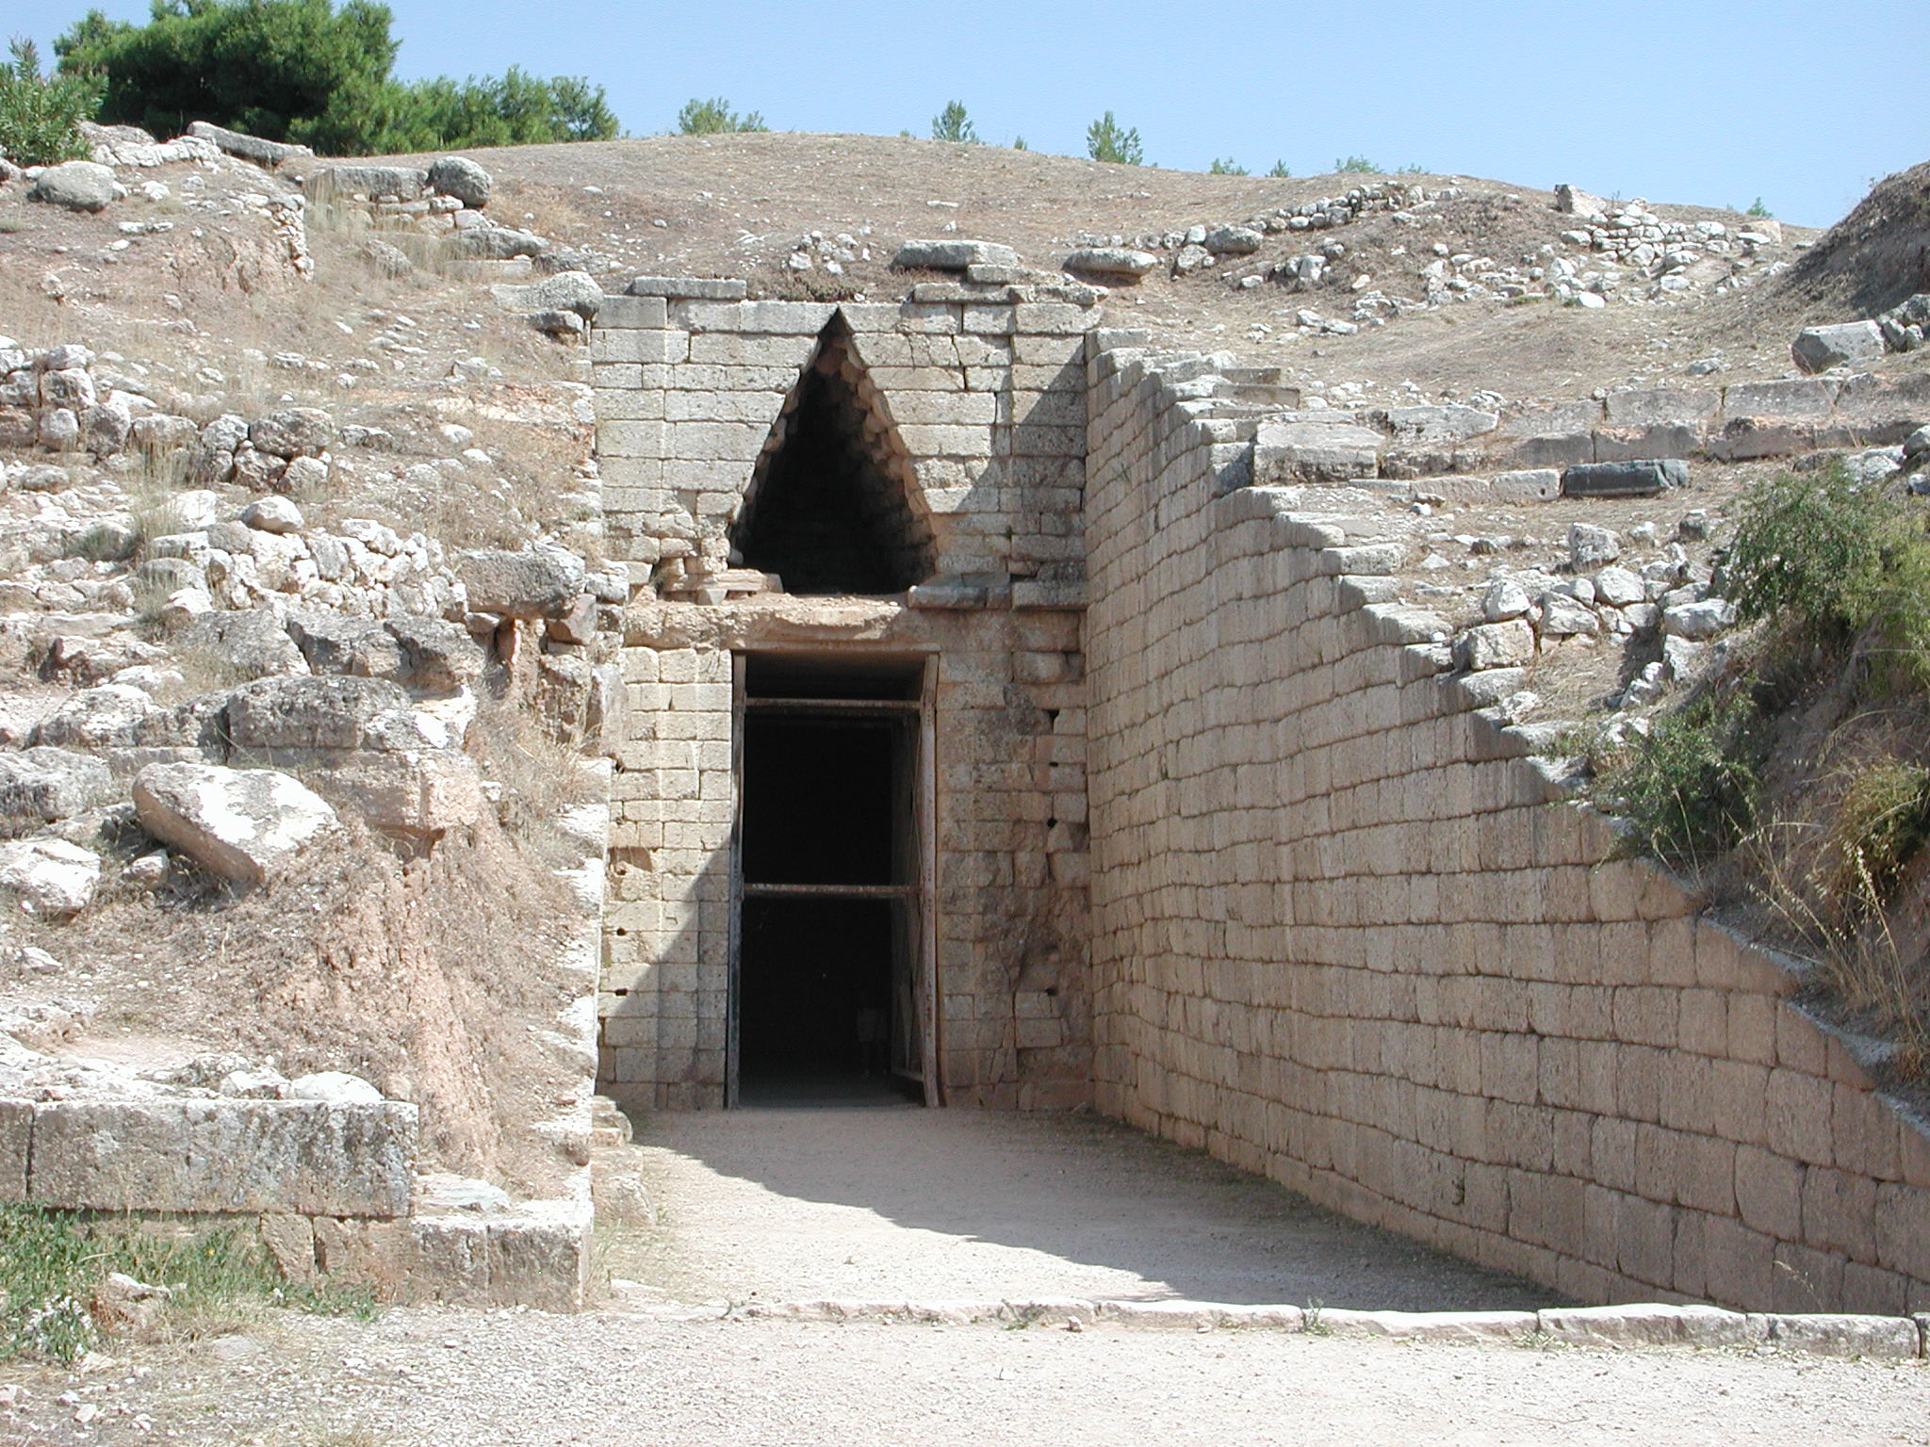
Notes:
Agamemnon’s tomb at Mycenae. The Tomb of Agamemnon is one of a number of 'beehive' tombs found in the vicinity of the ancient site of Mycenae constructed between 1510 BC and 1220 BC. Agamemnon was the King who invaded Troy, along with Achilles.

Slide 46
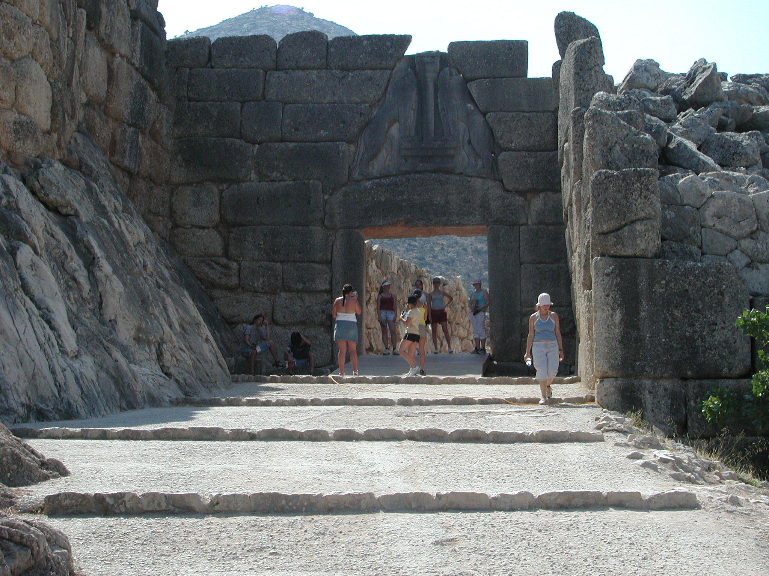
Notes:
The Lion’s Gate at Mycaenae, Greece location of Agamemnon’s Tomb and start site for the Greek invasion of Persian Troy.

Slide 47
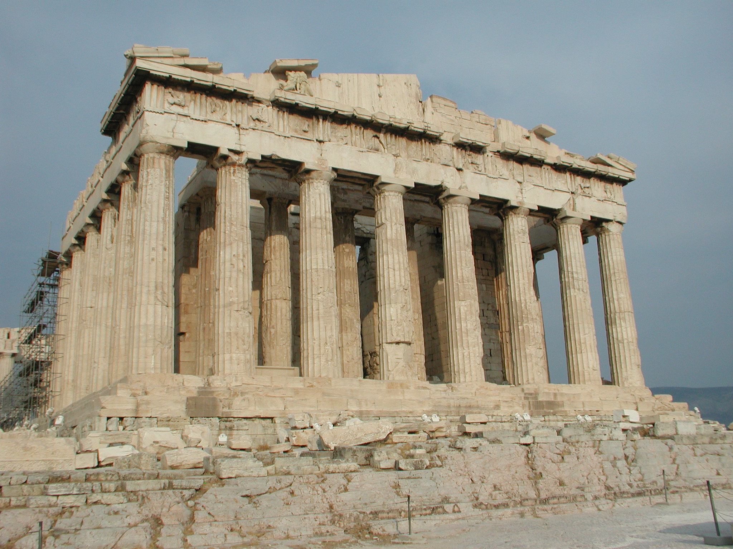
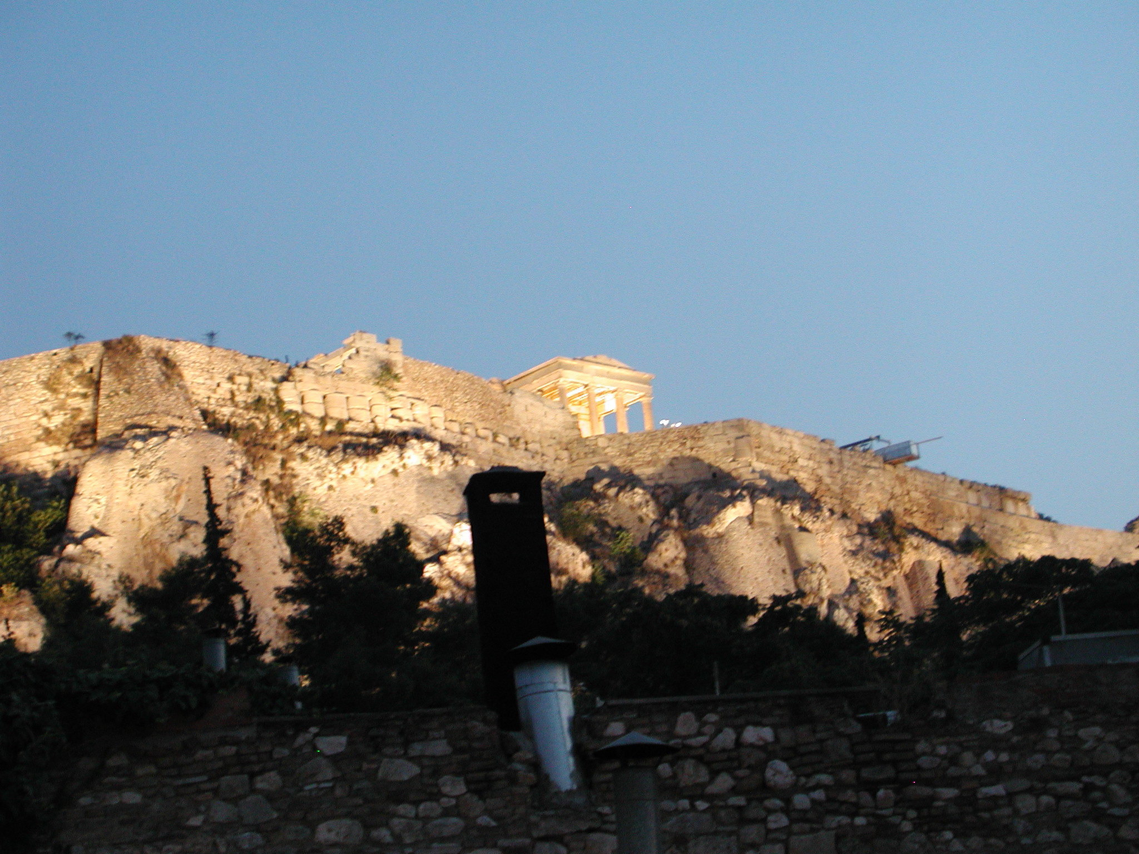
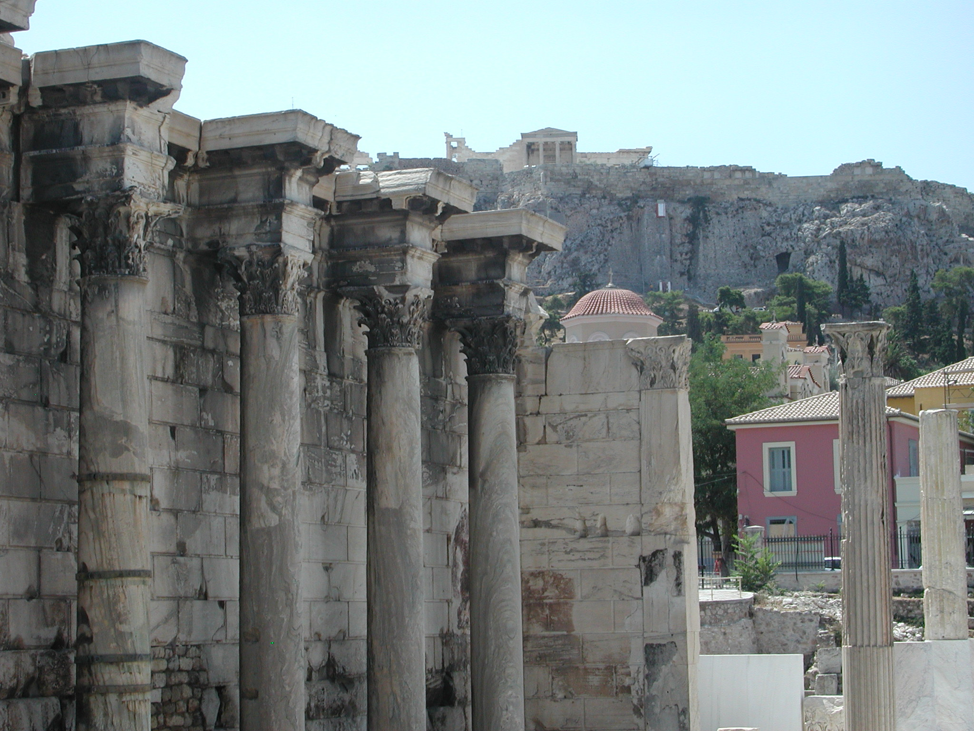
Notes:
Modern Greece

Slide 48
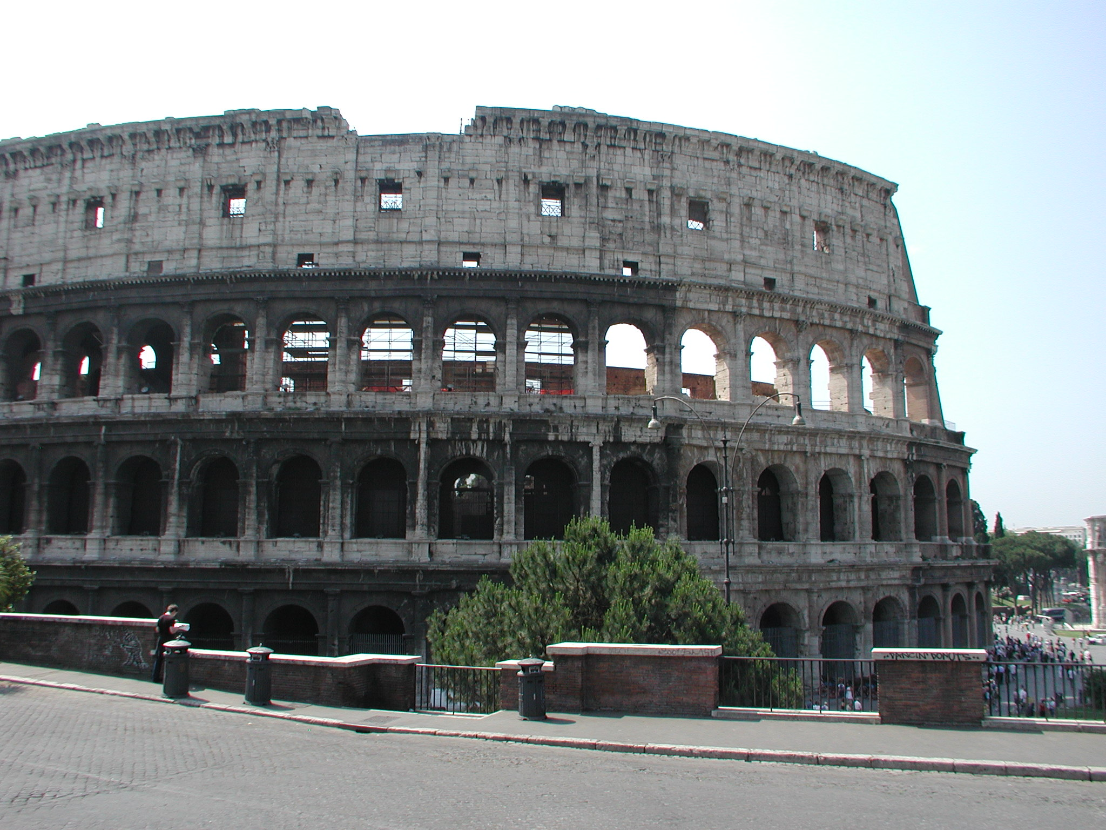
Notes:
The Roman Colliseum. The Colosseum or Coliseum (/kɒləˈsiːəm/ kol-ə-see-əm), also known as the Flavian Amphitheatre (Latin: Amphitheatrum Flavium; Italian: Anfiteatro Flavio [amfiteˈaːtro ˈflaːvjo] or Colosseo [kolosˈsɛːo]), is an oval amphitheatre in the centre of the city of Rome, Italy. Built of concrete and sand, it is the largest amphitheatre ever built. The Colosseum is situated just east of the Roman Forum. Construction began under the emperor Vespasian in AD 72, and was completed in AD 80 under his successor and heir Titus. The Colosseum could hold, it is estimated, between 50,000 and 80,000 spectators, having an average audience of some 65,000; it was used for gladiatorial contests and public spectacles such as mock sea battles (for only a short time as the hypogeum was soon filled in with mechanisms to support the other activities), animal hunts, executions, re-enactments of famous battles, and dramas based on Classical mythology. The building ceased to be used for entertainment in the early medieval era. It was later reused for such purposes as housing, workshops, quarters for a religious order, a fortress, a quarry, and a Christian shrine.

Slide 49
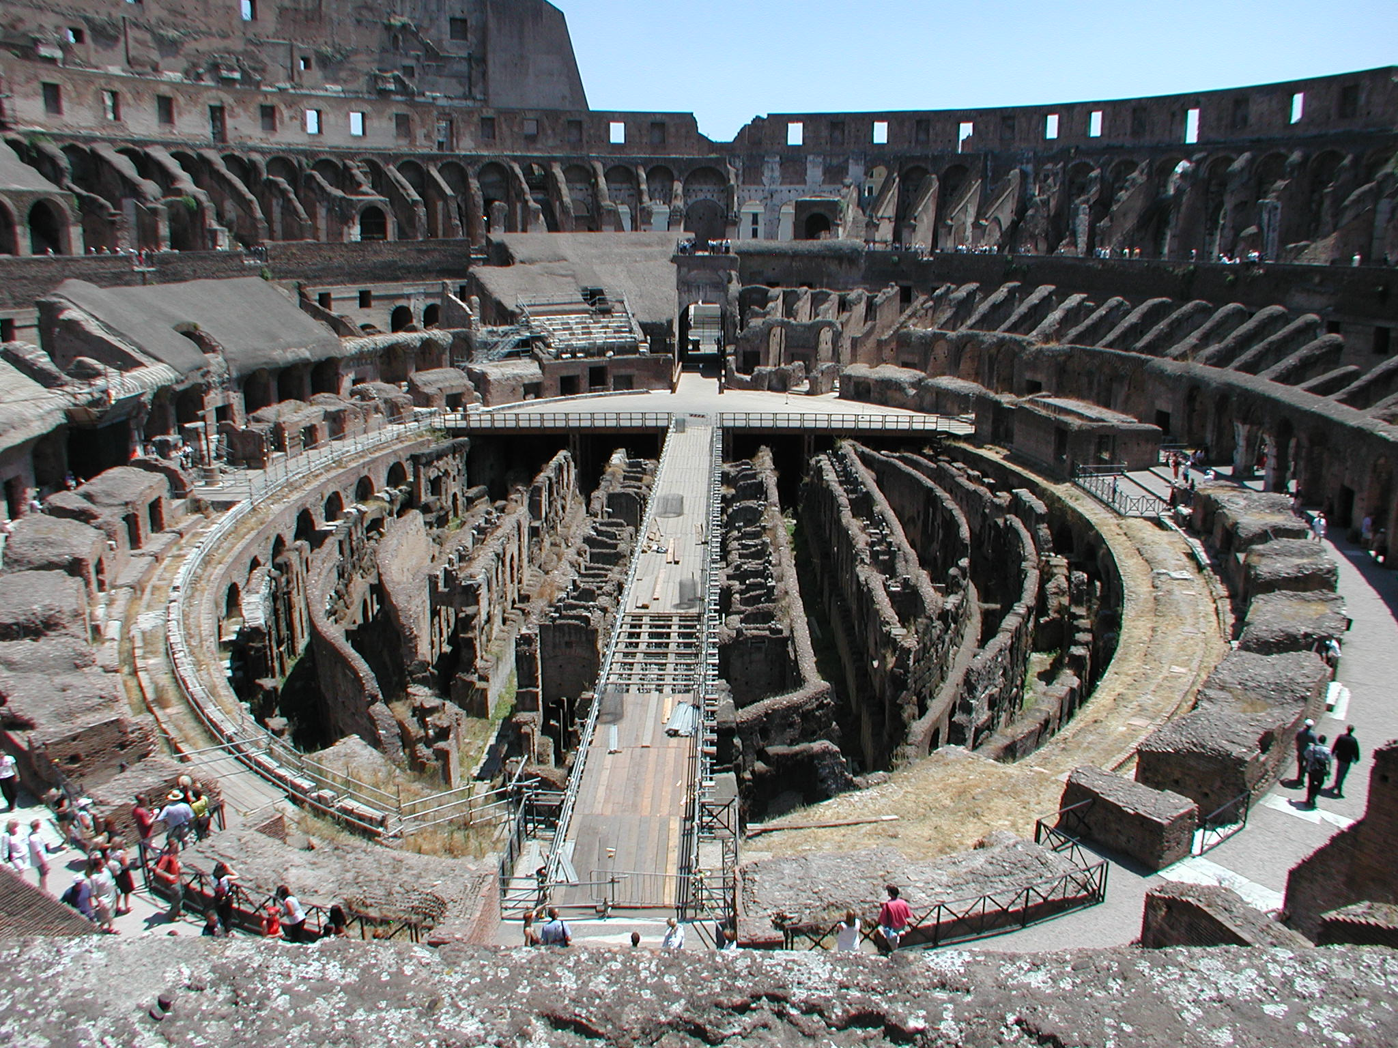
Notes:
Inside the Roman Colliseum, the floor slid off and on

Slide 50
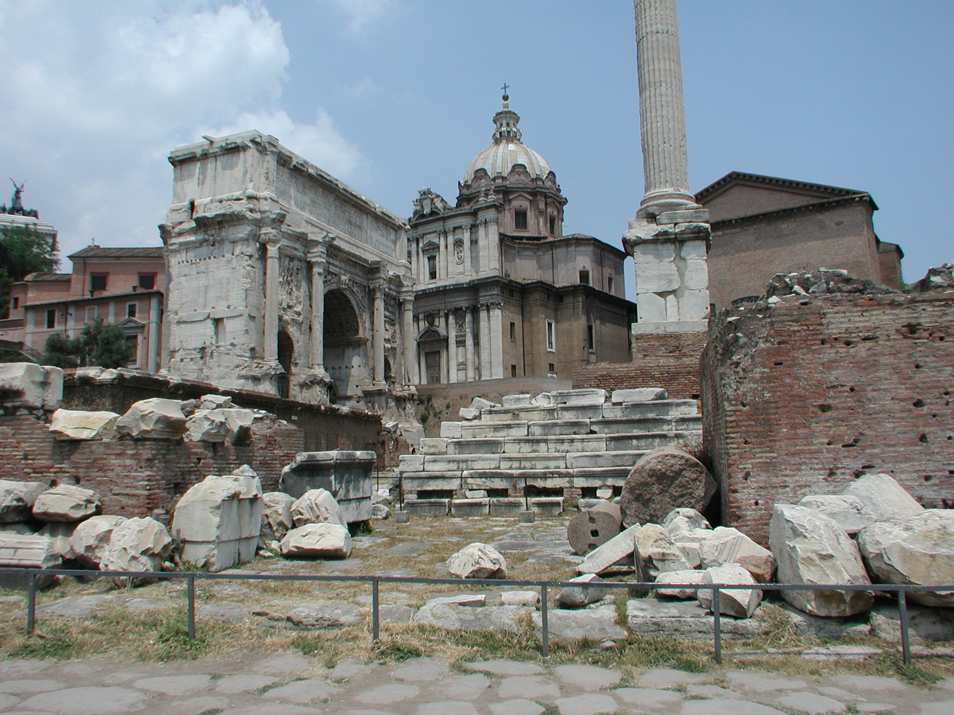
Notes:
The Roman Forum. The Roman Forum (Latin: Forum Romanum, Italian: Foro Romano) is a rectangular forum (plaza) surrounded by the ruins of several important ancient government buildings at the center of the city of Rome. Citizens of the ancient city referred to this space, originally a marketplace, as the Forum Magnum, or simply the Forum. It was for centuries the center of Roman public life: the site of triumphal processions and elections; the venue for public speeches, criminal trials, and gladiatorial matches; and the nucleus of commercial affairs. Here statues and monuments commemorated the city's great men. The teeming heart of ancient Rome, it has been called the most celebrated meeting place in the world, and in all history.

Slide 51
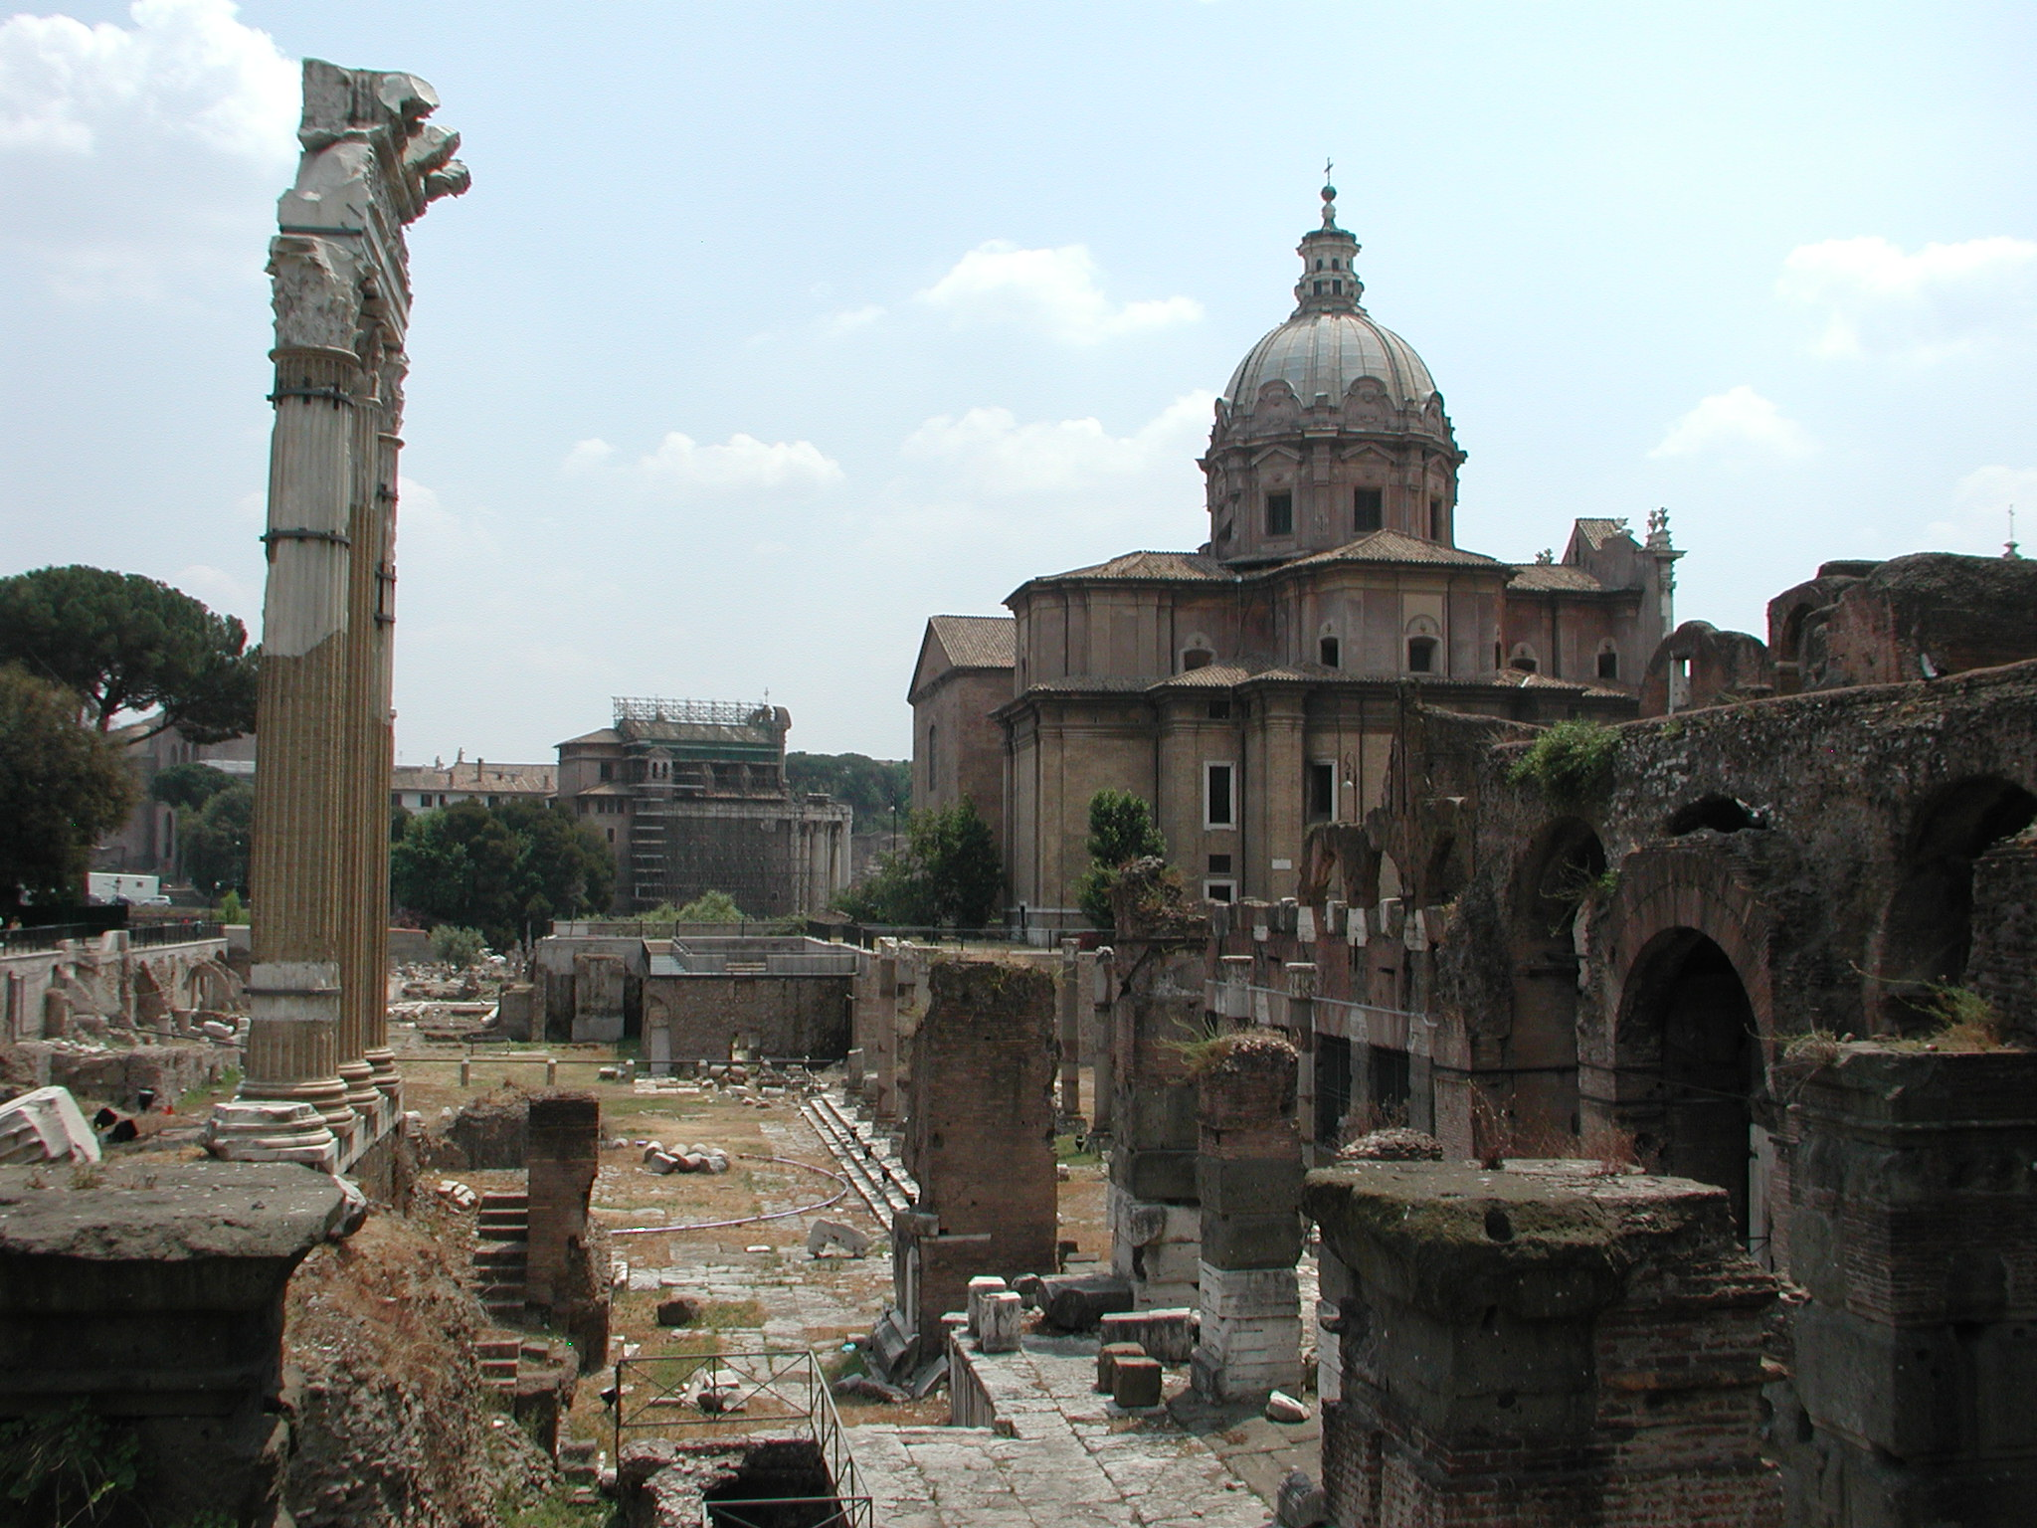
Notes:
The Roman Forum

Slide 52
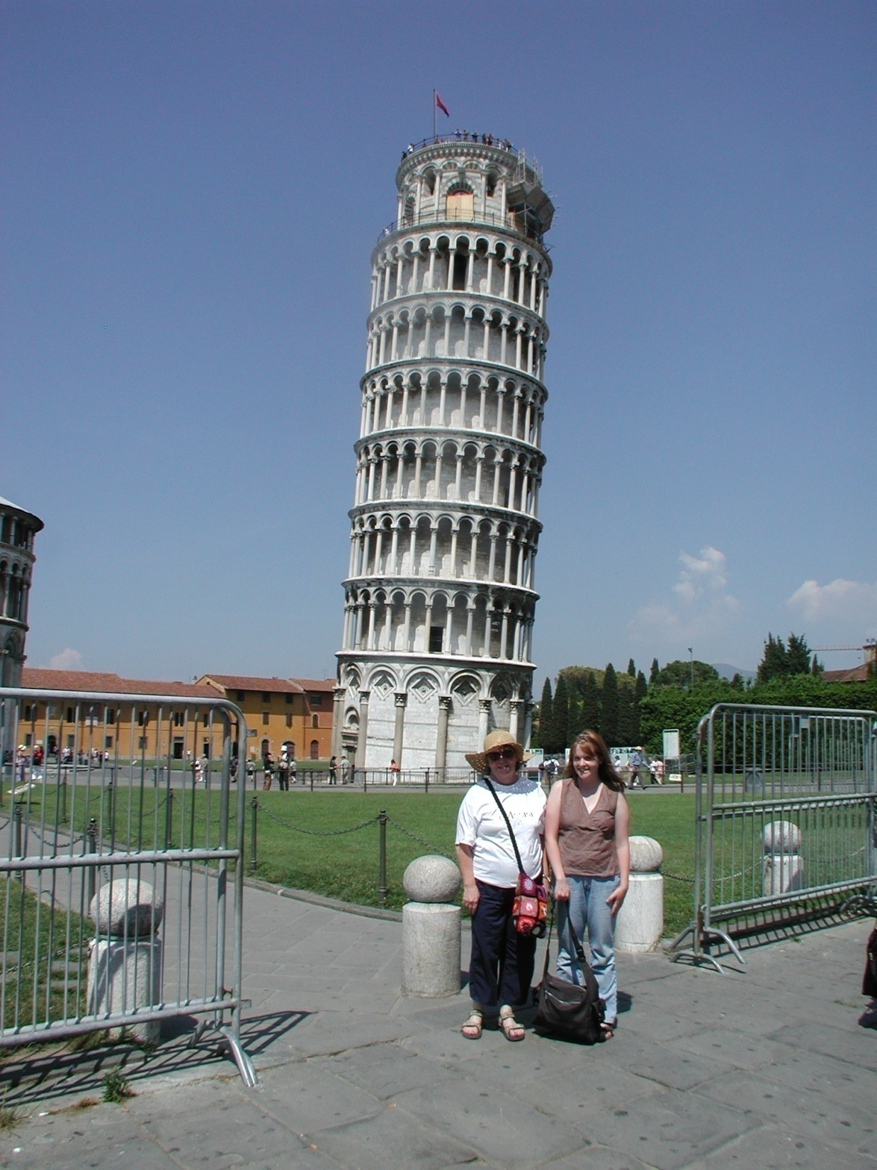
Notes:
Pisa. The Leaning Tower of Pisa (Italian: Torre pendente di Pisa) or simply the Tower of Pisa (Torre di Pisa [ˈtorre di ˈpiːza]) is the campanile, or freestanding bell tower, of the cathedral of the Italian city of Pisa, known worldwide for its unintended tilt. Construction of the tower occurred in three stages over 199 years. Work on the ground floor of the white marble campanile began on August 14, 1173 during a period of military success and prosperity. This ground floor is a blind arcade articulated by engaged columns with classical Corinthian capitals. The tower began to sink after construction had progressed to the second floor in 1178. This was due to a mere three-meter foundation, set in weak, unstable subsoil, a design that was flawed from the beginning.

Slide 53
Notes:
Pompeii. The Lupanar of Pompeii is the most famous brothel in the ruined Roman city of Pompeii. It is of particular interest for the erotic paintings on its walls. Lupanar is Latin for "brothel". The Pompeii lupanar is also known as Lupanare Grande. By the way, the people streaming in are my students.

Slide 54
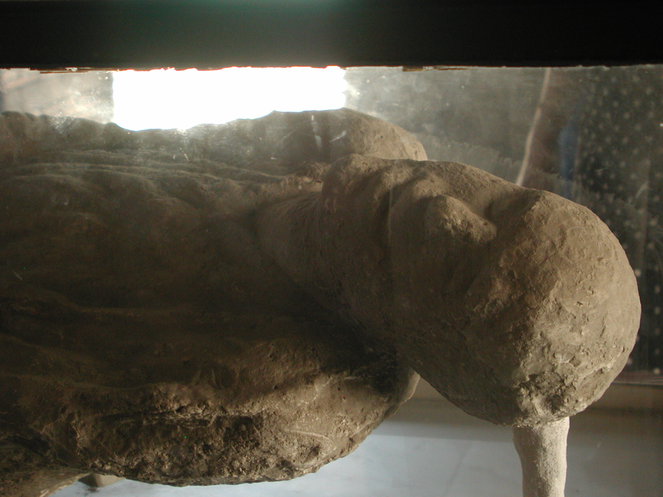
Notes:
Pompeii. In 79AD, Vesuvius erupted, destroying the cities of Herculaneum and Pompeii. In Herculaneum, the inhabitants were incinerated when a single pyroclastic surge hit the town. But in Pompeii, the eruption preserved as well as destroyed. Archaeologists have discovered approximately 1150 bodies since excavations of the city began. The unique set of circumstances created by the eruption has allowed archaeologists to bring one hundred of those bodies ‘back to life’ in the form of casts that preserve the body at the moment of death.

Slide 55
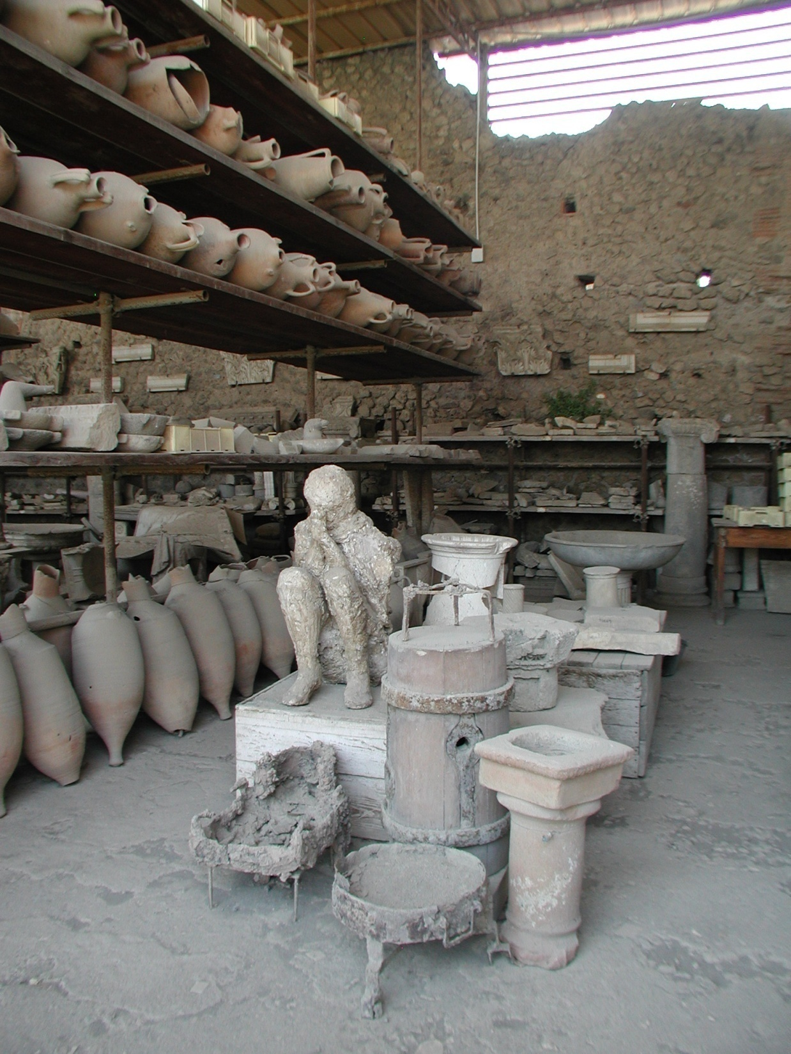
Notes:
Pompeii

Slide 56
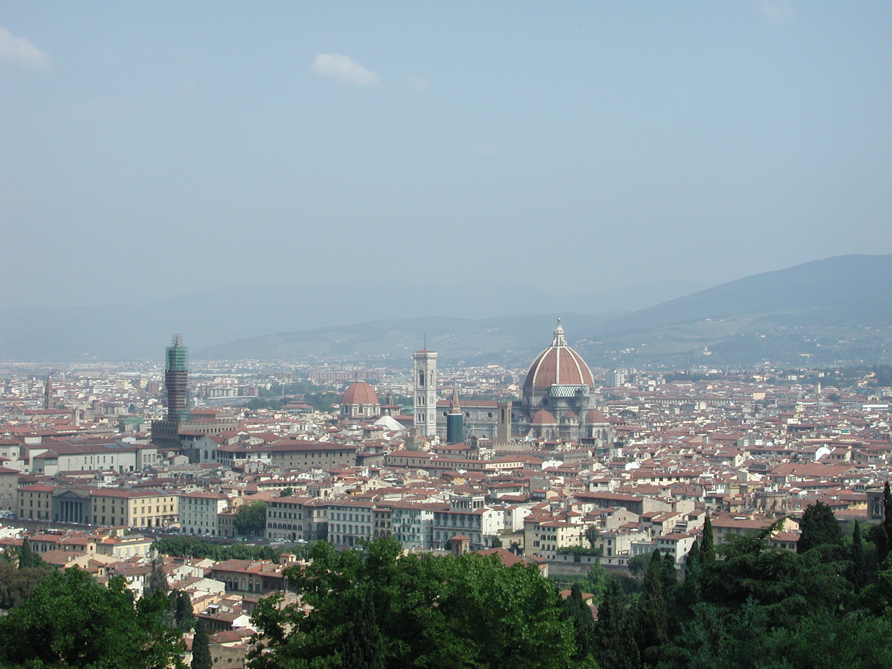
Notes:
Florence Italy, with Duomo center right, and Palacio Vecchio tower to left. The Cattedrale di Santa Maria del Fiore (Italian pronunciation: [katteˈdraːle di ˈsanta maˈriːa del ˈfjoːre]; in English "Cathedral of Saint Mary of the Flowers") is the main church of Florence, Italy. Il Duomo di Firenze, as it is ordinarily called, was begun in 1296 in the Gothic style with the design of Arnolfo di Cambio and completed structurally in 1436 with the dome engineered by Filippo Brunelleschi. It remains the largest brick dome ever constructed.

Slide 57
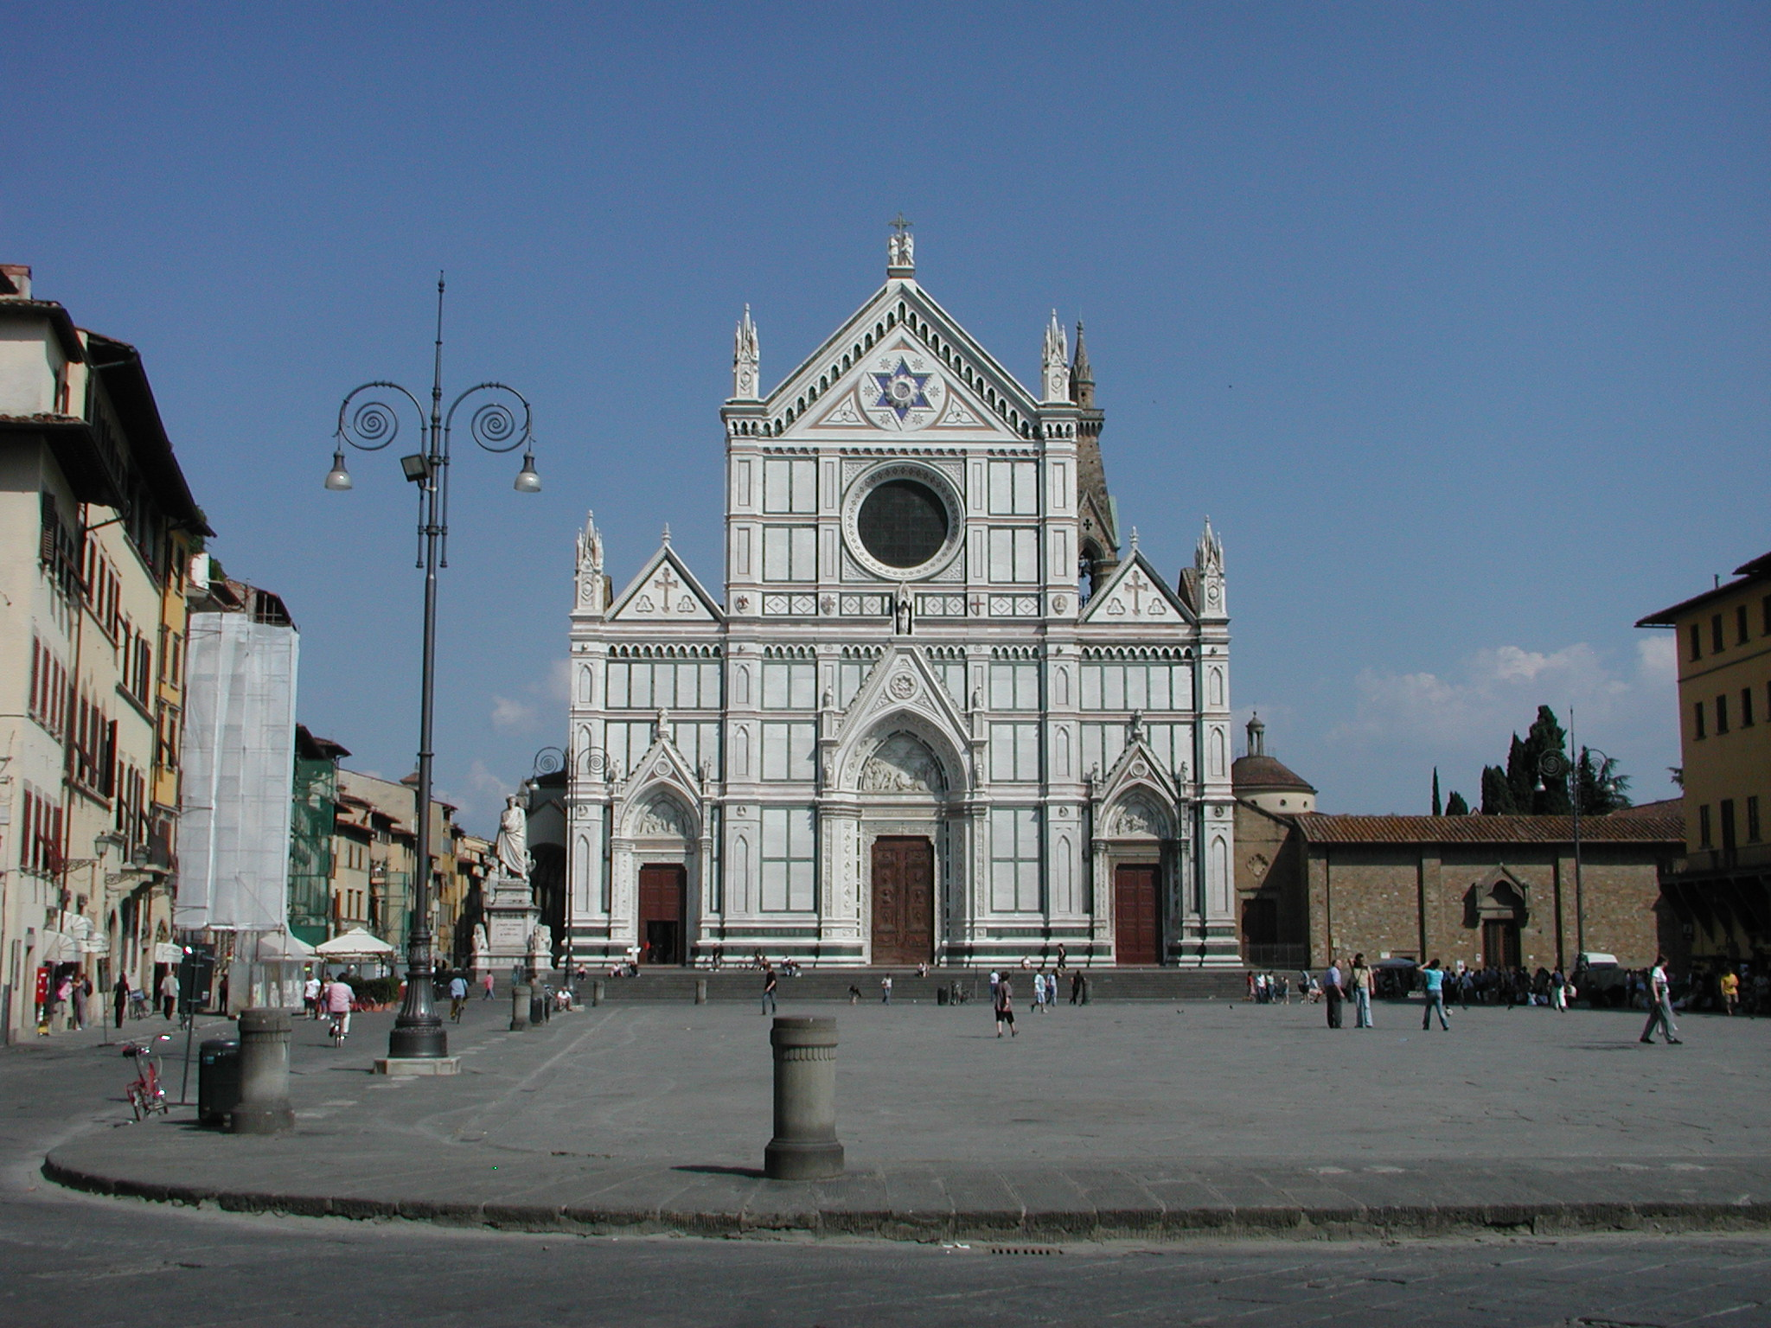
Notes:
Florence and Santa Croce, burial site of Dante (though the body is actually in Ravenna), Galileo, Michelangelo, Enrico Fermi, Marconi, Machiavelli.

Slide 58
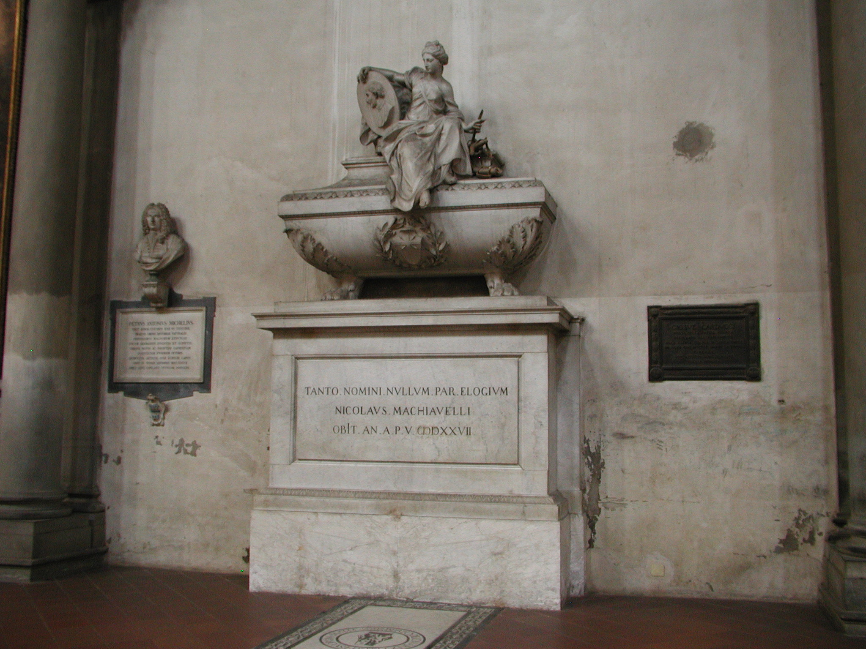
Notes:
Machiavelli’s tomb in Santa Croce

Slide 59
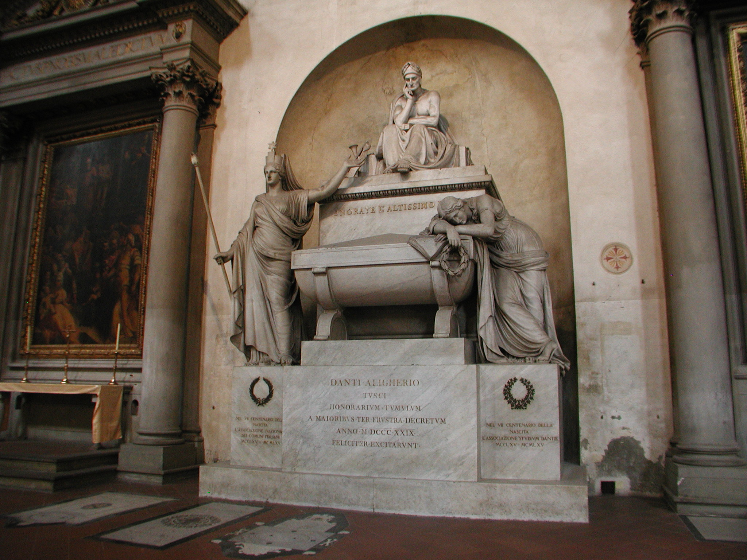
Notes:
A memorial in Santa Croce, but actually buried in Ravenna. He was exiled from Florence for political reasons and spend the last years of his life in Ravenna. Ravenna has refused to send his remains back to Florence.

Slide 60
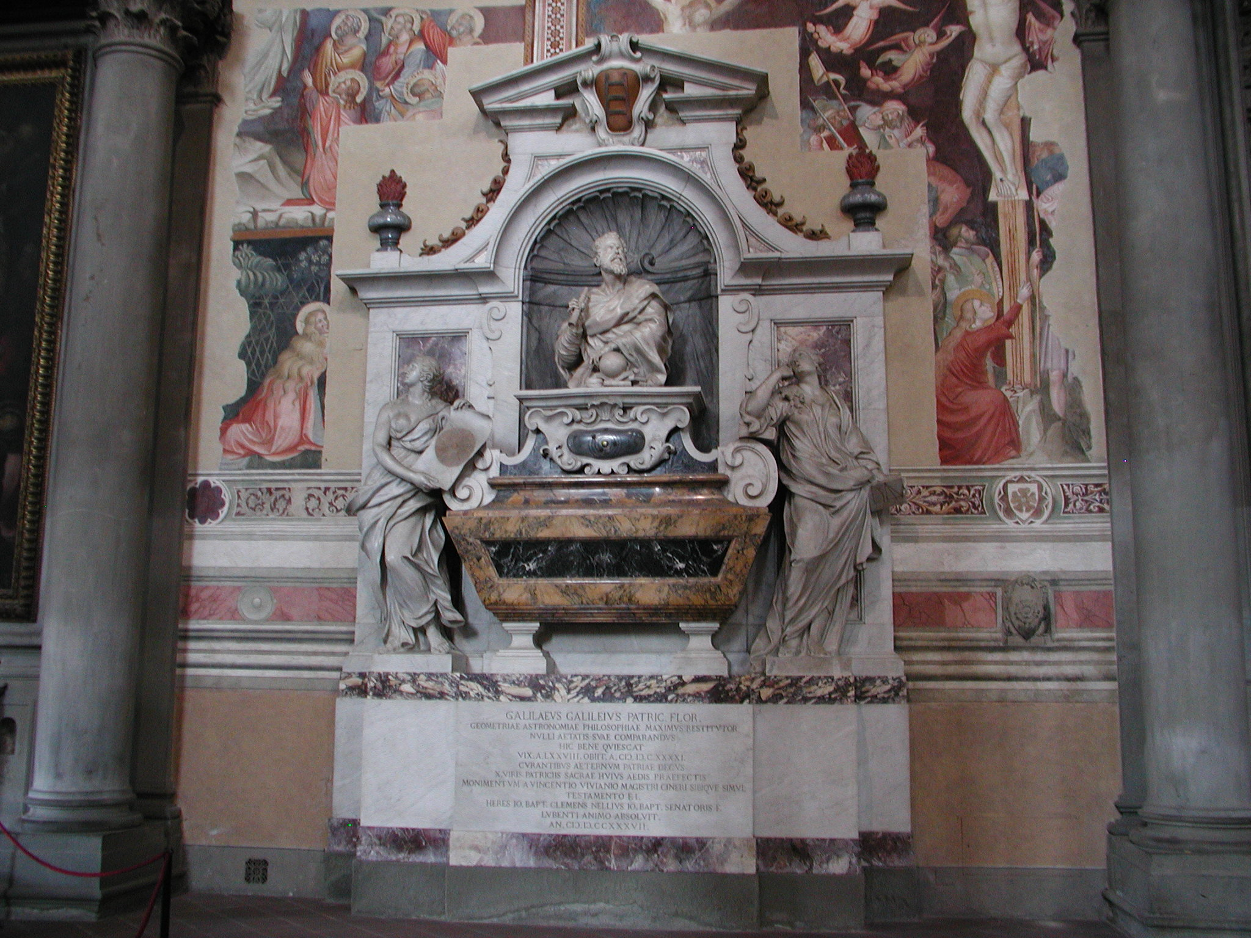
Notes:
Galileo’s tomb in Santa Croce

Slide 61
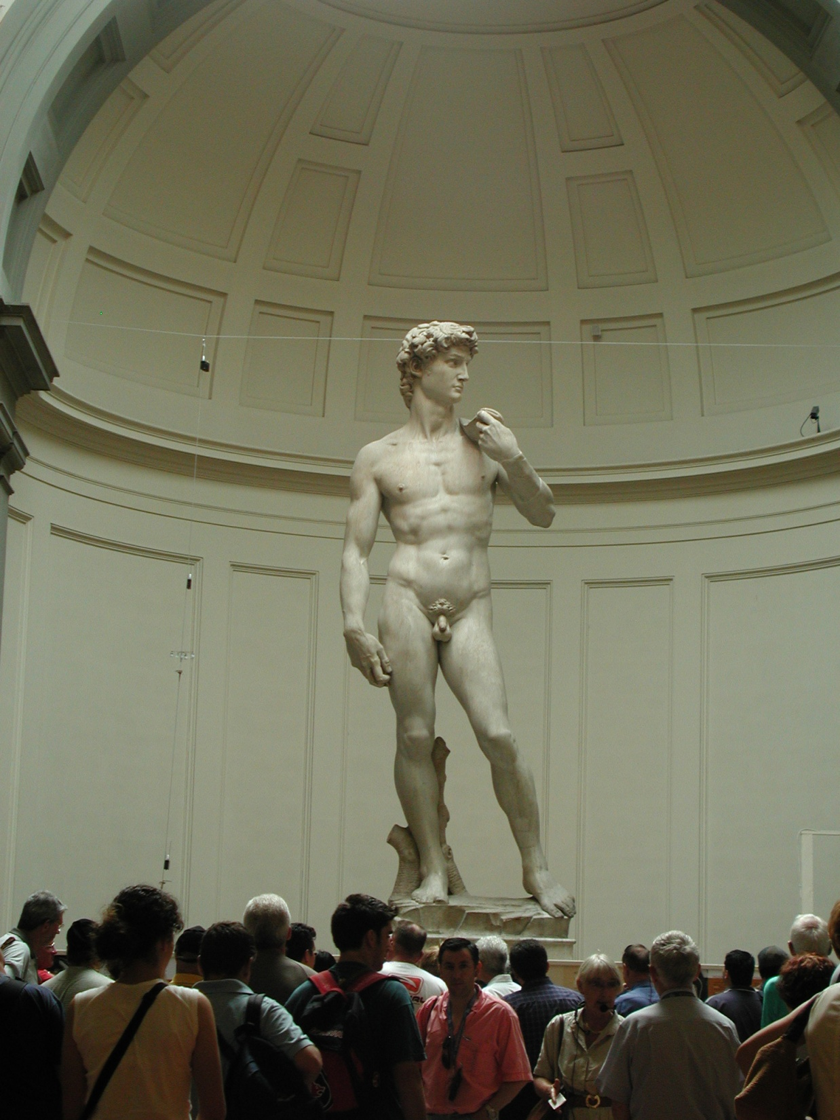
Notes:
The David, by Michelangelo, in Accademia di Belle Arti di Firenze.

Slide 62
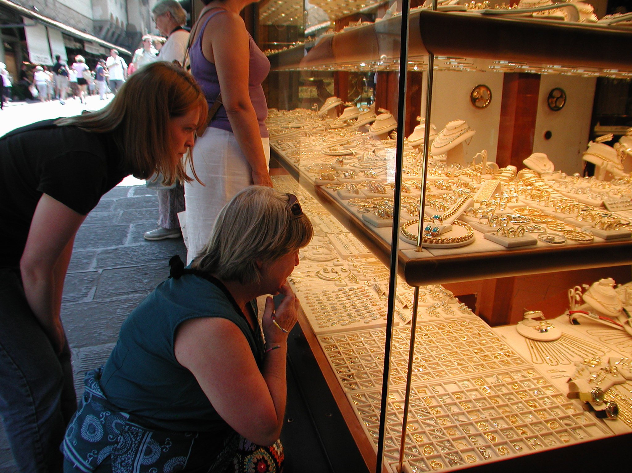
Notes:
Ponte Vecchio in Florence, Italy and two women engaging in economic behavior.

Slide 63
Notes:
Lima Peru Catacombs at San Francisco Cathedral

Slide 64
Notes:
Machu, Picchu, 15th Century Inca Site. Most archaeologists believe that Machu Picchu was built as an estate for the Inca emperor Pachacuti (1438–1472). Often mistakenly referred to as the "Lost City of the Incas" (a title more accurately applied to Vilcabamba), it is the most familiar icon of Inca civilization. The Incas built the estate around 1450 but abandoned it a century later at the time of the Spanish Conquest. Although known locally, it was not known to the Spanish during the colonial period and remained unknown to the outside world until American historian Hiram Bingham brought it to international attention in 1911.

Slide 65
Notes:
Machu, Picchu, 15th Century Inca Site

Slide 66
Notes:
Ollantaytambo. Ollantaytambo was the royal estate of Emperor Pachacuti who conquered the region, built the town and a ceremonial center. At the time of the Spanish conquest of Peru it served as a stronghold for Manco Inca Yupanqui, leader of the Inca resistance.

Slide 67
Notes:
Modern Cusco, Peru at Corpus Christi Festival

Slide 68
Notes:
Cusco Market

Slide 69
Notes:
Peruvian Market Near Ollantaytambo

Slide 70
Notes:
Corpus Christi in Cusco

Slide 71
Notes:
Corpus Christi in Cusco

Slide 72
Notes:
Chichen Itza, Yucutan Mexico, a Mayan temple and city from 900 to 1200 AD. Chichen Itza was one of the largest Maya cities and it was likely to have been one of the mythical great cities, or Tollans, referred to in later Mesoamerican literature. The city may have had the most diverse population in the Maya world, a factor that could have contributed to the variety of architectural styles at the site.

Slide 73
Notes:
Ball Court at Chichen Itza where deadly games occurred. Captives were often shown in Maya art, and it is assumed that these captives were sacrificed after losing a rigged ritual ballgame. The ballcourt at Chichen Itza shows the sacrifice of practiced ballplayers, perhaps the captain of a team. Decapitation is particularly associated with the ballgame—severed heads are featured in much Late Classic ballgame art and appear repeatedly in the Popol Vuh. There has even been speculation that the heads and skulls were used as balls.

Slide 74
Notes:
Corcovado, Rio de Janeiro Brazil with Christo Redentor, constructed between 1922 and 1931

Slide 75
Notes:
School in Ecuadorian Amazon jungle, January 2015

Slide 76
Notes:
8 family home in Amazon jungle near Napo river, a feed river for the Amazon. January 2015. The family had just gotten electricity when we visited.

Slide 77
Notes:
Open air market in Coca Ecuador

Slide 78
Notes:
Coca, Ecuador, also called San Francisco de Orellana. Remember Indiana Jones and the Kingdom of the Lost Skull and Orellana.

Slide 79
Notes:
Soweto, South Africa near Johannesberg

Slide 80
Notes:
Living conditions in and around Soweto.

Slide 81
Notes:
Namibia: A village just across the border from Kasane, Botswana

Slide 82
Notes:
Top Left: Chobe Marina Lodge on Zambeze River. Top Right Royal Zambeze Lodge in Botswana. Bottom Right: Stanley and Livingstone Lodge at Victoria Falls in Zimbabwe. Bottom Left: Capetown The One and Only.

Slide 83
Notes:
Taj Mahal, a Muslim monument built by Shah Jahan starting in 1632 as a mausoleum for his favorite wife Mumtaz Mahal.

Slide 84
Notes:
Hindu civilization traces its roots to at least 3300 BC. Hinduism is the world’s third largest religion and is dominant in India where 80 percent of the 1.3 billion citizens follow Hindu practice. Here is worship in a Hindu temple in Khajuraho, India.

Slide 85
Notes:
Hindus believe in an endless cycle of birth, life, death, and reincarnation. Death, cremation, and scattering ashes on the Ganges stops reincarnation and the deceased goes immediately to heaven.

Slide 86
The Great Mosque at Cordoba
Notes:
The Great Mosque of Cordoba. The site was originally a small temple of Christian Visigoth origin, the Catholic Basilica of Saint Vincent of Lérins. When Muslims conquered Spain in 711, the church was first divided into Muslim and Christian halves. This sharing arrangement of the site lasted until 784, when the Christian half was purchased by the Emir 'Abd al-Rahman I, who then proceeded to demolish the original structure and build the grand mosque of Córdoba on its ground. Córdoba returned to Christian rule in 1236 during the Reconquista, and the building was converted to a Roman Catholic church, culminating in the insertion of a Renaissance cathedral nave in the 16th century.

Slide 87
Notes:
The Alhambra is a palace and fortress complex located in Granada, Andalusia, Spain. It was originally constructed as a small fortress in AD 889 on the remains of Roman fortifications and then largely ignored until its ruins were renovated and rebuilt in the mid-13th century by the Moorish emir Mohammed ben Al-Ahmar of the Emirate of Granada, who built its current palace and walls. It was converted into a royal palace in 1333 by Yusuf I, Sultan of Granada. After the conclusion of the Christian Reconquista in 1492, the site became the Royal Court of Ferdinand and Isabella (where Christopher Columbus received royal endorsement for his expedition) and the palaces were partially altered to Renaissance tastes.

Slide 88
Notes:
The Plaza de España ("Spain Square", in English) is a plaza located in the Parque de María Luisa (Maria Luisa Park), in Seville, Spain built in 1928 for the Ibero-American Exposition of 1929. It is a landmark example of the Renaissance Revival style in Spanish architecture. The Plaza de España has been used as a filming location, including scenes for the 1962 film Lawrence of Arabia. The building was used as a location in the Star Wars movie series Star Wars: Episode II – Attack of the Clones (2002) — in which it featured in exterior shots of the City of Theed on the Planet Naboo. It also featured in the 2012 film The Dictator.

Slide 89
Notes:
Christopher Columbus’s tomb in Seville, Spain

Slide 90
In America 100 miles is no distance; in Europe, and elsewhere in the world, 100 years is no time.

