Slide 1
Deficits and Debt

Slide 2
Causes
Deficits occur when government spends more than it receives in revenues. You have learned that revenues derive from a number of sources, including taxes, fees, and levies of various sorts.
Deficits occur when 1) revenues are too low or 2) spending is too high.
Low revenues can be due to 1) taxes are too low or 2) the economy is doing poorly resulting in weak revenue collections due to the form of taxation not being buoyant.
A balanced budget will occur when revenues and spending are equal. A balanced budget leads to no change in the debt.
New debt occurs when government runs a fiscal deficit. At the federal level this has been a regular occurrence since the American Revolution. Andrew Jackson was the only time in American history when there was no federal debt.

Slide 3
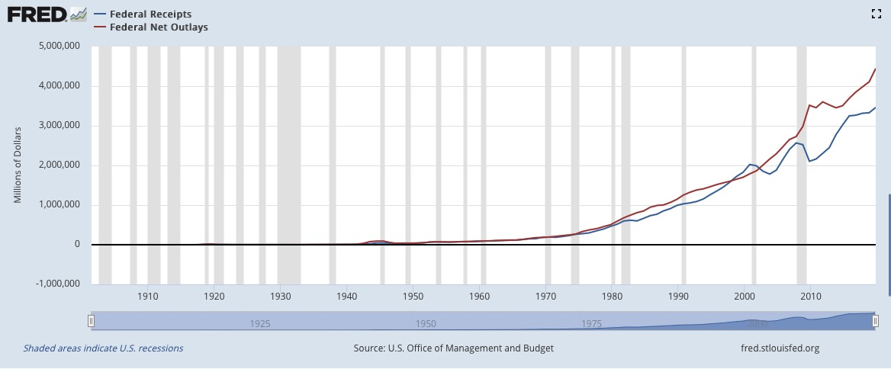
This FRED graph runs from 1901 to present. The blue line is federal spending and the red line is federal revenues. Note that the distance between the lines has increased 1) when there are large tax cuts and 2) when the economy was very weak or in recession such as from 2001-2002 or 2008-2010.

Slide 4
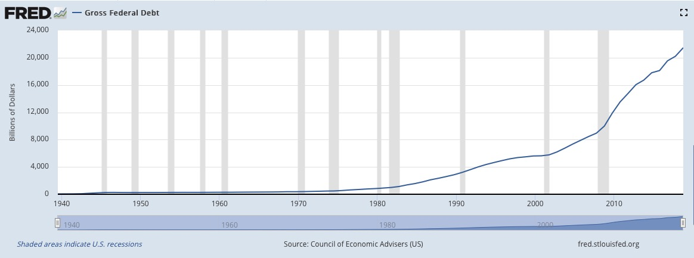
This FRED graph tracks the Federal debt over this same period. Looks like it is growing exponentially. However, there are periods of accelerated growth during the period from 1981-1990 and from 2001-2008 (associated with the Reagan and GW Bush tax cuts). However, it really took off after 2007 after the Great Recession.

Slide 5
However, debt only has meaning in the context of one’s income. For example, a person who makes $100k per year can more easily handle a debt of $20k than a person who only makes $20k per year.
On the next slide is the historical federal debt as a percentage of national income. Observe that it increased sharply during World War II but declined steadily through 1981. After 1981 the debt/GDP ratio started increasing again (Reagan/Bush I). During the 1990s the trend reversed (Clinton), but started increasing again in 2001 after the Bush tax cuts. The Great Recession sharply accelerated the debt/GDP ratio as the federal government “primed the pump” to keep us out of another Great Depression. However, notice that after the 2011 budget deal, in which taxes were increased on the highest income group and spending was curtailed, the growth became flat. In the last couple of years it has started to increase again.

Slide 6
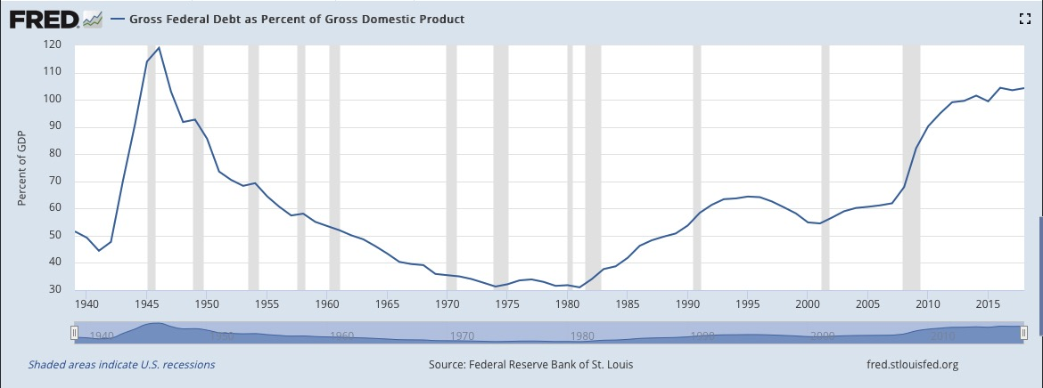

Slide 7
A more long run historical perspective.

Slide 9
Historical Overview
The United States has had public debt since its inception. Debts incurred during the American Revolutionary War and under the Articles of Confederation led to the first yearly reported value of $75,463,476.52 on January 1, 1791.
Over the following 45 years, the debt grew, briefly contracted to zero on January 8, 1835 under President Andrew Jackson but then quickly grew into the millions again.
The first dramatic growth spurt of the debt occurred because of the Civil War. The debt was just $65 million in 1860, but passed $1 billion in 1863 and had reached $2.7 billion following the war.
The debt slowly fluctuated for the rest of the century, finally growing steadily in the 1910s and early 1920s to roughly $22 billion as the country paid for involvement in World War I.

Slide 10
The buildup and involvement in World War II plus other social programs during the F.D. Roosevelt presidency in the 1930s and 40's caused a sixteen-fold increase in the debt from $16 billion in 1930 to $223 billion in 1945. Most of this was due to the mobilization for war.
After this period, the debt's growth closely matched the rate of inflation where it tripled in size from $293 billion in 1950 to around $2,789 billion in 1980.
Nominal debt in dollars quadrupled during the Reagan and first Bush presidencies from 1980 to 1992.
Growth in the debt slowed, and began declining near the end of the Clinton presidency in 2000.
During the administration of President George W. Bush, the debt increased again from $5.6 trillion in January 2001 to $10.7 trillion by December 2008, rising from 31.4% of GDP to 52.3% of GDP.

Slide 11
The debt continued increasing significantly due to the stimulus efforts for the Great Recession during President Obama's administration to 70.1% of GDP, its highest level since World War II.
In September 2019, debt held by the public was approximately $16.81 trillion or about 81.68% of GDP. Intragovernmental holdings stood at $5.91trillion, giving a combined total federal debt of $22.72 trillion. This total is 110% of GDP. See https://www.treasurydirect.gov/govt/reports/pd/mspd/2019/opds092019.pdf and https://fred.stlouisfed.org/series/GDPA

Slide 12
What is the Debt Held by the Public?
  The Debt Held by the Public is all federal debt held by individuals, corporations, state or local governments, Federal Reserve Banks, foreign governments, and other entities outside the United States Government less Federal Financing Bank securities. Types of securities held by the public include, but are not limited to, Treasury Bills, Notes, Bonds, TIPS, United States Savings Bonds, and State and Local Government Series securities.
What are Intragovernmental Holdings?
  Intragovernmental Holdings are Government Account Series securities held by Government trust funds, revolving funds, and special funds; and Federal Financing Bank securities. A small amount of marketable securities are held by government accounts.

Slide 13
The national debt can also be classified into marketable or non-marketable securities. As of September 2019, total marketable securities were $16.32 trillion while the non-marketable securities were $0.49 trillion.
Most of the marketable securities are Treasury notes, bills, and bonds held by investors and governments globally.
The non-marketable securities are mainly the “government account series” owed to certain government trust funds such as the Social Security Trust Fund, which represented $2.9 trillion in December 2018. See next slide for current state of Social Security

Slide 15
Who Owns the Debt?
The Congress has granted authority to the Treasury Department to fund the federal debt; more than 200 sales of federal securities by auction occur every year.

Slide 17
In June 2019, China owned $1.18 trillion of U.S. debt. It's the largest foreign holder of U.S. Treasury securities. Still, it holds only 5.6 percent of all the federal debt.
The second largest holder is Japan at $1.03 trillion. This amounts to about 4.9 percent of all the federal debt.
Both Japan and China own federal securities because they want to keep the value of the dollar higher than the value of their currencies. That helps keep their exports affordable for the United States, which helps their economies grow.
Despite China's occasional threats to sell its holdings, both countries are happy to be America's biggest foreign bankers.

Slide 19
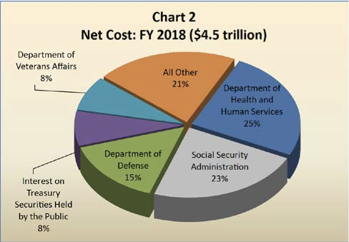
Who Owns Intra-Governmental Debt Holdings?

Slide 20
Go to this link to see comparison of Debt/GDP ratio across countries
http://worldpopulationreview.com/countries/countries-by-national-debt/
As of 2019, the United States was 13th in the world in debt as a percentage of national income.

Slide 21
The Debt Ceiling
The second Liberty Bond Act of 1917 established a statutory limit on the federal debt. In order to accrue more debt, Congress must increase the statutory debt limit.
Whether this law is constitutional or not is an open question. The Fourteenth Amendment states “The validity of the public debt of the United States, authorized by law, including debts incurred for payment of pensions and bounties for services in suppressing insurrection or rebellion, shall not be questioned.”
In recent years, Republican’s have tried to use the statutory limit to leverage policy advantages over the administration and Democrats. They even shut down the government in 1995 and again in 1995-1996.
In 2011, Republicans in Congress demanded deficit reduction as part of raising the debt ceiling. The resulting contention was resolved on 2 August 2011 by the Budget Control Act of 2011.

Slide 22
On 5 August 2011, S&P issued the first ever downgrade in the federal government's credit rating, citing their April warnings, the difficulty of bridging the parties and that the resulting agreement fell well short of the hoped-for comprehensive 'grand bargain'.
The 2011 credit downgrade and debt ceiling debacle contributed to the Dow Jones Industrial Average falling nearly 2,000 points in late July and August. Following the downgrade itself, the DJIA had one of its worst days in history and fell 635 points on August 8.
Controversy and fighting over the debt ceiling continued in 2013 and 2014.
These events were politically costly for Republicans, resulting in historically low public approval ratings for Congress.
No further shenanigans occurred as the 2014 mid-term elections approached, or before the 2016 presidential and congressional elections.

Slide 23
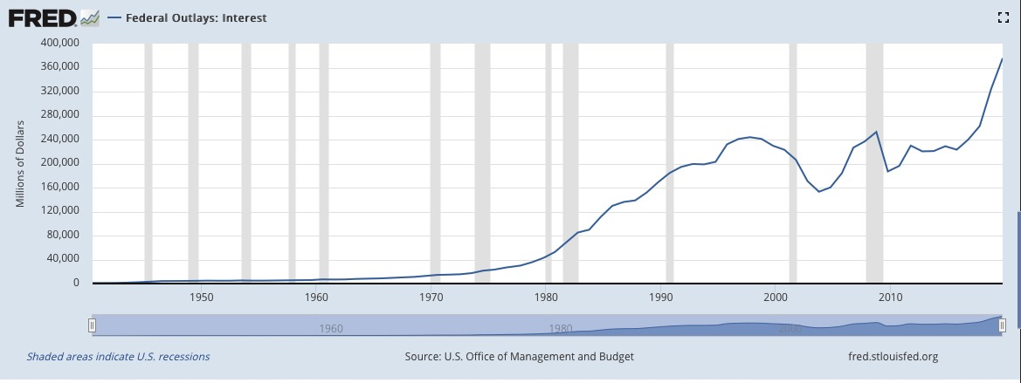
Further Considerations
Interest on the federal debt is money that could be spent to more productive purposes. It squeezes out other spending.
Here is a breakdown of how much we are spending to service the debt relative to income historically.

Slide 24
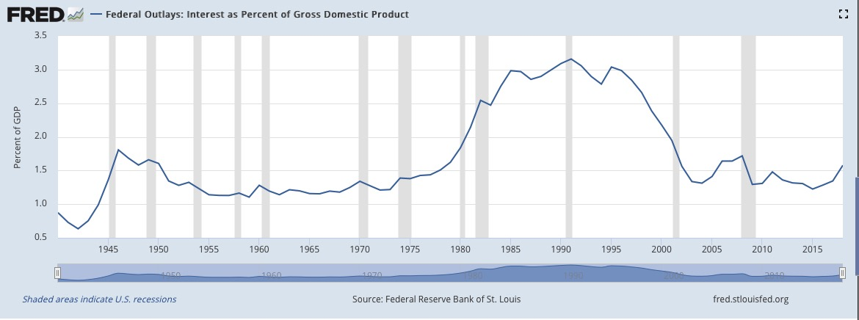
Here is the federal money spent on interest relative to national income.

Slide 25
Viewed as a percent of national income the interest seems pretty small.
Nevertheless, we are asking future generations to pay for consumption by the present generation. Is this moral? Is it responsible? Is it rational?
It may well be rational. Why? Future generations may be able to pay our debts more readily than the current generation can due to inflation and higher incomes.
There are some who have argued that running the nation into deep debt by the Reagan and George W. Bush administrations was a deliberate strategy to prevent social spending on greater equity. Grover Norquist, a conservative ideologue, has indeed advocated such a strategy.

Slide 26
Macroeconomics and the Federal Debt
Deficits and Debt have implications for the macro economy. Let’s return again to our income flow model.

Slide 27
Deficits and debt can be good or bad, depending on one’s perspective.
Deficit spending can be used to inject money into the income stream during times of economic decline. Tax cuts can also be used to reduce leakages from the income stream. Both can be considered economic stimulus, as recommended by Keynes.
However, deficits and debt also increase competition for money in the system. Government demands money when it incurs deficits. It gets this money by selling debt instruments such as bonds, Treasury Bill and Notes. This shifts the money demand curve upward, which results theoretically in higher interest rates. In other words, government competes with private actors for money, resulting in higher interest rates for everyone.

Slide 28
Consider the following graph in evaluating the implication.
In other words, as government competes for money, the quantity demanded of money increases. This, in turn, pushes up interest rates.

Slide 29
This is theoretically true, but there is a controversy in the literature as to how large the effect is.
There is also the supply side of these relations to consider. Deficits and debt also affect interest rates as the Treasury Department attempts to fund the federal deficit. Selling bonds and treasury notes to fund the deficit drains money from the system, exactly in the same way as the FED does through open market operations. Decreasing the money supply should also increase interest rates.
Government deficits also impact other elements of the macroeconomy. If we return to the income flow model again, we can see that there is also an effect of deficits (and potentially higher interest rates) on the saving (increases) and investment (reduces) part of this model, as well as on the Imports/Exports part (increased U.S. interest rates increase foreign participation in U.S. securities).

Slide 30
Higher interest rates should in theory increase savings, but reduce
investment, thereby reducing national income, an opposite effect from
what was intended by incurring the deficit in the first place.
Higher interest rates also should in theory affect capital flows into and
out of the country (Exports/Imports). Higher interest rates attract foreign
capital if they are higher than in the sending country. The resulting
increase in foreign capital increases the money supply, which in turn
should decrease interest rates. Hence, foreign capital inflows due to higher
interest rates are stimulative.

Slide 31
Understanding These Effects
All of this seems complex. However, the Keynesian IS/LM model of general equilibrium offers a way to understand these effects and the interconnection between fiscal and monetary policy.

Slide 32
See https://en.wikipedia.org/wiki/IS%E2%80%93LM_model
Note that the IS-LM model is just a mathematical representation of Keynes macroeconomic theory that connects fiscal and monetary policy.
i is the interest rate, while Y is output in the form of national income (what is in the income loop in our simplified model of the economy).
IS stands for Investment and Savings equilibrium.
Note that the IS curve slopes downward as national income increases.
The IS curve shows every possible point with respect to the interest rate i and Y (GDP) where investment is equal to savings.
For the IS curve, the independent variable is the interest rate and the dependent variable is the level of national income.
Any change in consumption, investment, or government taxation or spending will affect the location of the IS curve.

Slide 33
The LM curve stands for Liquidity Preference and Money Supply equilibrium.
The LM curve shows all combinations of interest rates and levels of national income for which the money market is in equilibrium.
For the LM, the independent variable is the level of national income and the dependent variable is the interest rate.
Anything that affects the demand for money and money supply can shift the LM curve. This includes transaction demands, willingness to invest, FED operations, willingness of commercial banks to lend money, and foreign investment.
The intersection of the IS/LM curves shows when there is simultaneous equilibrium in interest rates and national income.
The IS/LM framework allows us understand macroeconomic policy effects.

Slide 34
Consider first fiscal policy which only shifts IS. (The top 4 rows below.)

Slide 35
Consider now monetary policy, which only shifts LM (the last two rows below).

Slide 36
If the government reduces taxes or increases spending, then this shifts the IS curve up, resulting in increased national income, and increasing interest rates.
If the FED increases the money supply, then this shifts the LM curve down. This results in higher national income and lower interest rates.
However, there is a catch to all this. The extent to which either fiscal or monetary policy can affect interest rates and national income depends on the slopes of the two functions.

Slide 37
With a horizontal LM curve, a change in fiscal policy shifts the IS curve and we will see a movement along the LM curve. Because the LM curve is horizontal, we will see ONLY a change in GDP and not interest rates. This means that fiscal policy is super effective at changing GDP because there is no change in the interest rate causing crowding out. A change in monetary policy will shift the LM curve up or down, with an associated movement along the IS curve as normal.

Slide 38
With a vertical IS curve, a change in fiscal policy shifts the IS curve and we see a movement along the LM curve. A change in monetary policy shifts the LM curve and we see a movement along the IS curve which will ONLY change the interest rate, not real GDP. This means monetary policy is ineffective at increasing or decreasing real GDP.

Slide 39
Finally, with a vertical LM curve, a change in fiscal policy shifts the IS curve and we will see a movement along the LM curve. Because the LM curve is vertical, we will see ONLY a change in interest rates, no change in GDP. This means that fiscal policy is ineffective at changing GDP in this situation. A change in monetary policy will shift the LM curve, with an associated movement along the IS curve as normal.

Slide 40
Of course, these are the extreme cases. In practice, the slopes of the two functions will never be at the ideal; nor will they be at the vertical or horizontal extremes. They will be somewhere in between.
The steepness of the IS curve depends on the response of saving and investment to a change in interest rates and national income.
The steepness of the LM curve depends on the extent to which the demand for money changes in response to interest rates and national income.
The slopes of both curves are also a function of uncertainty about the economy. If economic actors are uncertain about the future, then there is little that either fiscal or monetary policy can do to change their behavior.
More intuitively, businesses and individuals are unlikely to demand money or invest when there is uncertainty that their investment will be rewarded. Under this circumstance, they are more likely to save and wait for less uncertain times.

