Slide 1
Macroeconomics: Fiscal Policy,
Taxation

Slide 2
Many of the New Deal reforms were intended to stabilize the U.S. economy through time. These include unemployment compensation, welfare, and a variety of other benefits that kick in during hard times.
The Employment Act of 1946 made the president responsible for the operation of the U.S. economy. The president was given a Council of Economic Advisors to assist, and was required to submit to Congress an Annual Economic Report. The president routinely also gives an an Annual Economic Report to Congress.
The political science research shows that Presidents are held accountable by the public for a bad economy; however, they may not be given full credit for a good economy. The relation is asymmetrical

Slide 3
Amendments in 1979 to the Employment Act (called the Humphrey-Hawkins Act) required the president to set full employment and inflation goals for achieving “full employment” Presidents have routinely ignored this requirement.
This Humphrey-Hawkins Act also made the U.S. Federal Reserve a co-party in stabilizing the economy. The Chairman of the Federal Reserve is required to issue a report to Congress twice a year on the state of the economy, and is also required to testify before relevant committees in both Houses periodically. See https://www.federalreserve.gov/monetarypolicy/mpr_default.htm
How well have the New Deal, Employment Act, and Humphrey-Hawkins reforms worked in stabilizing the U.S. economy?
The next two slides contain graphs of U.S. economic growth and inflation throughout American history, along with shaded areas marking periods of recession/depression.

Slide 6
Goals of Macroeconomic Policy
Promote economic growth.
Achieve full employment.
Stabilize prices.
Promote a positive balance of payments with foreign nations.
Promote structural change
Achieve equity and fairness.

Slide 7
Economic growth means that the Gross Domestic Product (GDP) (also called national income) is increasing. That is, the total goods and services produced by the U.S. economy are increasing.
Economic growth may result from
More of the productive capabilities of society are employed. (Labor)
The productive capabilities of society are increased. (Capital)
The productivity of existing resources is increased. (Technology)
Low economic growth means that economic gains for some must come at the expense of others, a condition that often leads to dissatisfaction and conflict. Presidents and political parties are held accountable for low economic growth.

Slide 8
Full employment means that all those who are able and willing to work are employed. Some level of unemployment is normal. People may be changing jobs, being retrained, or temporarily out of the labor market for other reasons. Normal unemployment is called structural unemployment. Full employment is generally considered to be about 3-6 percent of the labor force out of work. What is the current rate of unemployment in the U.S.?
Price stability means having neither excessive inflation (rapidly increasing prices) nor deflation (rapidly decreasing prices). Prices are typically measured through time using the consumer price index (CPI). The CPI is computed using an assortment of consumer goods, with prices indexed to a particular period. For example, the 1982-84 period is sometimes used. There are also producer price indices. Inflation and deflation have adverse impacts on various groups in the economy. Inflation hurts those on fixed or relatively inelastic incomes. It may help those with fixed mortgage interest rates if their incomes keep up with the interest rates.

Slide 9
Positive balance of payments means having a positive flow of money into the U.S. The balance of payments consists of
  the balance of trade with foreign nations,
  movements of capital into and out of the U.S. through investments, and
  movements of gold and reserve assets (e.g., through the monetary system.)
Actually, having a positive balance of payments is not always desirable. For example, U.S. investment in foreign nations may actually produce income for U.S. companies which is helpful to the U.S.
Structural change relates to affecting components of the economy to foster the previous four factors. For example, government policy on taxing and spending to promote investment may affect the infrastructure so as to promote economic growth and full employment. Japan provides an example of a nation that takes a leading role in promoting their business and industry.

Slide 10
Achieving equity and fairness implies that the tools of economic management may be employed to produce social values other than economic growth and full employment, based on political outcomes. For example, the federal income tax reduces income inequity across the system.

Slide 11
Where can one go to find out how the U.S. economy is performing?
There are a number of web sites, both governmental and private that make available U.S. macroeconomic data. These include the following:
https://stats.bls.gov
https://www.census.gov/economic-indicators/
https://www.bea.gov
https://fred.stlouisfed.org (a massive repository of data)

Slide 12
Tools for Managing the Economy
Fiscal policy- Fiscal policy is managing U.S. government spending and taxing to affect the macro-economy. Spending and taxing can also affect saving, investment, exports, and imports.
Fiscal policy is the primary tool of Keynesian economics, the dominant macroeconomic paradigm from 1933 until the 1970s.
During the 1970s, skepticism arose about the Keynesian approach due to the prevalence of “stagflation”, which violated the Phillips curve assumption. (unemployment and inflation are inversely related)
After the 1970s, the importance of monetary economics became clear. However, the approach recommended by Milton Friedman, its chief advocate failed and was abandoned in the early 1980s after an experiment in the U.S. and United Kingdom.

Slide 13
Now the dominant macroeconomic theory is called New Keynesianism, which also takes account of the importance of monetary policy. Fiscal policy is used to change aggregate demand and investment.
Monetary policy- Monetary policy is managing the overall supply of money in the U.S. that is available for use in markets. Monetary policy is extremely important in fighting inflation and promoting business investment. Some (monetarists) argue that it is also the most important tool for promoting economic growth and full employment.
Regulatory policy-Regulatory policy is attempting to control or influence the behavior of individuals in the economy to alter the operation of the marketplace.

Slide 14
Control of the tools of macroeconomic management is not in the hands of any single policy actor. Rather, economic policy making tends to be decentralized, lacking coordination.
The president has more control over fiscal and regulatory policy than any other actor. However, the president is not free to work his will on the system. Congress and the bureaucracy clearly constrain the president and he is dependent on them for implementation.
The Federal Reserve Board is the primary actor responsible for monetary policy. It tends to be independent by design as we will discuss later.

Slide 15
Fiscal Policy Theory
How does fiscal policy work? The next slide provides a very simplified explanation of how things work.
Note, however, that the simple diagram is deceiving, in that it also allows great complexity.

Slide 16
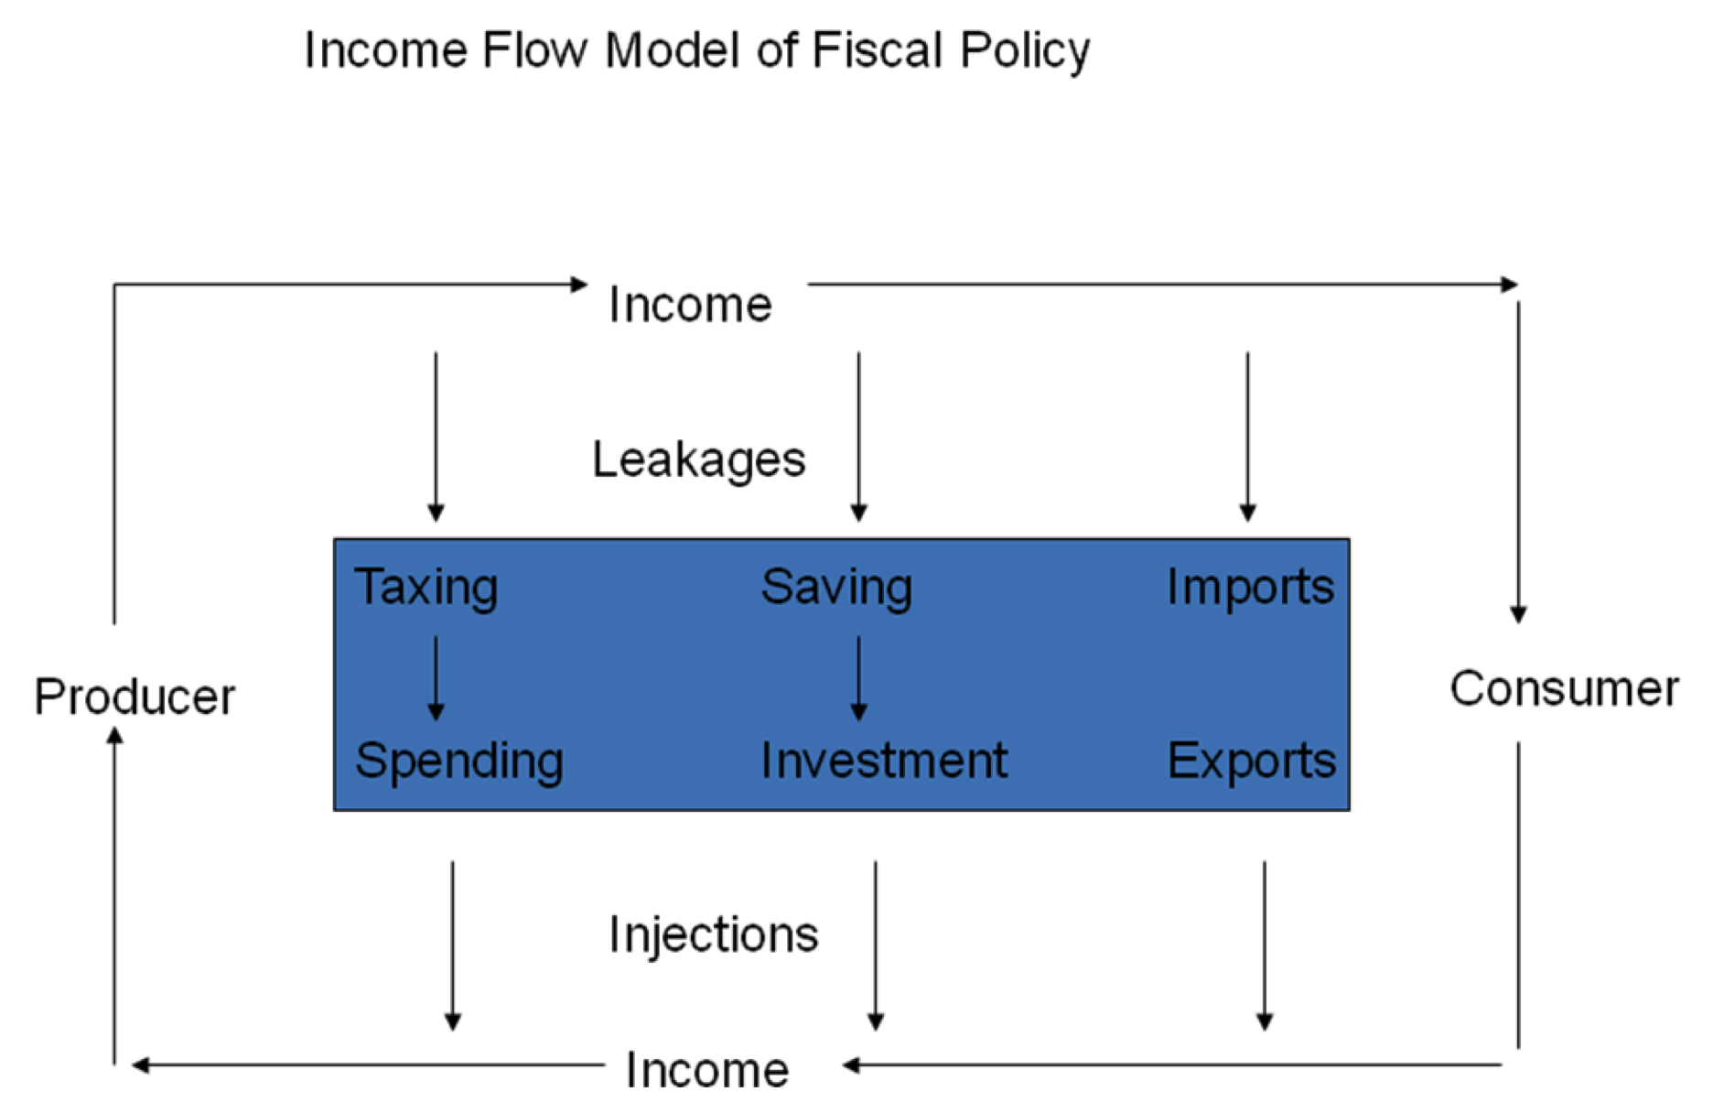

Slide 17
From the right side, consumers buy, which sends money back to producers for further production. In turn, producers pay consumers for their work, which sends money back for further consumption.
Leakages on the top arrows involve money taken out of the personal consumption stream for domestic commodities.
Injections on the bottom arrows involve money injected into the income stream from consumers and to producers by government, investors, and foreign consumption.
It is easy to see from this model how various macroeconomic factors (taxing, saving, importing, spending, investing, exporting) affect consumption and production. Leakages diminish domestic consumption and production; injections stimulate domestic consumption and production.

Slide 18
Another example, what is the effect of tariffs on the elements of our income flow model if we assume that there is equal retaliation from the country which is the subject of tariffs. It is easy to see that national income declines when there are tariffs, because both imports and exports decline.
Suppose the other country does not retaliate. It is easy to see that the leakage at imports declines, which means that domestic income will be higher. Of course, other countries will typically retaliate to protect their own interests.
Of course, none of this accounts for higher prices for imports due to tariffs, as well as domestic business’s ability to raise prices with less competition. The income flow model does not account for this phenomenon, which is outside the model.

Slide 19
A Mathematic Version of the Theory
Income is what is present on both loops. Define C as consumption, I as investment or savings (presumed to be equal), G as government spending or taxing (presumed no deficits), and Z as exports-imports, then
Income (GDP) = C + I + G + Z
Also, note some very powerful identities.
(Govt. Spending-Taxes) + (Investment-Savings) + (Exports - Imports)=0
What if we relax our assumptions of equal savings/investment, no government deficits, or no trade surplus/deficit? We can use this identity to flesh out the implications of each using the preceding identity.
For example, what is the effect of deficits on investment and savings, holding exports and imports constant and equal? Since this is an identity, (investment-savings) must decline.

Slide 20
Again, fiscal policy is involved with the activities of government that affect these relationships. It is policy affecting income, consumption, taxation, government spending, saving, investment, exports, and imports.

Slide 21
Tax Policy
Tax policy is formulated by Congress and the president acting in concert through the democratic process.
Tax policy includes policies relative to excises, income taxes, tariffs, etc.
Tax policy is a very important means whereby presidents and Congress affect the macroeconomy.
Again, tax policy generally has implications for saving, spending, and other incentives.
Tax policy, along with spending policy also affects savings, investment, imports, exports, interest rates and monetary policy.

Slide 22
Criteria for Evaluating Tax Policy
Economic Effects- Effect on the Economy at Large, as well as its components (C+I+Z).
Economic Neutrality- Should not benefit some at the expense of others.
Buoyancy- Tax system should maintain itself regardless of the economy.
Distributive consequences- Equity effects.

Slide 23
Distributional Consequences of Taxes
Taxes can be progressive, proportional, or regressive.
Progressive taxation means that those with higher incomes pay proportionately more of their income relative to those with low incomes. Examples: the income tax, estate taxes. Emphasizes “equal results”.
Regressive taxation means that those with higher incomes pay proportionately less of their incomes relative to those with low incomes. Examples: the sales tax, excise taxes, sin taxes. Deemphasizes “equal results”.
Proportional taxation means that the tax rate remains the same for all groups regardless of income. Also called a flat tax. Examples: Social Security tax, sales taxes, excise taxes. Emphasizes “equal treatment”.
Note that these groups may not be mutually exclusive. That is a proportional tax may also be regressive due to its effects on individual taxpayers.

Slide 24
Specific Taxes
Income Tax- tends to be progressive.
Consumption tax- tends to be regressive. This includes the sales tax, value added tax (Europe), tariffs, and excise taxes (alcohol and tobacco). Wealthy people do consume more. However, they consume proportionately less of their income than low and middle income groups.
Property tax- tends to be progressive. The wealthy tend to own more property than the poor or middle class.
User fees- tolls or airport use fees are examples- tends to be regressive since the bulk of the tax falls on the larger population, rather than being directed toward upper incomes.

Slide 25
Implications of Not Collecting Enough in Taxes
A failure to collect an adequate amount in taxes results in government deficits and debt. As a result, the government must issue bonds in order to finance the extra spending.
When the government issues bonds, someone must buy the bonds. This market competes with private investors for capital. This in turn can move interest rates up, which effectively becomes a tax on the rest of society.
So one way or the other we pay. Higher taxes to fund spending, or higher interest rates to fund deficits. Both can be costly.

Slide 26
Implications of Higher Interest Rates
For example, higher interest rates can be pretty taxing, resulting in hundreds of thousands of dollars of extra mortgage costs. They may also be costly for purchasing automobiles and using a credit card. Consider the following loan amortization calculator to demonstrate this.
http://www.amortization-calc.com

Slide 27
Dynamic Trends in Top U.S. Tax Rates

Slide 28
Implications for Income and Wealth Inequity

Slide 29
The graph shows that the U.S. tax system has grown increasingly regressive over time, with a sharp break around 1981, with more and more income going to the upper income groups.

Slide 30
Implications for Wealth Accumulation.

Slide 31
The Politics of Taxation
Taxation is highly visible and involves macropolitics. That is, changing taxes requires the participation of actors at the highest level of the system.
There are also partisan differences over the issue of taxation. Republicans generally prefer less expenditure and less taxation, implying smaller government. In terms of our hypothetical economy, this implies less leakage from the income stream and more individual choice over consumption.
Indeed, in recent times Republicans have been highly ideological and even fanatical about maintaining tax advantages for the wealthy. Grover Norquist, founder of Americans for Tax Reform, secures pledges from Republicans in Congress that they will oppose any and all tax increases. In the 113th Congress, over 95 percent of Republicans had signed his tax pledge. Republicans were even willing to shut down the government in 2010 over a small tax increase at the upper end.

Slide 32
In contrast, Democrats often prefer a higher level of government services, greater redistribution, both of which imply higher expenditure and more taxation.
In terms of our hypothetical economy, this implies more leakage from the income stream and less individual choice over consumption.
Normatively, which is better? Well it depends on your perspective about the role of government in the economy.
If one believes that government exists simply to protect private property, then the Republican perspective is normatively preferred. If one believes that government exists to promote the general welfare of the community, then the Democratic perspective is normatively better.
One thing that is certain is that the issue is more complex than simple “gut-level” fanatacism would reveal.

Slide 33
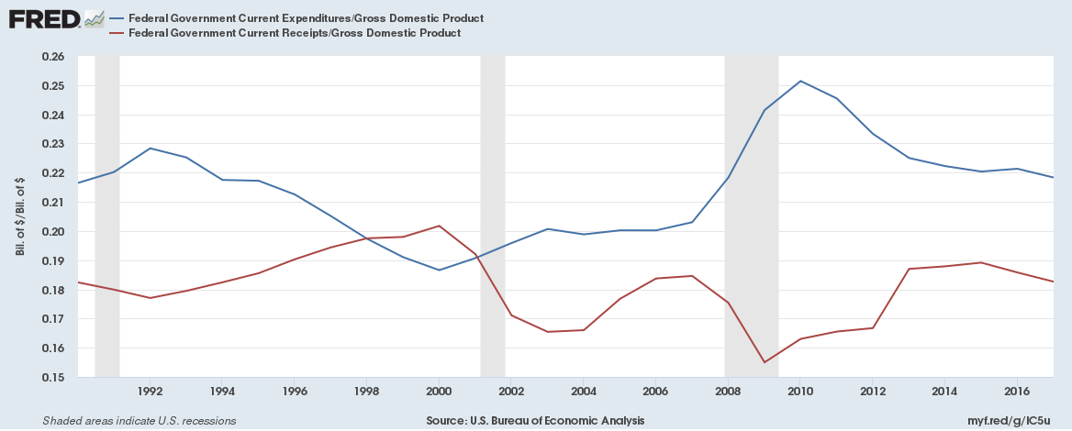
Consider the following concerning the prior two decades.

Slide 34
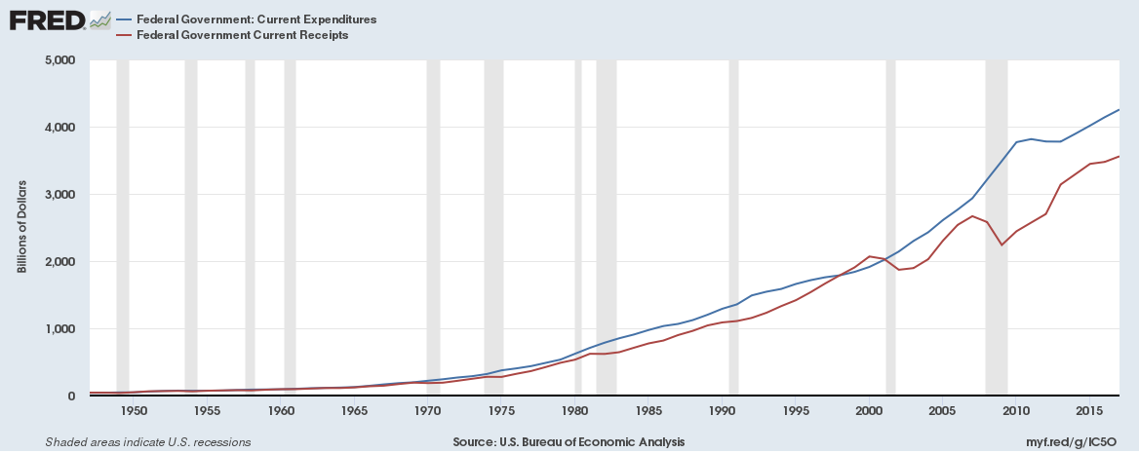
The Historical Dynamics of Taxing and Spending

Slide 35
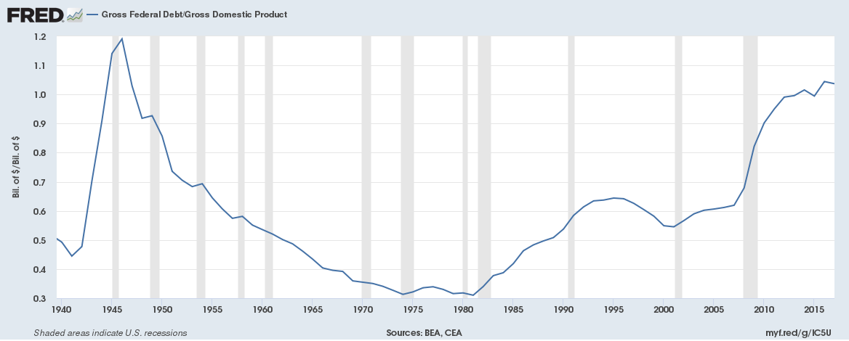
Effects of Revenue Shortfalls on the Federal Debt

Slide 36
A Dynamic Comparative Perspective on Taxes

Slide 37
Corporate Taxes
Out of the 34 countries in the OECD, America ranks first in the statutory tax rate with a 39.1 percent corporate tax rate, compared to an OECD average of 24.1 percent.
However, companies aren’t actually taxed at the statutory rate. Tax deductions -- on health insurance, pensions, and investment losses, depreciation, for example -- allow corporations to reduce the pool of taxable profits. So economists often look at what they call the effective tax rate, which experts say is just as valid a measurement of corporate tax rates as the statutory rate.
A 2011 study by the Congressional Research Service put the U.S. effective rate at 27.1 percent, slightly lower than the OECD average of 27.7 percent.

