Slide 1
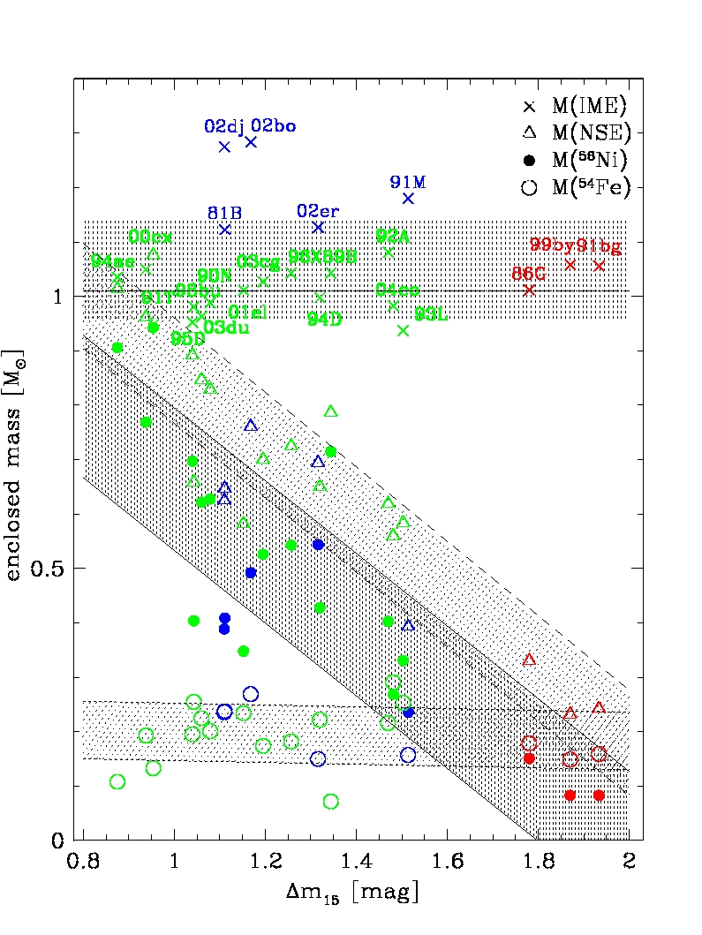
SNe Ia: beyond Zorro
Paolo A. Mazzali

Slide 2
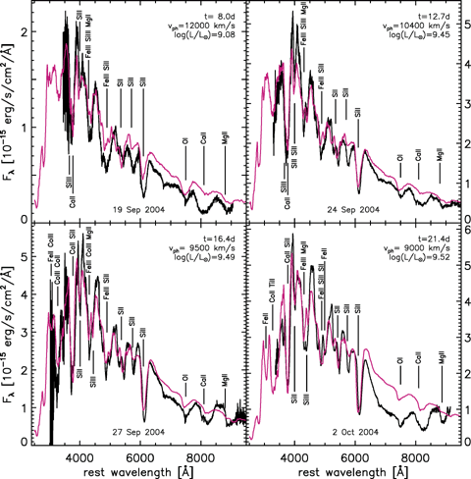
Abundance Stratification
Models of spectral sequence reveal composition layering
SN 2002bo: bright [∆m₁₅(B)=1.15] SN 2004eo: dim [∆m₁₅(B)=1.45]
(Stehle et al. 2005) (Mazzali et al. 2008)

Slide 3
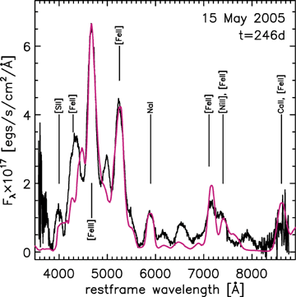
Late-time spectra
Full view of inner ejecta (⁵⁶Ni zone )
Monte Carlo LC code + NLTE nebular code (no radiative transfer)
→ Estimate masses (both ⁵⁶Ni and ejecta)
SN 2002bo SN 2004eo (narrower lines)

Slide 4
SN2011fe: one of the nearest recent SNe Ia
Discovered very early (PTF11kly)
Normal SN Ia
Δm₁₅(B)~1.1 mag
HST coverage (UV)
A weak delayed-detonation ?
PM et al 2014

Slide 5
How early was SN2011fe discovered?
Nugent et al. (2011) suggest first detection was 11 hrs after explosion based on t² fit of early light curve
This ignores photon diffusion time inside star
Early spectra can be used to test t(rise): N2011:17.6d
Result: “dark epoch” > 1 day, t(Max)~19 d
(Mazzali et al 2013, cf also Piro & Nakar 2013)

Slide 6
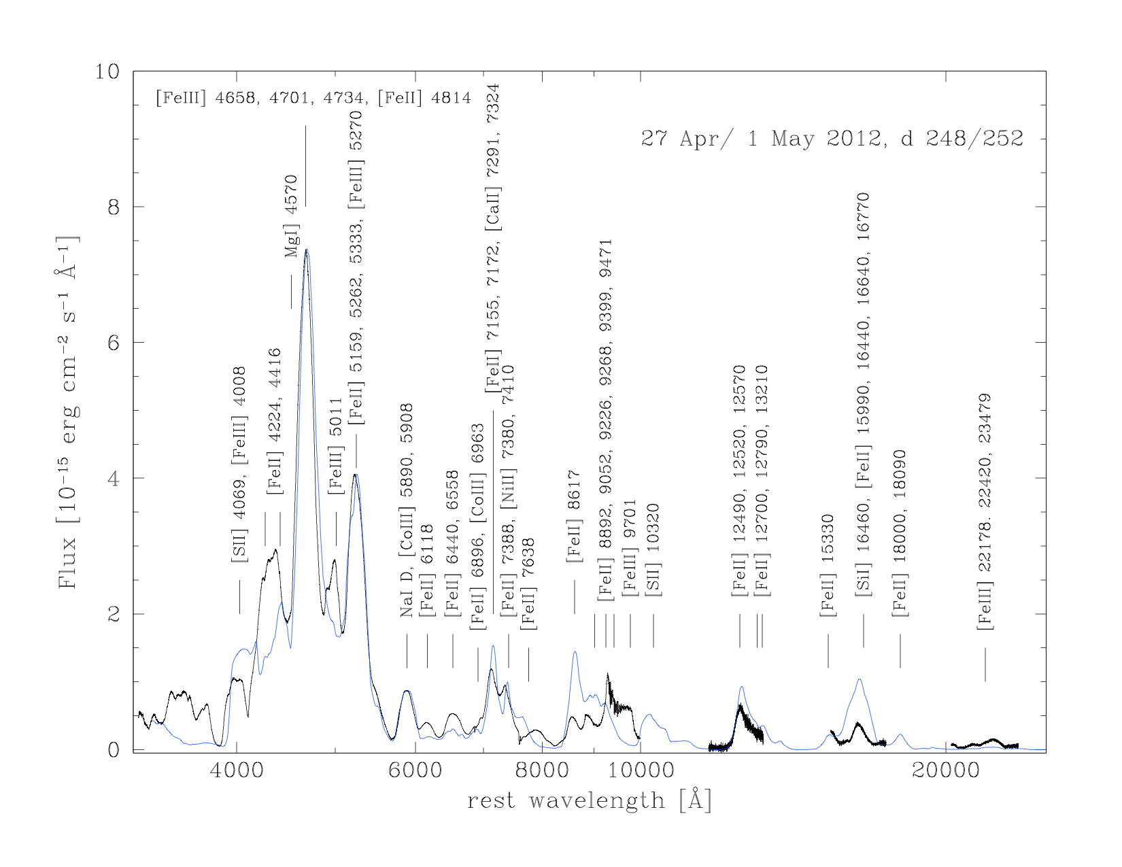
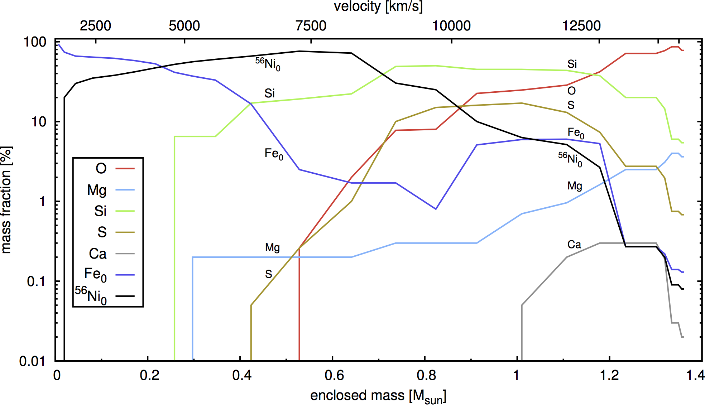
Abundance Tomography of SN2011fe
Add model of late-time spectra
Inner layers dominated by ⁵⁶Ni, stable Fe-gp
(PM et al 2015)

Slide 7
Test results with Light curve
Use density and abundance distribution to compute synthetic bolometric LC with Montecarlo method
Successful match confirms results:
Mass ~ M(Ch)
Ek ~ 1.25 10⁵¹ erg
M(⁵⁶Ni) ~ 0.47 M
M(NSE) ~ 0.70 M
M(IME) ~ 0.42 M
M(CO) ~ 0.24 M

Slide 8
Zorro: ordered distribution, Fe-group and IME compensate
Abundances
Sample behaviour
Stable Fe – ⁵⁶Ni – IME
Ratio affects Lum, LCW
Most Ia seem predictable
PM et al. 2007a PM et al. 2007b

Slide 9
The Role of Fe-group, IME on LC
⁵⁶Ni: light, opacity, KE
⁵⁴Fe, ⁵⁸Ni: opacity, KE
IME: KE, some opacity
CO (if any): little opacity

Slide 10
Using Zorro to reconstruct Phillips’ Rel’n
Use composition to compute LC parameters
Derive Phillips’ Relation

Slide 11
Using Zorro to reconstruct Phillips’ Rel’n
Use composition to compute LC parameters √
Derive Phillips Relation √

Slide 12
Problems with Single Degenerate scenario
Lack of progenitors
Most WDs come from low-mass stars, and have masses of 0.4-0.8 M
Where is the accreting H ?
Searches in both early and late-time spectra so far have failed
Where is the companion?
No signatures in light curves, no evidence of interaction

Slide 13
Other proposed scenarios
He accretion
He shell is prone to detonation, which can lead to the explosion of both M(Ch) and sub-M(Ch) WDs (“edge-lit”) (Livne / Arnett etc.)
WD collisions
An extreme version of mergers
Direct collision can be more common in dense environments such as globular clusters (Rosswog) or in triple systems (Katz/Kuschnir)
Both sub- and super-Ch (“anything”) possible

Slide 14
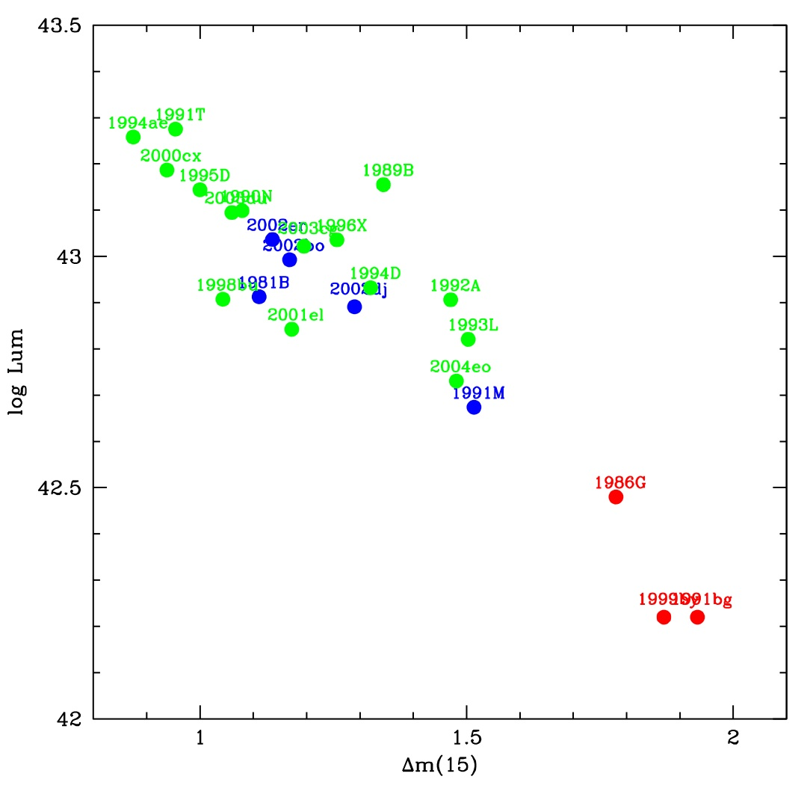
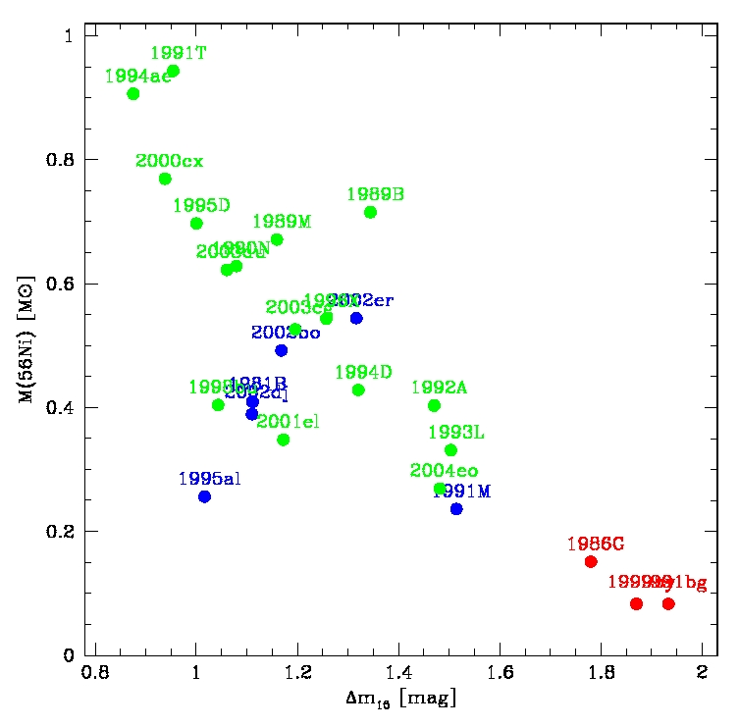
Can we find evidence of different channels?
2009dc
Is 91T M(Ch)?
1991T-like
2003hv
2009dc
2011iv
2007on
2005hk
1986G
2011iv
2002cx
1986G
2007on
2005hk
2003hv
1991bg-like
Too little 56Ni
SN 1991bg-like: mergers? SN 2003hv: a sub-Chandra event?
SNe 1986G, 1991T: still M(Ch)? SN 2002cx-like: pure deflagrations?
SN 2009dc “super-Ch”: ?? SNe 2007on, 2011iv: collisions?
Lancaster Univ.
14

Slide 15
SN 2002cx, 2005hk
Early: hot spectra (like 91T) but low velocities
Late: spectra DO NOT become nebular

Slide 16
SN 2002cx, 2005hk
Need low E/M (E~3 10⁵⁰ for M=M(Ch))
A pure deflagration gives good fits
M(56Ni) ~ 0.2 M
Maximum is reached late (Sahu et al. 2008)

Slide 17
SN 2002cx, 2005hk
Both Early-time spectra (low velocities, high ionization) and Late-time spectra (narrow emissions of allowed Fe transitions, no forbidden lines) are reproduced Sahu et al. 2008

Slide 18
SN2003hv: Δm₁₅(B)=1.6
The only well-observed SN in the “gap”
Early-time spectra normal, but
⁵⁶Ni from LC peak (0.4 M) ≠LC tail (0.2 M)
Late time spectra show weak IR flux (Leloudas et al. 2009)

Slide 19
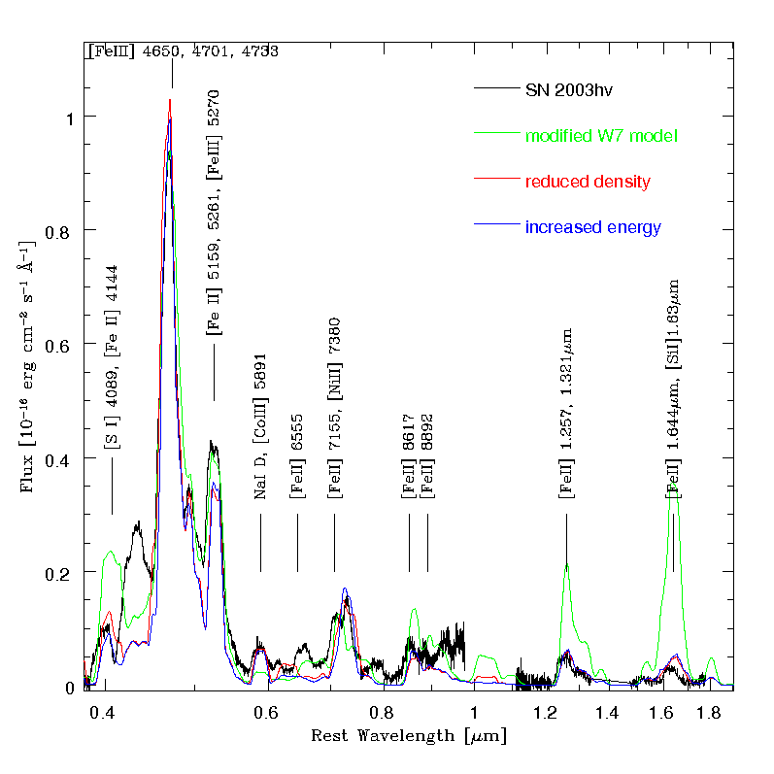
SN 2003hv: reduced inner density
Large FeIII/FeII ratio: high ionization: low density
Model with M ~ 1.2 M and reduced inner density reproduces nebular spectrum (PM et al. 2011)

Slide 20
SN2003hv: a sub-Chandra event?
Reduced density leads to an earlier LC peak (~12 days)
M(56Ni) = 0.2 M
Estimate of M(⁵⁶Ni) from LC peak inaccurate if t(Max) not known
Density structure similar to that of sub-Chandra explosions

Slide 21
What’s wrong with SN1991bg?
It made too little ⁵⁶Ni, even for a deflagration
Nebular spectra evolve significantly, inconsistent with any M(Ch) density profile
Inner nebula dominated by [FeIII] emission: high ionization
This implies low densities, again

Slide 22
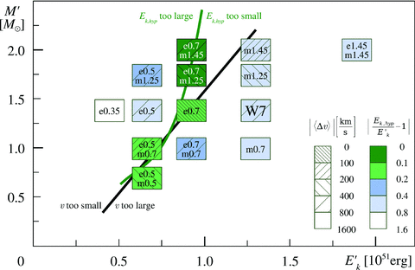
What’s wrong with SN1991bg?
Hachinger et al. 2009
Early-time spectra require low Ek, i.e. little M at high vel.
Abundances show unburned material, IME down to low vel.
Different models are possible, as long as E/M is small

Slide 23
How to solve SN 1991bg
A modified density, esp in the innermost zones, makes it possible to reproduce the spectral evolution
The ionization is higher mostly at very low velocities (PM et al. 2012)

Slide 24
Are SN1991bg-like SNe mergers?
Key to nebular behaviour is low density in innermost region
Only merger models seem to show that trend
Very early data could be useful

Slide 25
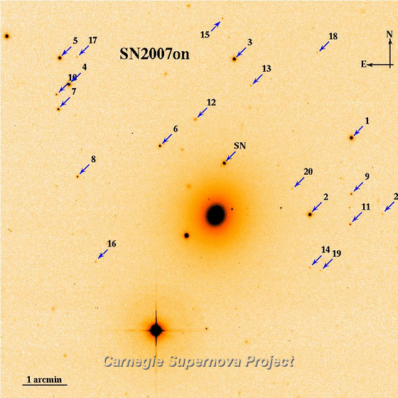
Do collisions exist? SNe 2007on and 2011iv
SN 2007on famous for its double-peaked NaID emission line
Both 07on and 11iv are “transitional SNe”, with rapidly evolving LC:
SN 2007on, Δm_{B}(15)=1.96
SN 2011iv, Δm_{B}(15)=1.73
They both fall off the Phillips relation: too luminous for their LC shape
Both located on outskirts of the same passive host, suggestive of old progenitors
Spectrum shows double peaks, but also other subtle features

Slide 26
Modelling 07on: not just geometry
Spectrum appears to be the sum of two separate, “narrow-line” spectra.
They have blue/red-shift, but adding two equal components does not work.
The two components are different:
Their ionization degree is not the same, indicating that one spectrum is hotter (i.e. it comes from a more highly ionised, less dense nebula:

Slide 27
Modelling 07on: 2-components
1) Low ionization:
M(⁵⁶Ni) = 0.08 M
v= 4000 km/s
M (inside v) = 0.11M
2) High ionization:
M(⁵⁶Ni) = 0.08 M
v = 4200 km/s
M (inside v) = 0.09 M
Relative shift: 5750 km/s
Consistent with two separate expanding nebulae, receding from one another at v >~ v_{exp}(1) + v_{exp}(2)
(depending on orientation)

Slide 28
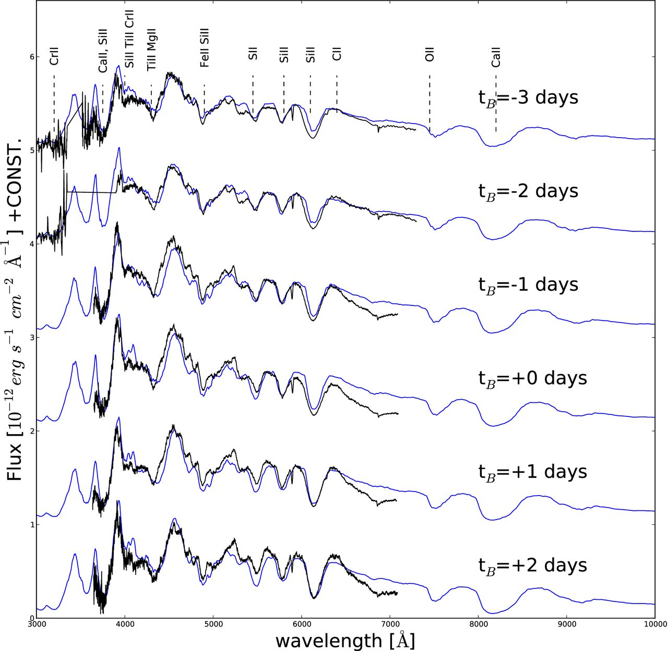
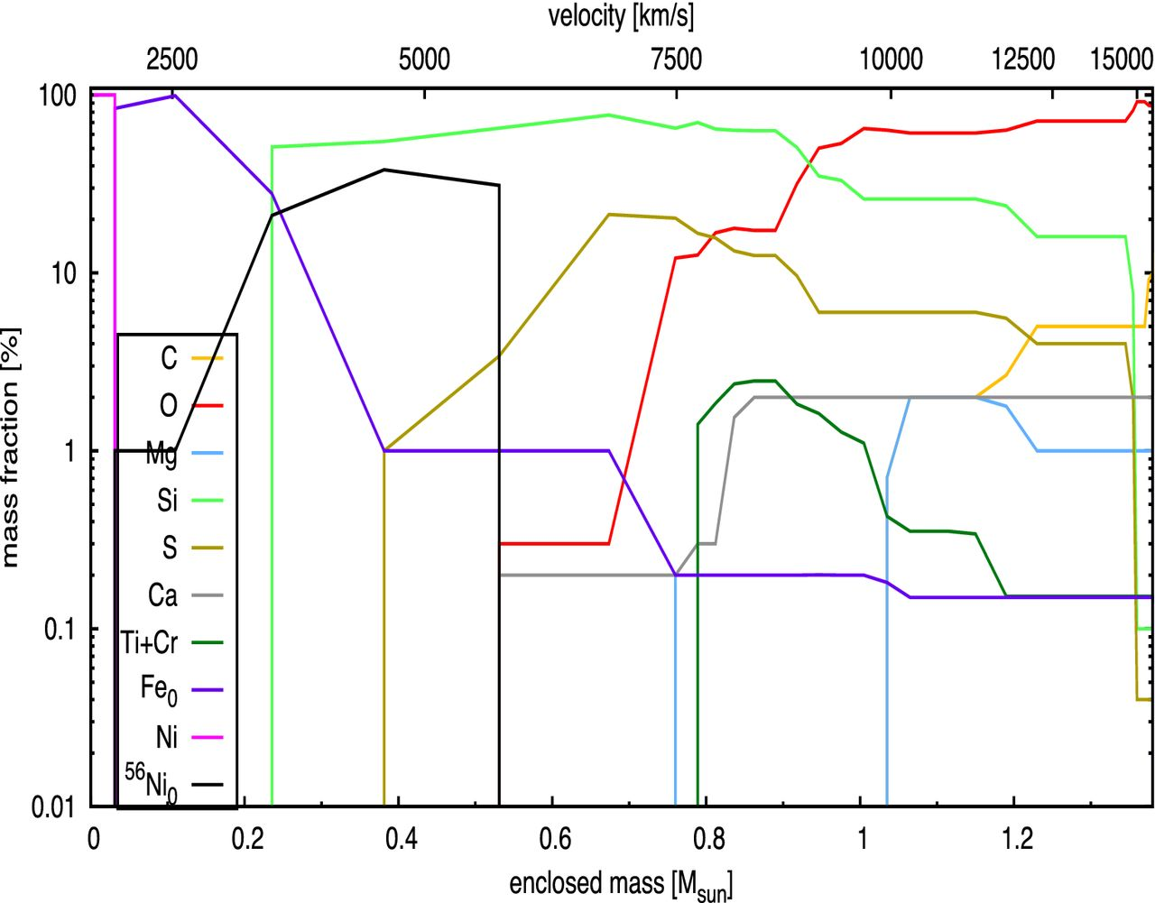
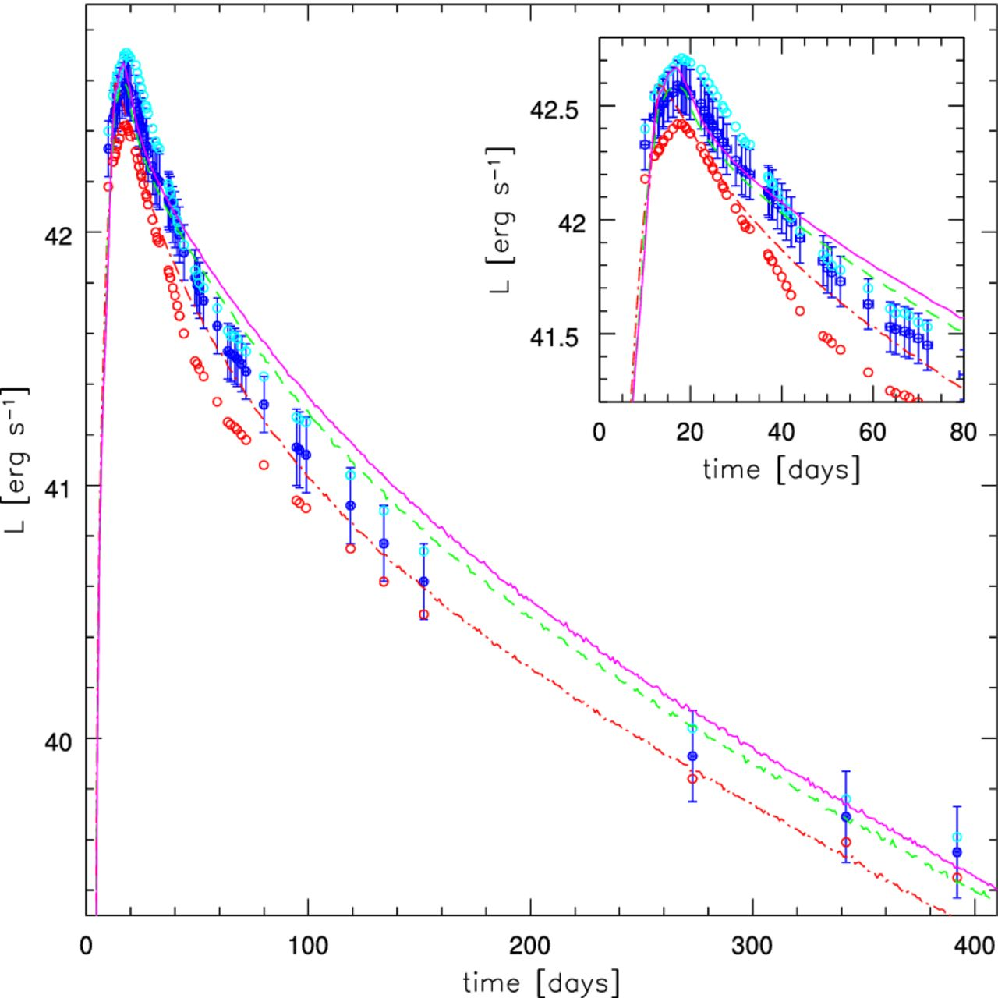
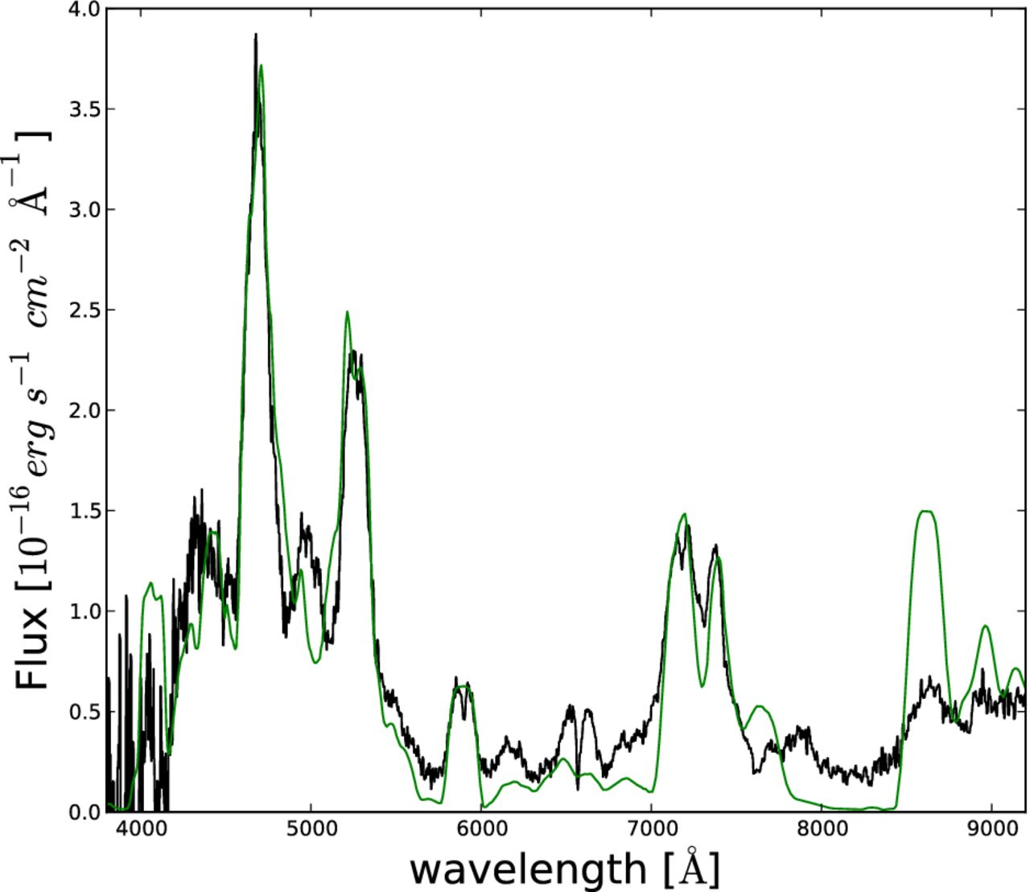
When does diversity begin? The faint end: the peculiar SN1986G
cool TiII lines, rapid LC evolution: Δm(B)₁₅=1.8
Solution: M(Ch) ejecta with low Ek (10⁵¹erg), ⁵⁶Ni (0.1)
Still an extension of normal SNe Ia (Ashall et al 2016)

Slide 29
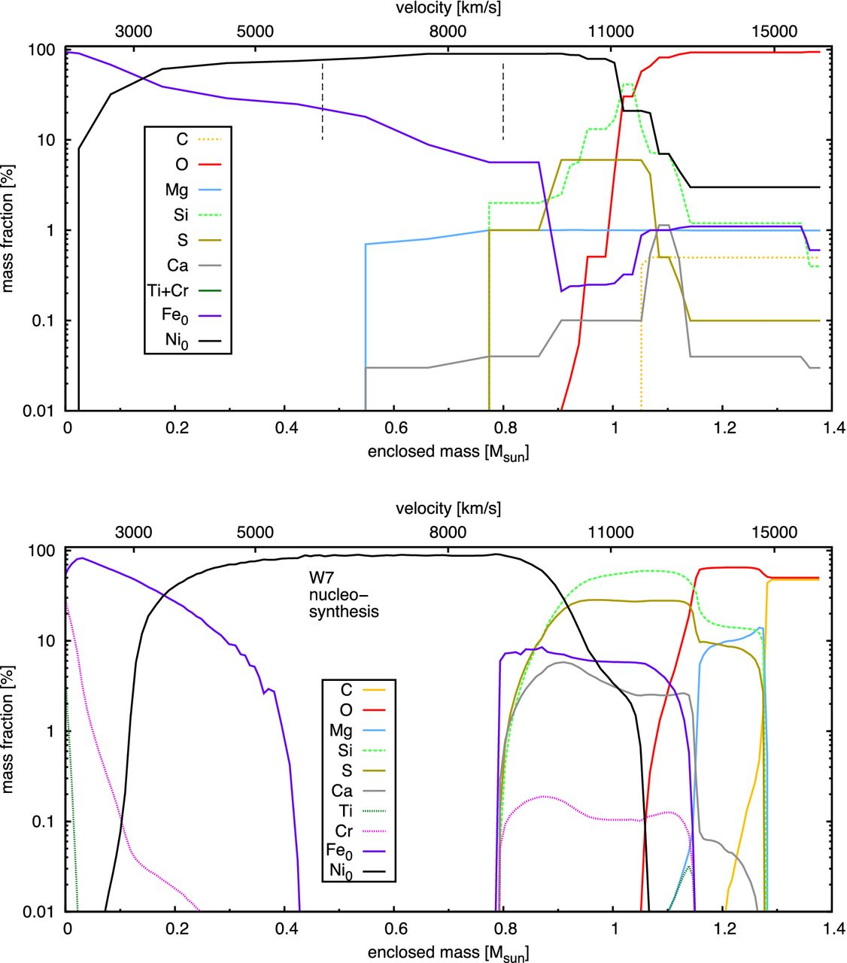
The bright end: the peculiar SN1991T: still M(Ch)
M(Ch) model with outer distribution of ⁵⁶Ni can explain evolution of spectra and LC. High M(⁵⁶Ni)≅0.78M leads to high T (FeIII)
Difficult to distinguish W7 from energetic Delayed Detonation
Other 91T-like SNe may be variations on theme (Sasdelli et al. 2014)

Slide 30
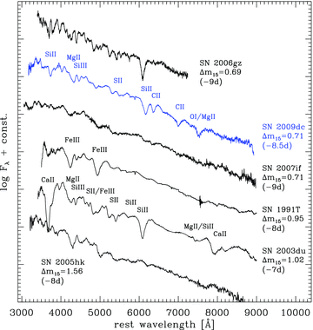
SN2009dc and other “super-Chandra” SNe Ia
Very bright peak [M(⁵⁶Ni) > M(Ch) ?]
Hot early spectra
Low line velocity (Taubenberger et al. 2010)

Slide 31
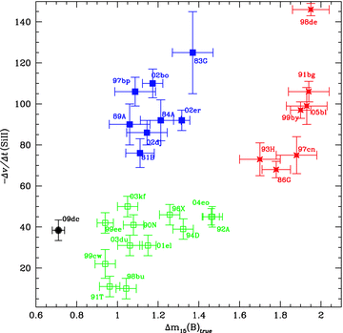
SN2009dc and other “super-Chandra SNe Ia
Very bright peak (M(56Ni) >~ M(Ch)
Hot early spectra
Low line velocity

Slide 32
CSM interaction (no H, no He) may explain spectra: a massive merger event? (Hachinger et al 2013)

Slide 33
SN2009dc and other “super-Chandra SNe Ia
Nebular spectra of 09dc show narrow lines and require M(56Ni) ~ 0.8 M

Slide 34
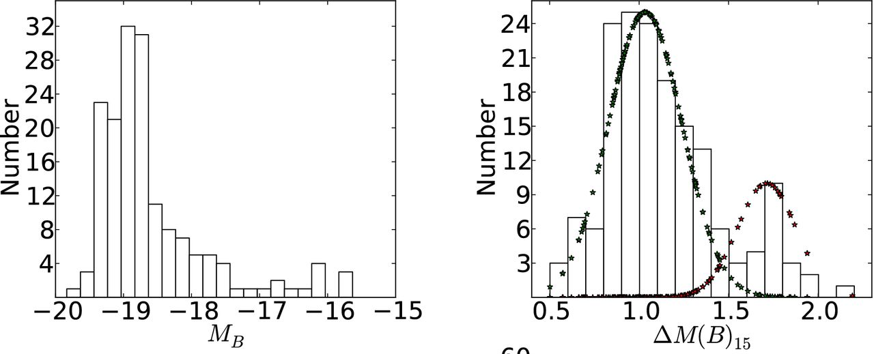
What is the relative incidence of different subtypes? Luminosity distribution of SNe Ia
There seem to be two separate components. Are these representative of two populations/channels? (Ashall 2016)

Slide 35
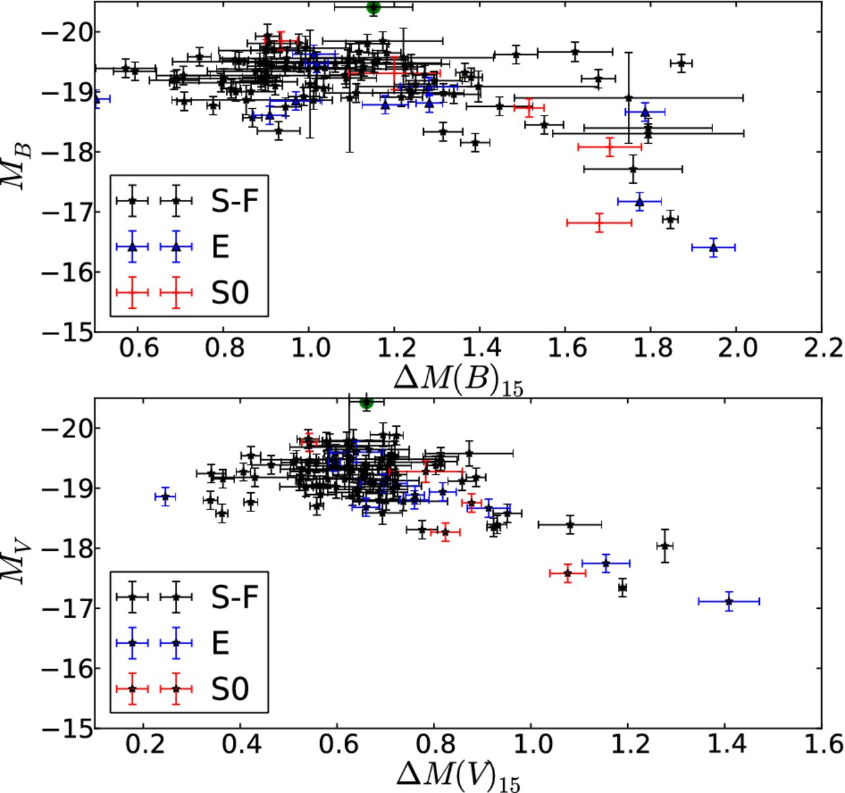
SNe Ia in Spiral galaxies are more uniform than those in passive galaxies
WLR corrected for extinction
MB and ΔM15(B) Distributions
Ashall et al 2016

Slide 36
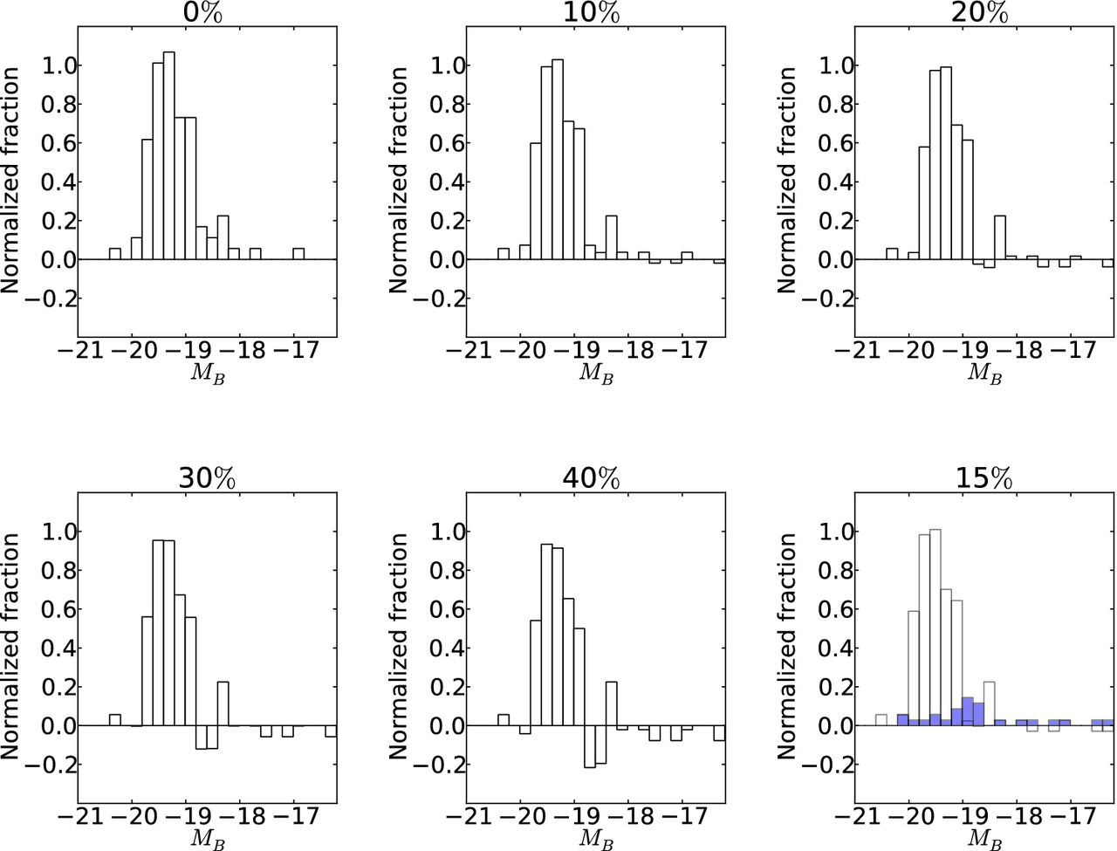
Spirals contain a fraction with a passive galaxy Luminosity distribution
Correcting for the passive distribution makes SN Ia’s in Spirals better standard candles
~ 15% seems the best “passive” SN Ia content in Spirals (bulge/halo?)
(Ashall 2016)

Slide 37
Conclusions
Most SNe Ia seem to conform with M(Ch)
Deviant cases often have peculiar spectra and LC
Not all peculiar Ia’s are necessarily ≠M(Ch):
Some are just extreme normals (high/low M(⁵⁶Ni), Ek)
Not all M(Ch) Ia’s are necessarily “normal’’
Normal, fast decliners may be (slightly) sub-Chandra
Peculiarities hint to explosion mode as well as progenitor scenario
Super-Chandras and 91bg’s may be mergers
Passive galaxies like low-Lum, peculiar (old?) SNe Ia

